Slide 1
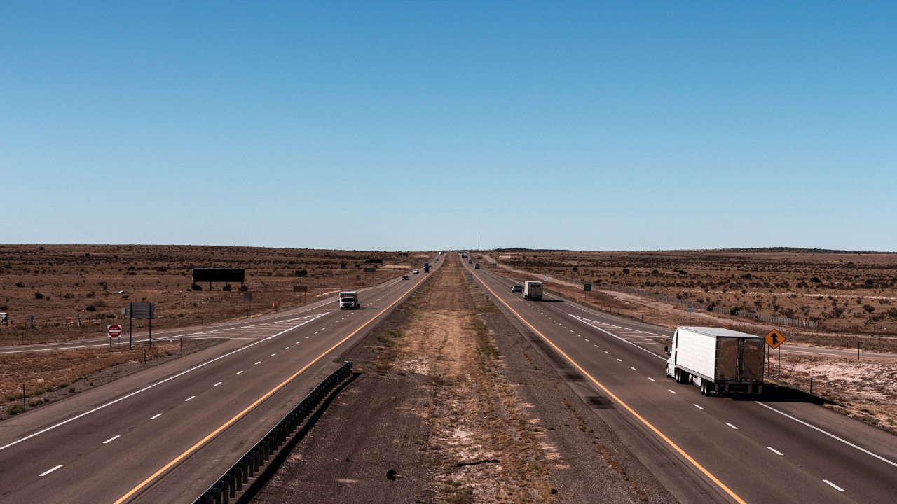

Creating NOW out of the Future
Lauren D. Garduño
2022 Annual Meeting
Big Spring, Texas

Slide 2
Why do we need this Corridor?

Slide 3

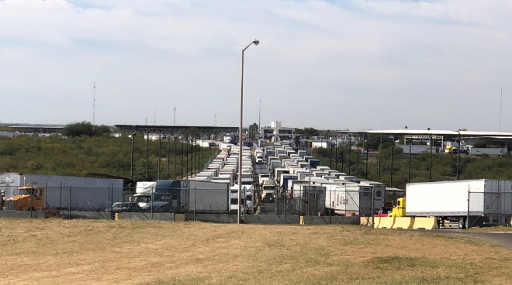
Notes:
International Trade
The Corridor connects the state’s and the nation’s strategic trade gateways of Laredo, Eagle Pass, and Del Rio to destinations north, west and east.
In 2019, together, these three border crossings accounted for $262 billion, or 66%, of Texas-Mexico cross border trade and 50% of U.S.-Mexico trade.
The Corridor is vital to the continued viability of these international trade gateways, especially with the recent passage of the United States-Mexico-Canada Agreement (USMCA).
Currently, Interstate-35 is the only interstate connection to and from Laredo, which does not efficiently serve trips headed northwest.
Eagle Pass and Del Rio are the only southern border crossings without direct access to an interstate highway, which has impacted their ability to attract cross-border related trade activities compared to Laredo.

Slide 4
The Ports to Plains corridor is designated as Corridor 38 in TEA-21, which reads as follows: “The Ports to Plains Corridor from the Mexican border via I-27 to Denver, Colorado”. As with other High Priority Corridors, the importance of the Ports to Plains corridor is related to its direct connection with the
US/Mexico border and potential to serve international trade and promote economic development.
A principal reason for evaluating transportation improvement needs in the Ports to Plains corridor is related to the implementation of the North American Free Trade Agreement (NAFTA) in 1994, which created a free trade zone between the US, Mexico and Canada. This treaty has dramatically increased the volume and value of trade between these North American countries, with the majority of Mexico trade passing through the Texas ports of entry.
(Executive Summary Ports to Plains Feasibility Study, Wilber Smith & Associates, 2001)

Slide 5
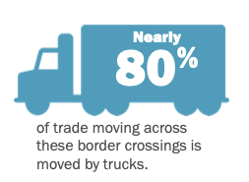
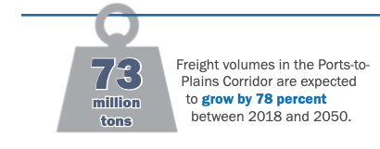
Freight Flow & Tonnage
2018-2050 Baseline
Notes:
Freight Flow & Tonnage 2018-2050 Baseline
Freight volumes are projects to grow by 76% between 2018 and 2050 with the planned and programmed projects.
Freight flow along the Corridor is generated by the three international border crossings in Laredo, Eagle Pass, and Del Rio. The truck flows from these port-of-entries reach all regions of the United States and into Canada.
Nearly 80% of trade moving across the border at these three border crossings is moved by trucks.

Slide 6
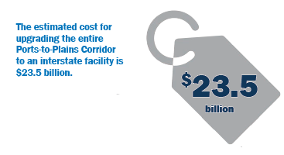
Economic Impact and Return on Investment
Notes:
Economic Impact and Return on Investment: The Cost
Projection to upgrade the entire Ports-to-Plains Corridor to an interstate facility is $23.5 billion.
This projection includes interstate design standards, right-of-way acquisition, utility relocations, frontage roads in all urban areas, frontage roads for approximately 553 miles of rural areas, and complete reconstruction of the corridor based on TxDOT District bid tabs for each TxDOT District.

Slide 7
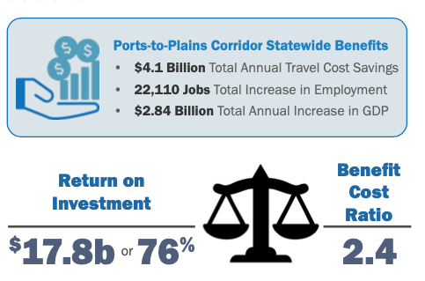
Economic Impact and Return on Investment
Notes:
Economic Impact and Return on Investment: The Benefit
The benefits far outweigh the costs.
The Interstate upgrade will save Texans $4.1 billion annually in Travel Time.
It will result an economy producing an additional 22,110 new jobs.
The economic benefits will increase Texas GDP by $2.84 billion
This all results in a Return on Investment of 76%. The economic benefits pay for the cost and return an additional $17.6 billion in benefits to Texas.
Another way of putting this is the Benefit/Cost Ratio of 2.4. For every dollar invested in the interstate upgrade, $2.40 of benefit is created.

Slide 8
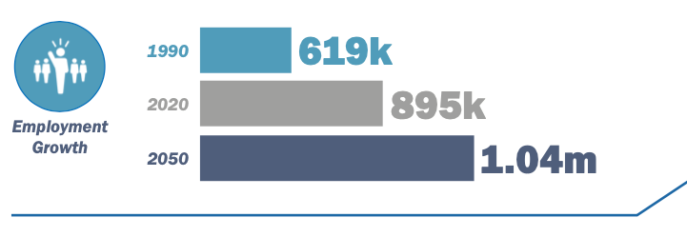
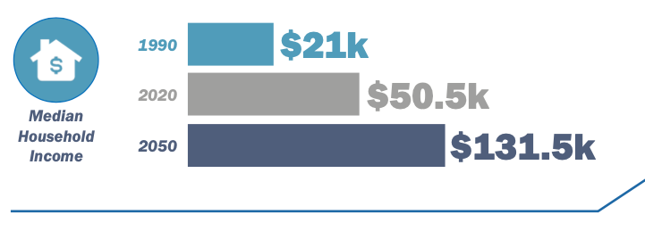
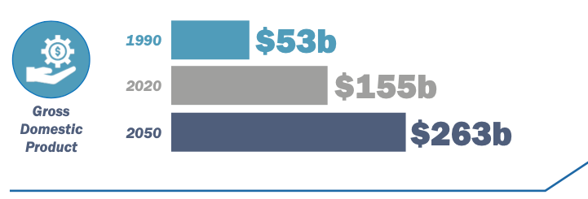
Economic Outlook
1990-2050 Baseline
Notes:
Economic Outlook: 1990-2050 Baseline
The economy of West and South Texas has grown consistently over the last 20 years.
Employment projections show the Ports-to-Plains Corridor employment will grow by 17% from 2020 to 2050.
The Committees found the Ports-to-Plains Corridor median household income more than doubled from 1990 to 2017. Median household income in the Corridor is projected to increase 161% between 2020 and 2050.
GDP in the Corridor more than doubled from 1990 to 2017, an increase of 158%. From 2020 to 2050, the Corridor GDP is projected to increase 69%.
The future projections are good news. The Corridor communities are expected to see a strong economy into the next 30 years. As we will see, any interstate upgrade can make these economic impacts even greater.

Slide 9
“The Ports-to-Plains initiative has helped us because of improvement projects on Highways 277 and 87. We have completed several projects over the past several years that add passing lanes for safety and hot mix asphalt to provide structure and smoothness.” (Roger Albert, Connecting Texas, 2020)

Slide 10

Notes:
Agriculture Production
The Committees explored the question: Why is the Ports-to-Plains Corridor Important to Texas and the Nation?
They found that the Ports-to-Plains Corridor is the only north-south transportation corridor that connects and integrates the nations’ and Texas’ most strategic economic engines of agriculture production, energy production and international trade and it supports growing population and economic centers of West and South Texas.
The Ports-to-Plains Corridor supports the production and export of agricultural products, generating approximately $11 billion a year in agricultural product sales.
Agriculture Production is especially important to Segment #1 in the Texas Panhandle.
The production and export of quality agricultural products: cotton, grain, oilseed, hay, beef, sheep and goats, and dairy relies directly on highway networks for transport of products to market.

Slide 11
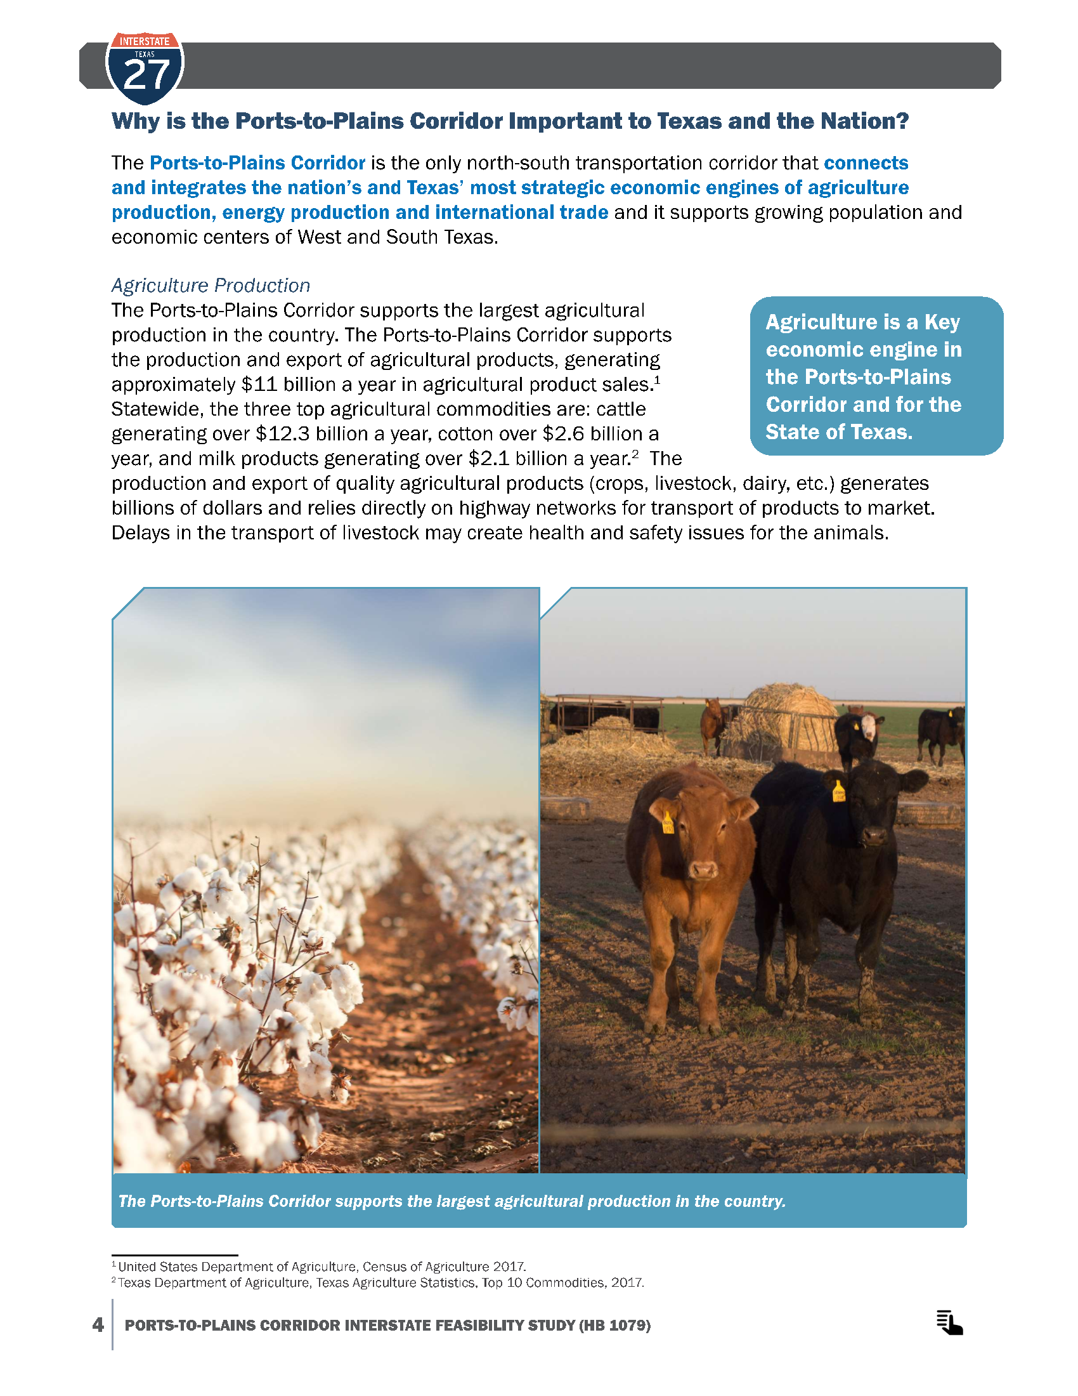

Slide 12

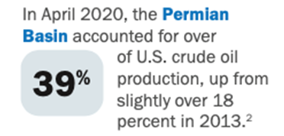
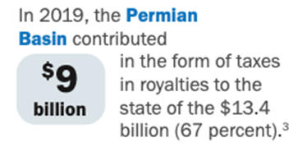
Notes:
Energy Production
The Ports-to-Plains Corridor is vital for the nation’s energy production supporting both the Permian Basin and the Eagle Ford Shale.
In April 2020, the Permian Basin accounted for over 39% of U.S. crude oil production, up from slightly over 18% in 2013.
In 2019, the Permian Basin contributed $9 billion of the $13.4 billion (67 percent) in energy taxes and royalties to the Texas. Eagle Ford Shale accounted for an additional 11%.
Wind is also a critical piece of the energy economy in South and West Texas. In 2019, Texas led the country in wind power additions representing a record amount of 3,938 megawatts. The central section of the Corridor was responsible for 60 percent of all Texas alternative energy.

Slide 13
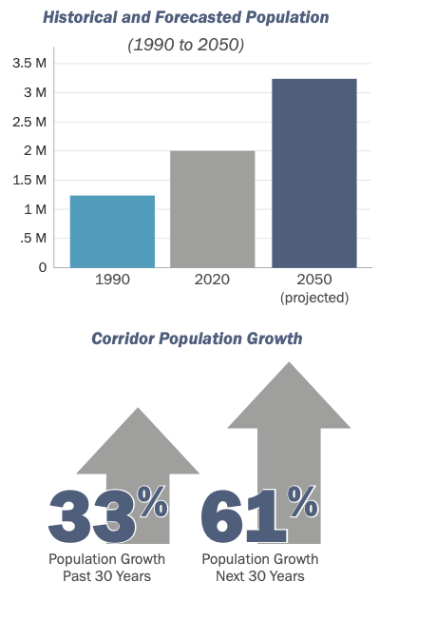
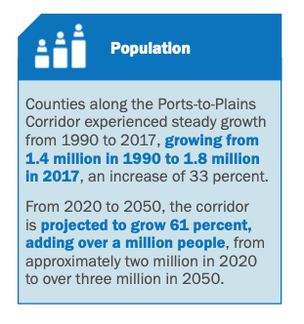
Ports-to-Plains Corridor Trends
1990-2050
Notes:
Ports-to-Plains Corridor Trends: 1990-2050
We now begin look at the current and future trends beginning with population. These future trends are projected without an interstate upgrade.
The corridor increased population by 33% in the past 30 years and is expected to grow 61% in the next 30 years.
That growth is from a base of 1.4 million in 1990 to 1.8 million in 2017 and is projected to grow to over 3 million by 2050.

Slide 14
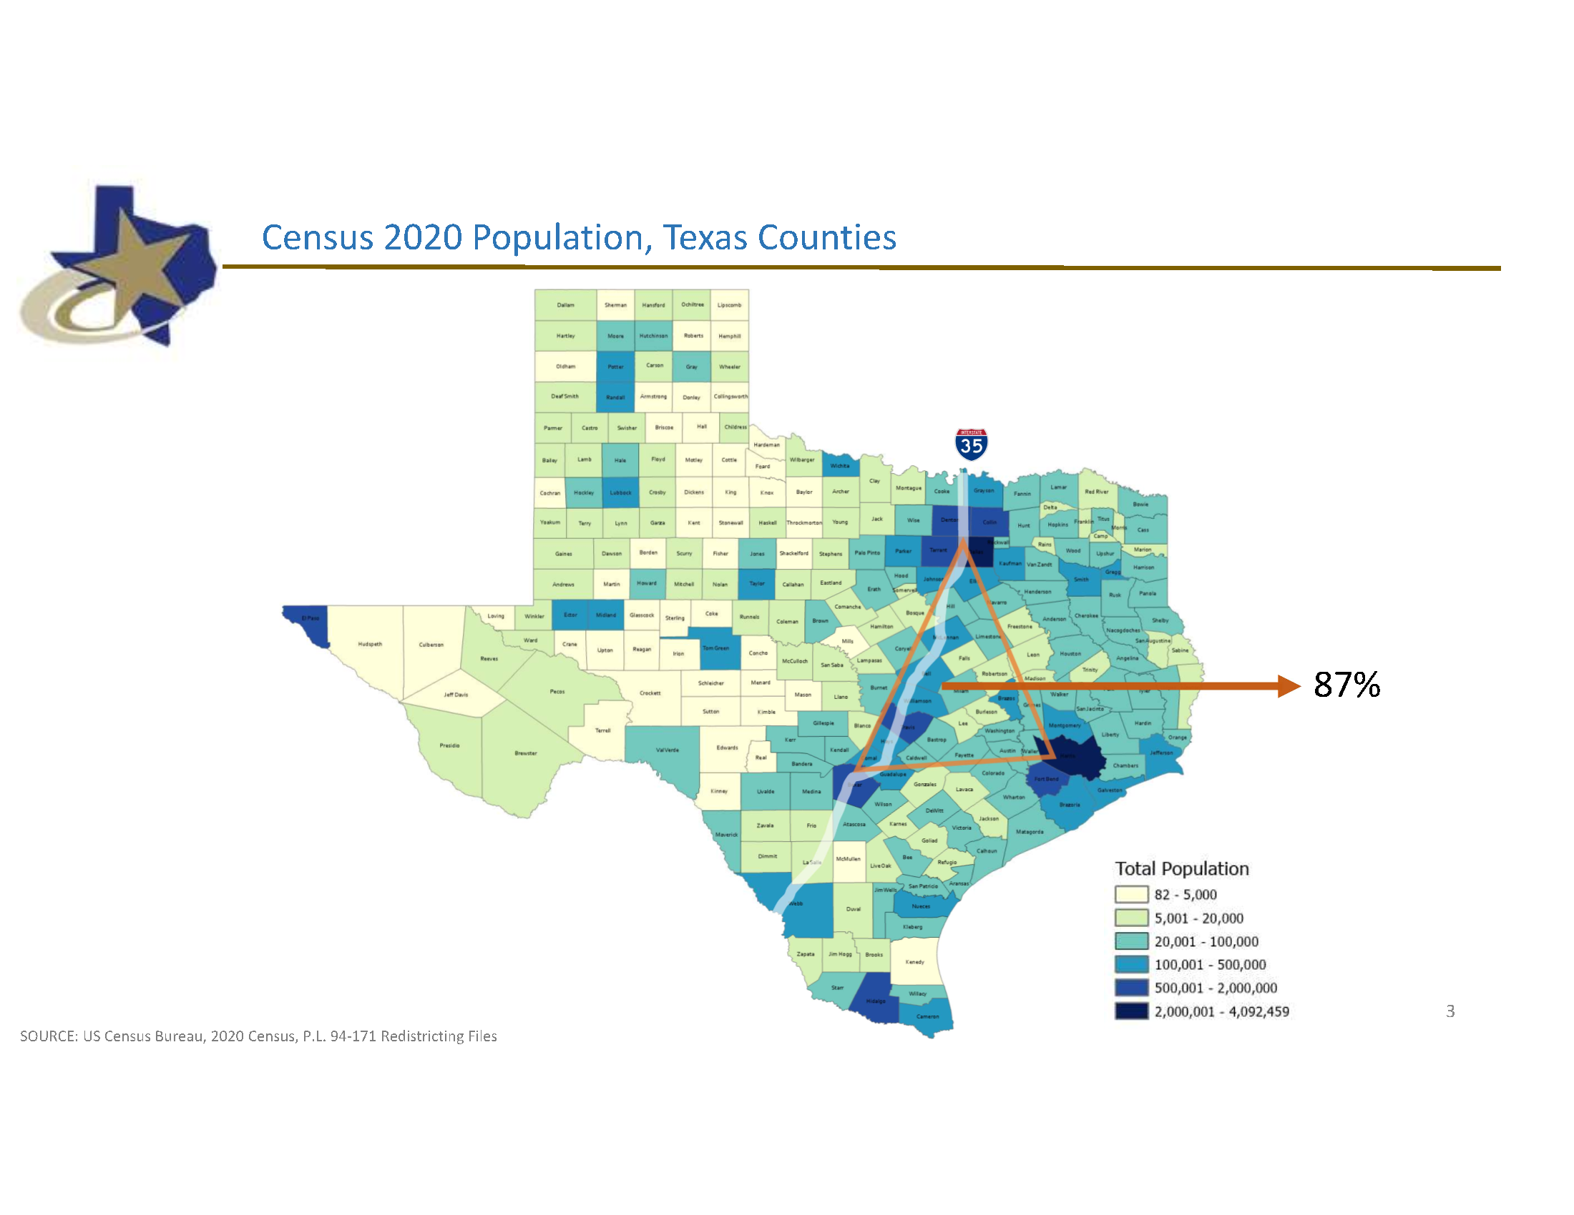

Slide 15
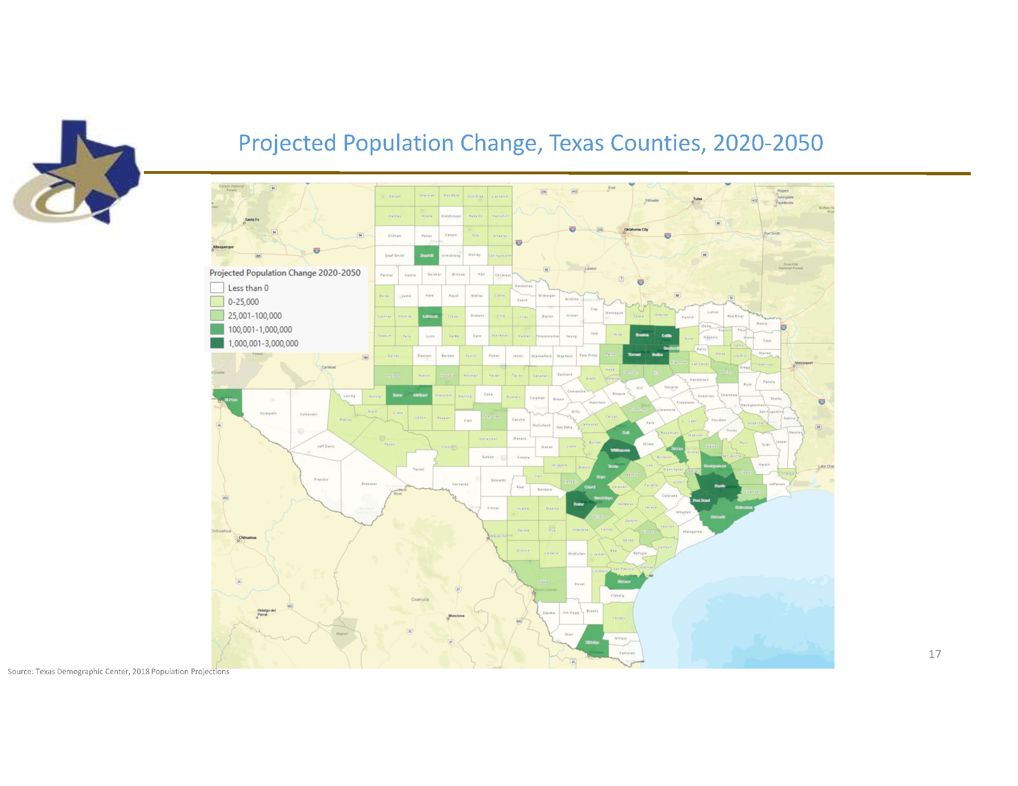

Slide 16
Knowing and Understanding our Past

Slide 17
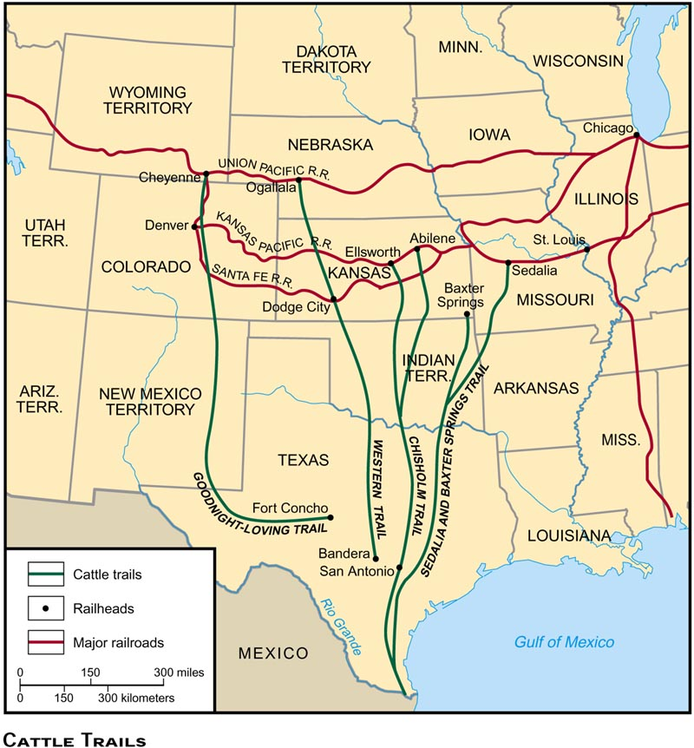

Slide 18
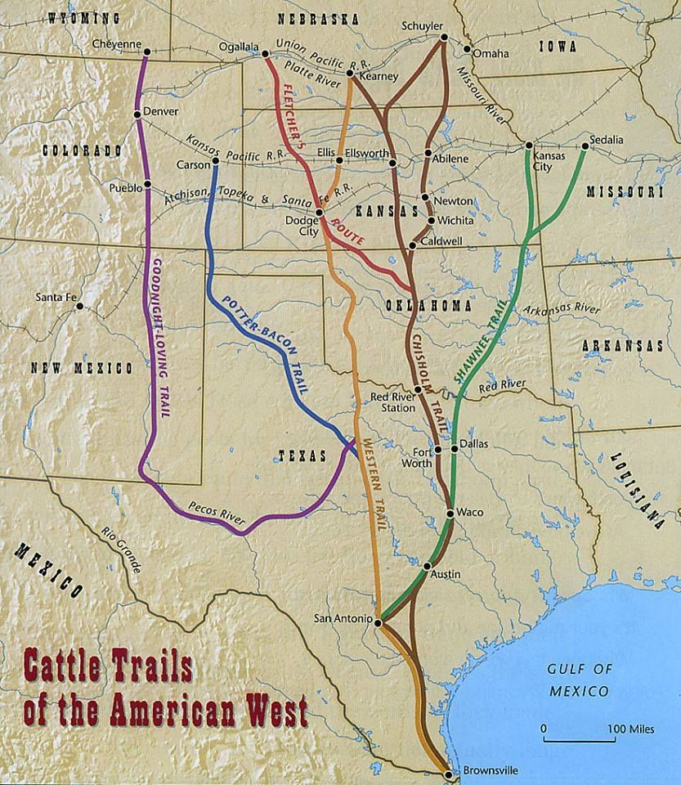

Slide 19
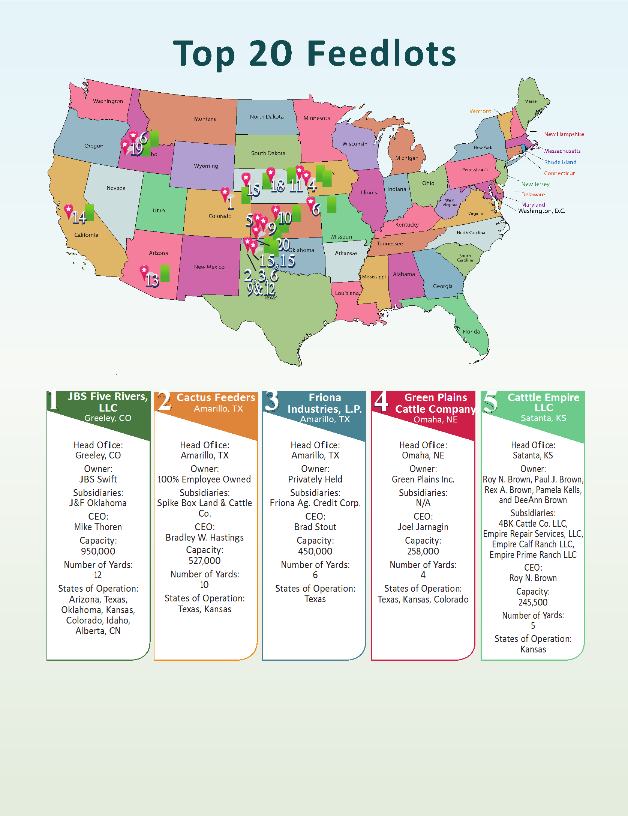

Slide 20


Slide 21
Furthermore, Colorado is strategically located as a “bridge” state in the national and international infrastructure system for movement of freight, resulting in large quantities of goods flowing through the state. Although this is predominately in the east-west direction today, the potential of NAFTA suggests that there may be opportunities for Colorado to also become a more significant player in the movement of goods in north-south corridors.
(EASTERN COLORADO MOBILITY STUDY, Colorado Department of Transportation, Felsburg Holt & Ullevig, April 2002

Slide 22
This CDMP was developed to enhance the efficiency of the Ports to Plains Corridor. It contains several elements that improve the transportation network’s ability to move people and goods. Nearly 1,400 miles long, the corridor consists of 511 miles of 4- to 6-lane roadway, 755 miles of 2-lane roadway, and 113 miles of roadway in metropolitan areas.
The Ports to Plains Corridor includes the following construction elements:
• Widening 755 miles of 2-lane roads to 4-lane divided roads;
• Constructing 15 relief routes around larger towns;
• Adding amenities needed by commercial vehicle operators;
• Improving or constructing connective interchanges;
• Improving or constructing overpasses for railroad crossings;
• Replacing obsolete or deficient bridges;
• Installing corridor-specific signs; and
• Integrating an intelligent transportation system.

Slide 23
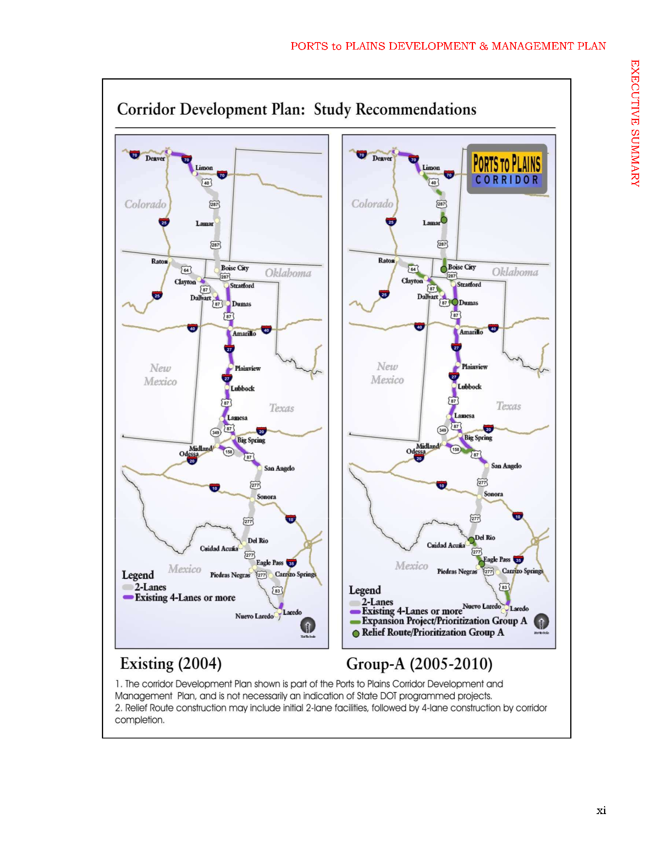

Slide 24
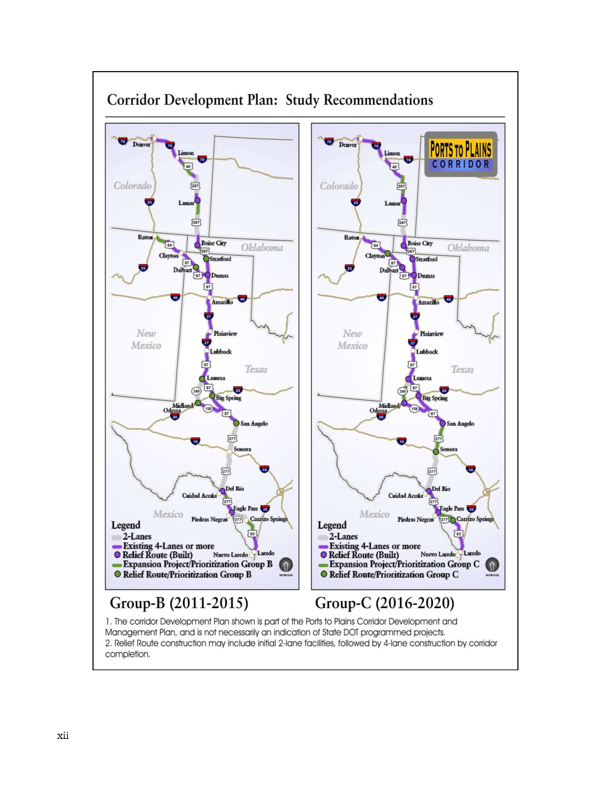

Slide 25
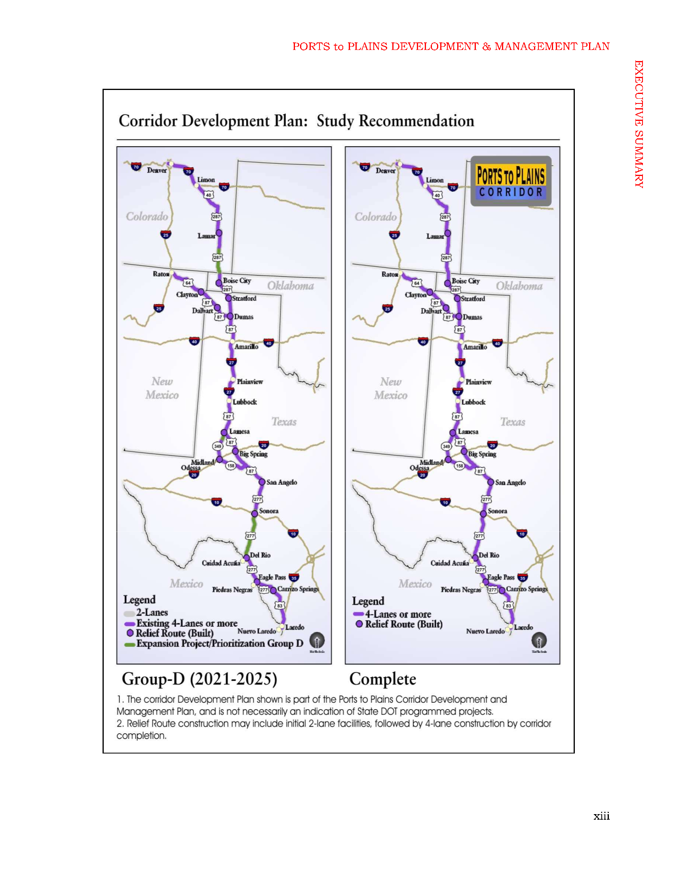

Slide 26
Agriculture and food processing activities anchor western Nebraska’s economy. Soybeans, corn, dry beans, sugar beets and animals are mainstays of the region’s farm economy and exports. Mexico is the third largest importer of agricultural goods from the US. Although rail is the dominant mode for such shipments, Nebraska shipped over $317 million in goods (of all types) to Mexico by truck through the Port of Laredo in 2011, the main route between western Nebraska and Mexico’s markets, according to the Bureau of Transportation Statistics’ TransBorder Freight Data. Another $7 million in Nebraska goods (of all types) traveled north to Canada through the Port of Raymond.
(Economic Benefits from Transportation Efficiency, HEARTLAND EXPRESSWAY CORRIDOR DEVELOPMENT AND MANAGEMENT PLAN Nebraska Department of Road, October 2014)

Slide 27
The Theodore Roosevelt Expressway (also known as the National Highway System High Priority Corridor 58), is made up of several existing highways between Rapid City, South Dakota and the Port of Raymond between Saskatchewan and Montana.[1] It is the northern third of the Ports-to-Plains Alliance.
The corridor is approximately 445 miles (716 km) long with the majority of the highway two lanes.[2] Congress designated the route as one of 80 National Highway System High-Priority Corridors in 2005 by the Intermodal Surface Transportation Efficiency Act. The designation did not create new design standards or create new eligibility for any additional federal funding.[3]
Wikipedia

Slide 28
Creating Now out of the Future

Slide 29
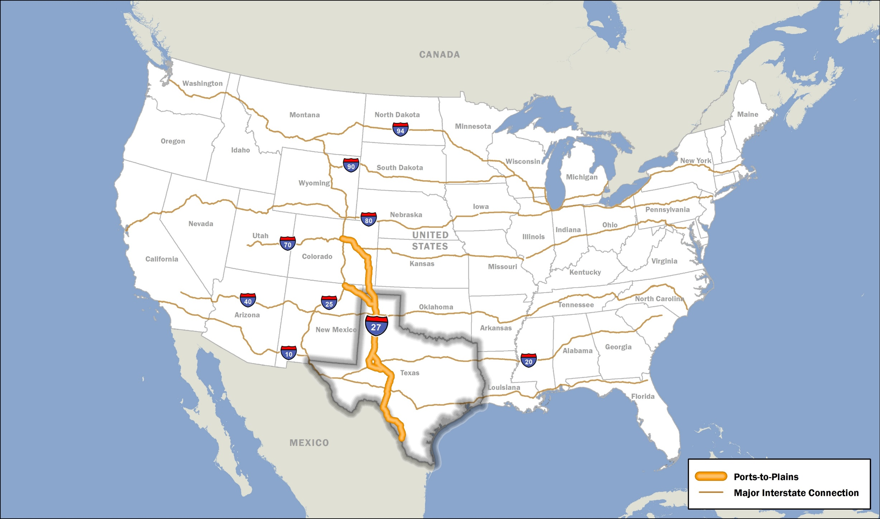
The Art of the Possible

Slide 30
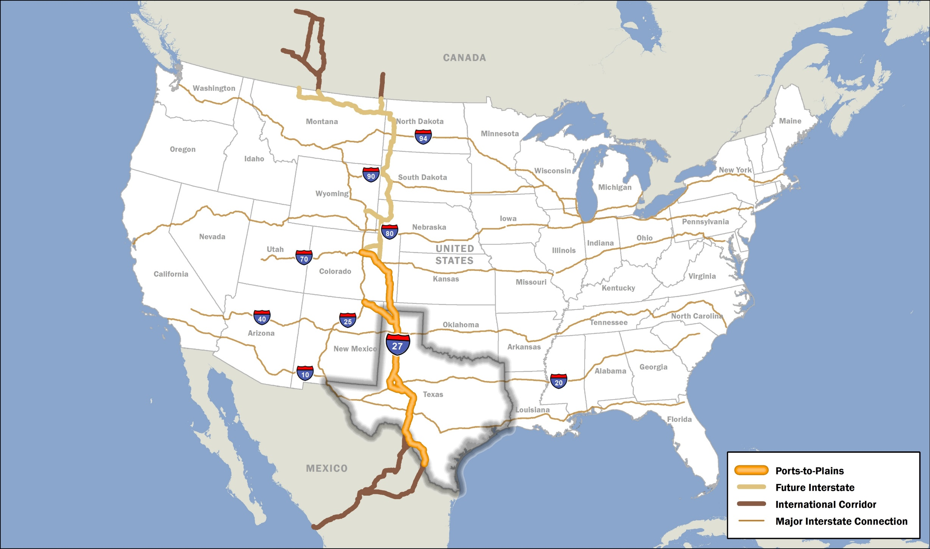
The Art of the Possible

Slide 31
20 Interstate Upgrade Projects
26 Relief Route Projects
32 Safety/Operational Improvement Projects

Slide 32
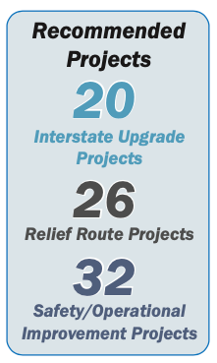
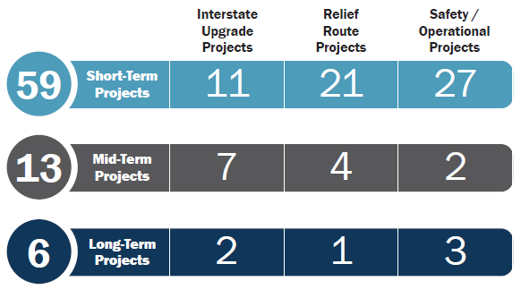
IH 27 Advisory Committee
Recommendations and Implementation Plan
Notes:
Advisory Committee Recommendations and Implementation Plan
The Segment Committees and the Advisory Committee recommends a full upgrade of the Corridor to an interstate including relief routes. In addition, the Committees recommends safety and operational improvements to address immediate needs in the Corridor.
Each project identified would have to go through the project planning, development, and programming process prior to any construction to upgrade the Corridor to an interstate-level facility.
The committees worked with each District office to put together a reasonable implementation plan. As you can see, the majority of the projects could begin the planning and development process within the next five years.

Slide 33
Where do we go from here?

Slide 34
The Path of our Success
Work the Plan (20,26,32)
It looks like we will have to go mining (Infrastructure Investment and Jobs Act 2021)
Leverage our resources (State, Federal, Private)
Celebrate First downs and Touchdowns (IH 27 Sign Unveiling)
Let’s get stuck in a do loop (Go to the top of this list and start all over)

Slide 35
Thank you for a wonderful Conference!
For additional information, contact:
Lauren Garduño, Joe Kiely or Duffy Hinkle and visit the Ports-to-Plains
Facebook page and website.

