Slide 1
North Dakota Energy & Transportation
Senator Brad Bekkedahl

Slide 2
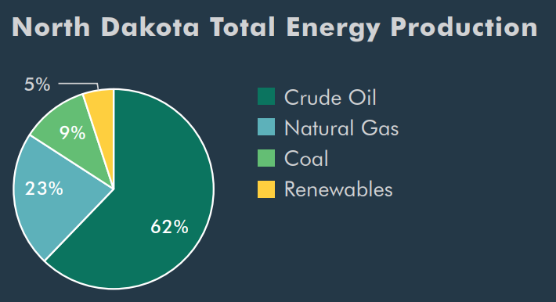
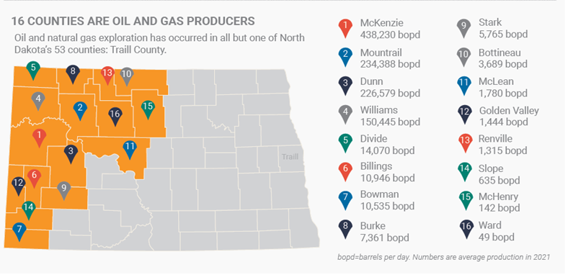
North Dakota Energy Production
800-year supply of lignite
Over 26 billion barrels of technically recoverable oil
Over 38 trillion cubic feet of natural gas
Abundant wind resources
189 million bushels annually converted to biofuels

Slide 3
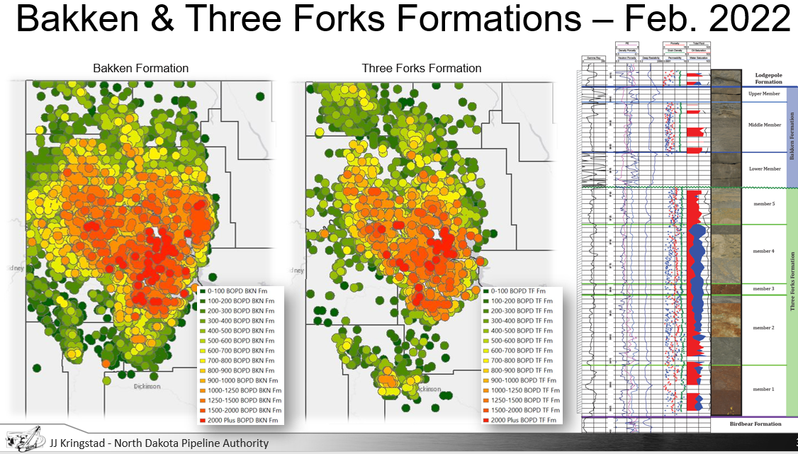
Bakken Energy Production

Slide 4
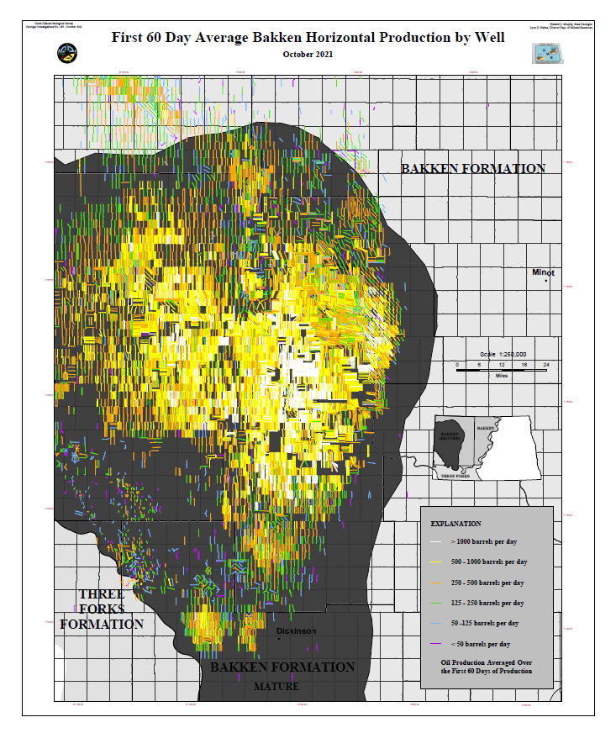
Core=Tier 1
80-85% developed
+8,000 wells
5% growth = 55 rigs = 5 years
1-2% growth = 35 rigs = 8 years
EOR
Tier 2
50% developed
+8,000 wells
5% growth = 100 rigs = 3 years
1-2% growth = 50 rigs = 6 years
Tier 3
25% developed
+7,000 wells
5% growth = 150 rigs = 2 years
1-2% growth = 75 rigs = 4 years
Total = 23,000 wells & 18 years
Current 17,000 wells & 16 years

Slide 5
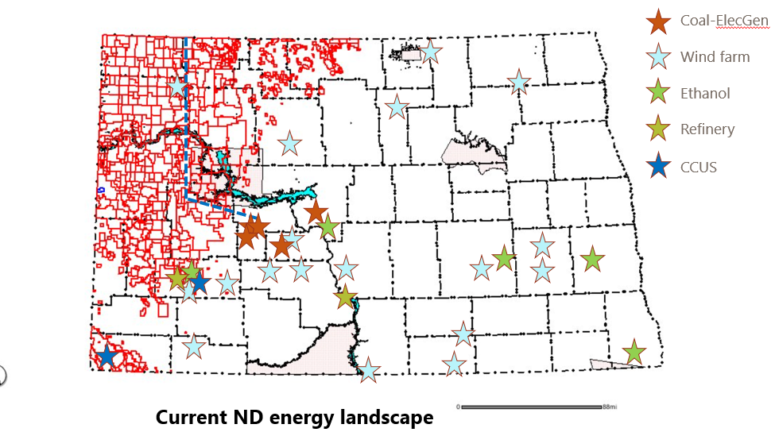

Slide 6
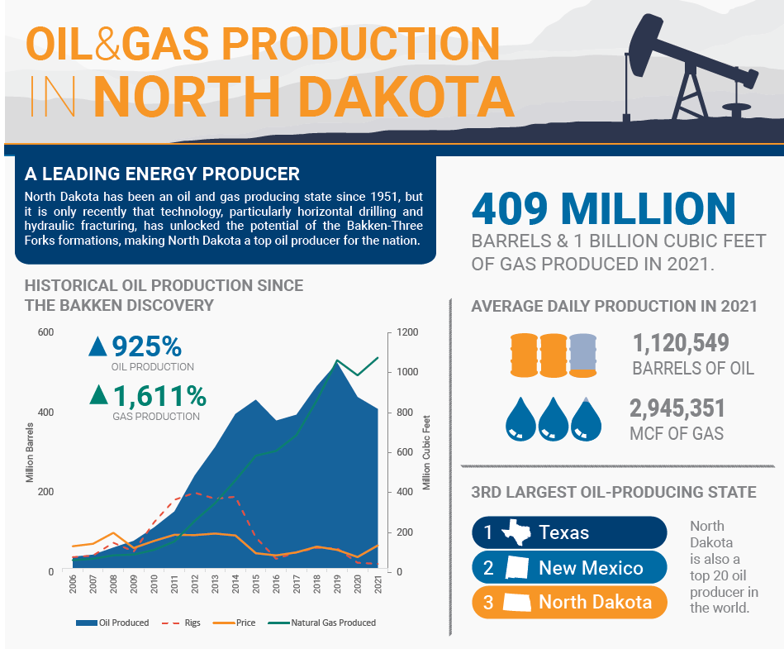

Slide 7
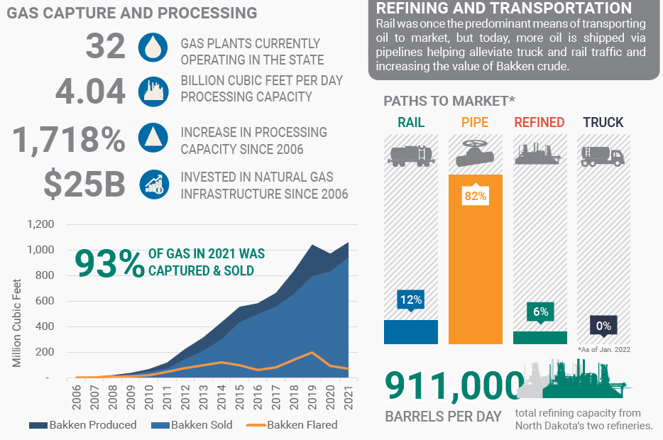

Slide 8
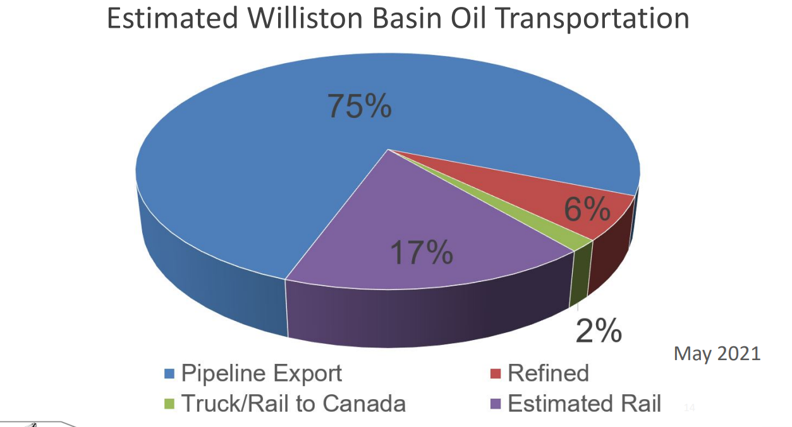
Transportation of Resources
As of May 2021, 75 percent of the oil produced in North Dakota is exported out of the state by pipeline, while 2 percent is exported to Canada by truck or rail
As of May 2021, 93 percent of gas is captured and sold, while 2 percent of gas is flared from zero sales wells because of the lack of pipelines. The remaining 5 percent is flared from wells with at least 1,000 cubic feet (Mcf) sold because of challenges on existing infrastructure.

Slide 9
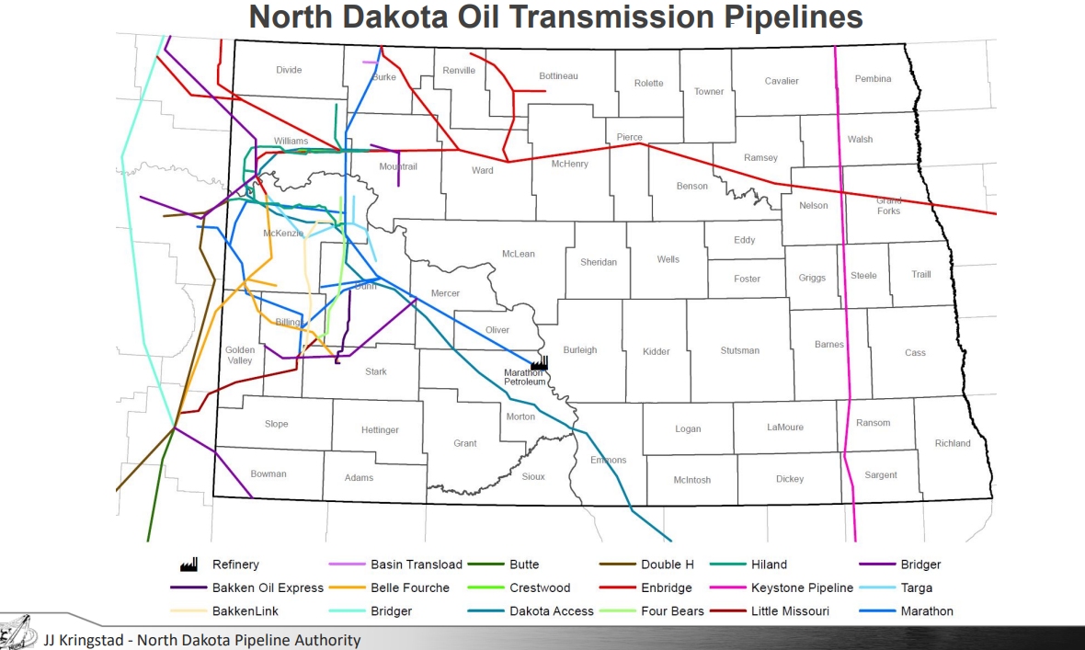

Slide 10
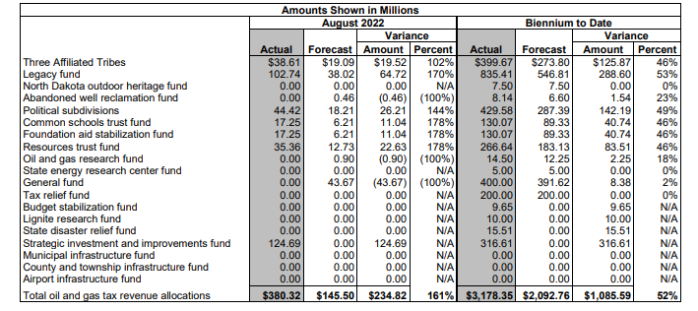
Oil & Gas Tax Revenue Allocations
The schedule provides information on oil and gas tax revenue allocations to the Three Affiliated Tribes of the Fort Berthold Reservation, state funds, and political subdivisions for August 2022 and for the biennium to date.

Slide 11
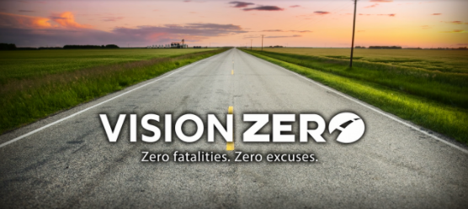
Vision Zero
Traffic safety initiative to end motor vehicle crash fatalities and serious injuries
Launched January 2018
Focus on Priority Safety Emphasis Areas:
  Lane Departure
  Intersections
  Alcohol and/or Drug Related
  Unbelted Vehicle Occupants
  Speeding/Aggressive Driving
  Young Drivers

Slide 12

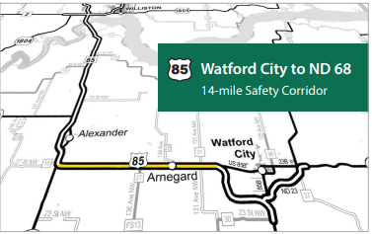
Safety Corridor
Designated section of highway that includes enhanced safety features and an increase in law enforcement to remind drivers they are responsible for obeying all traffic laws and speed limits
Selected based on highways with a higher number of vehicle crashes
Utilize engineering and technological solutions to change dangerous driving behavior and reduce the number of crashes on state highways
After implementation, provisional data shows the Highway 83 Corridor has experienced fewer severe crashes in 2020 and 2021
Highway 85 corridor is expected to be complete by early October

Slide 13
Carbon Sequestration
“Geologic Jackpot”: Up to 252 billion tons of storage capacity
  Over 4,400 years of total ND production
  Over 50 years of entire US production
First State with Class VI primacy
  First Class VI wells permitting this summer
After 10 years post-injection, State takes permanent liability
  Per ton fee for Carbon Dioxide Storage Facility Trust Fund
Interest from surrounding states to sequester their CO2

