Slide 1
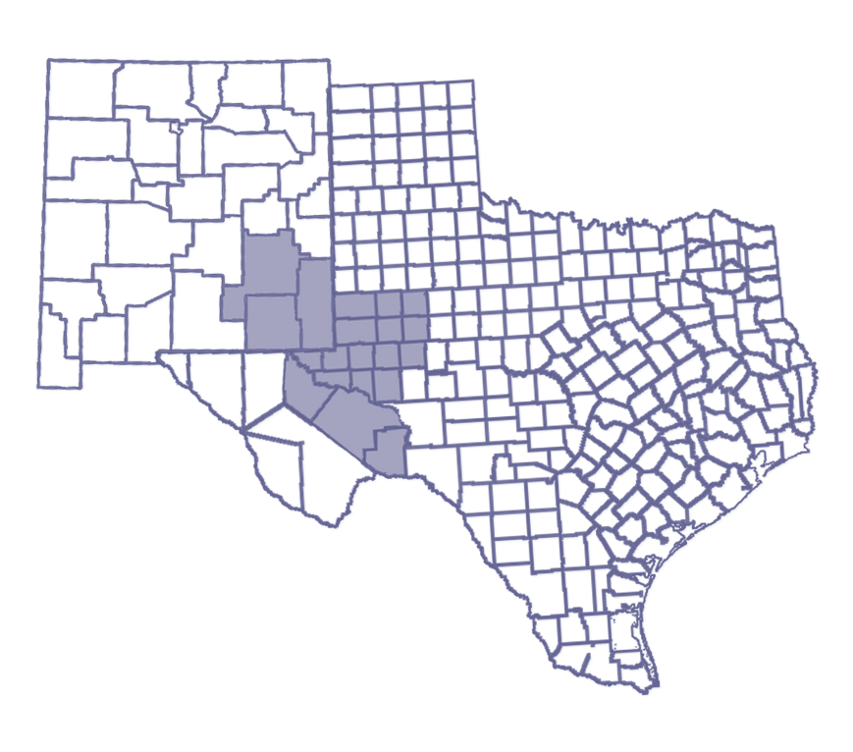
2022 Ports-to-Plains Alliance Conference
Tracee Bentley
Permian Strategic Partnership

Slide 2
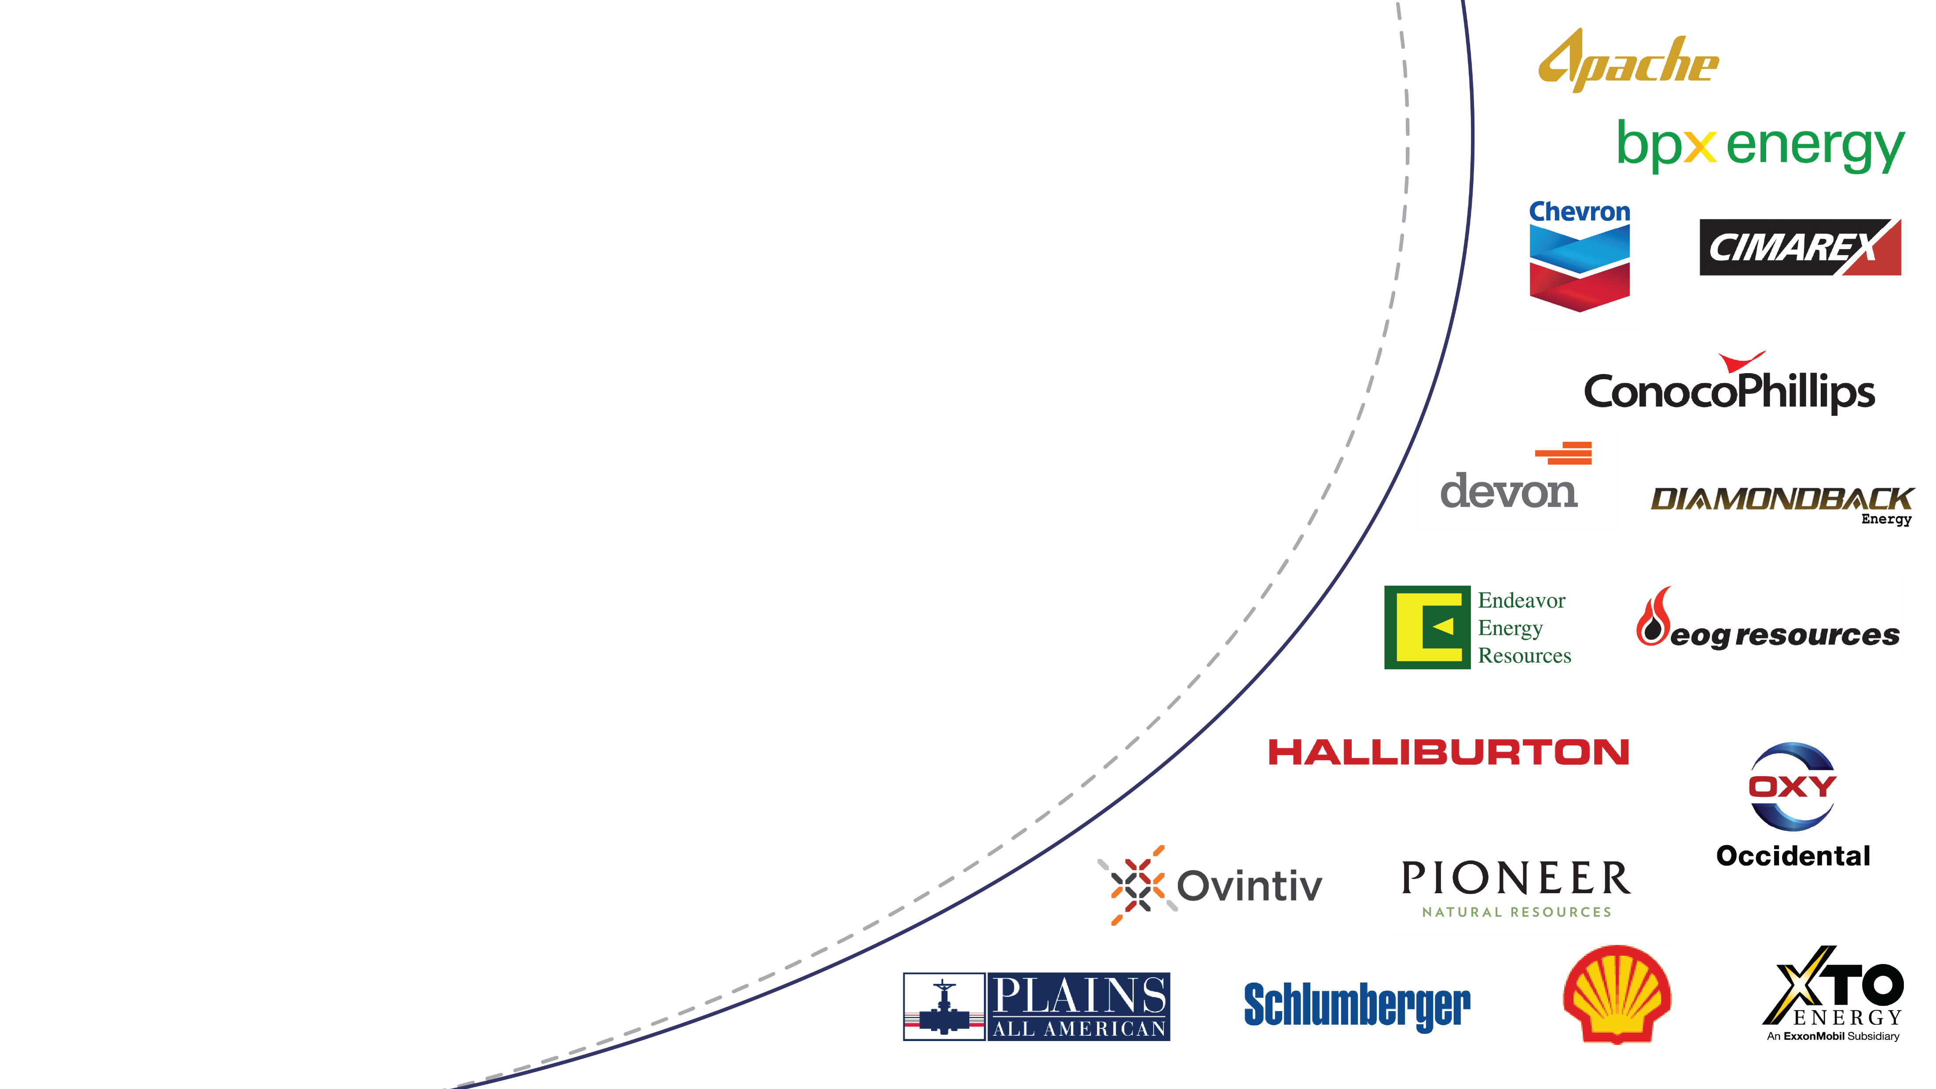


Permian Strategic Partnership
Permian Strategic Partnership
Mission Statement
The Permian Strategic Partnership is a coalition of 17 leading Permian Basin energy companies who joined together to work in partnership with leaders across the region’s communities to address current and future challenges to the responsible development of the vast oil and natural gas resources of the Permian Basin in the states of New Mexico and Texas.
The Permian Strategic Partnership leverages its relationships with like-minded organizations, federal, state, and local leaders, and public partners to achieve more together than we ever could alone. Working in collaboration, we have increased funding for education, invested in career training, expanded healthcare access, improved safety and infrastructure, made housing more affordable for teachers, and expanded broadband access across the Permian Basin.
To strengthen and improve the quality of life for Permian Basin residents by partnering with local leaders to develop and implement strategic plans that foster superior schools, safer roads, quality healthcare, affordable housing and a trained work force. The companies involved with PSP will bring people, expertise, resources and leadership to develop solutions in partnership with local leaders and communities.
Focus Areas
  Education
  Healthcare
  Housing
  Roads
  Workforce Development
2

Slide 3
Working Together for a Greater Impact
In its 3 years, the PSP has directly invested ~$109 million in Permian Basin projects and contributed to collaborative investments totaling ~$950 million.
~$109mm
~$950mm
in PSP contributions
in collaborative investments
Education
Healthcare
Workforce
Road Safety
$16,500,000
IDEA Public School Investment
$750,000
Catalyst Investment
$5,900,000
Texas Tech Family Medicine Residency
$10,700,000
UTPB Nursing and Pre-Med Expansion
$10,000,000
Hobbs CTE Program Investment
$4,600,000
Road & Safety Investment
$4,000,000
Teacher Certification Investment
$1,900,000
UTeach STEM Investment
$2,500,000
Regional Physician Assistant Investment
$12,800,000
Texas Tech Surgery & Subspecialty Investment
$800,000
Permian Basin Community Grants Investment
Housing
$8,500,000
Education Technology Investment
$10,000,000
MC Teacher Excellence & Pre-K Lab Investment
$2,300,000
PB Counseling & Guidance Expansion
$2,400,000
Other Healthcare Related Investments
$800,000
Permian Basin Catalyst Program Investment
$700,000
Teacher Housing Investment
$4,500,000
Energy Education and Workforce Curriculum
$4,000,000
Odessa College Nursing Expansion
$2,600,00
Skillpoint Alliance Investment
Initiative Support
$1,300,000
America’s Warrior Partnership Investment
$4,400,000
Data, Research, & Outreach

Slide 4
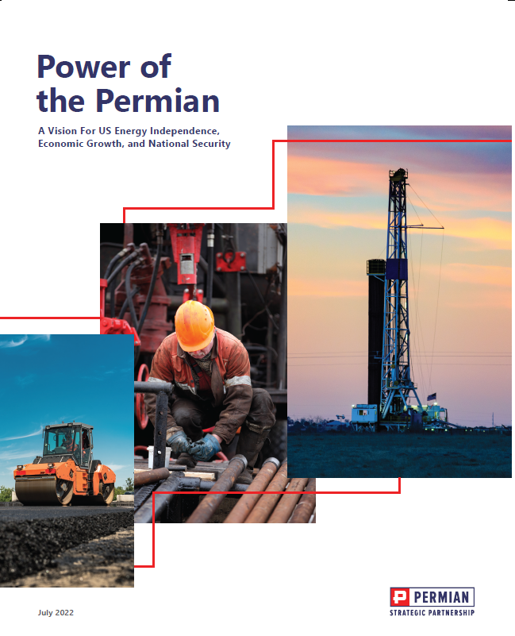
Power of the Permian – Economic Impact Report
Takeaways
The Permian Basin’s strategic importance to the US and more broadly the global landscape is huge
The US is the top producer globally and the Permian Basin makes up nearly 50% of that production
Evolving geopolitical issues such as Russia-Ukraine fallout, climate crisis and expanding global energy needs shows just how critical the Permian Basin is to the world
Not only is oil abundant in the Permian, but the region contributes cleaner and more environmentally friendly oil than other major production areas
The region also contributes significantly to US renewable energy supplies through wind and solar capabilities
The world is projected to need almost 50% more energy by 2050. The Permian Basin is distinctly positioned to provide the natural resources to ensure America’s energy security
Conclusion
As the world faces complex energy and geopolitical challenges, the Permian Basin provides clarity and stability and remains an essential - and trusted - global partner
Source: The Perryman Group.
Notes:
We recently released our new economic impact report in partnership with Ray Perryman and The Perryman Group
Some of the key finding are shown here – I encourage you to go to our website to view the full report: www.permianpartnership.org

Slide 5

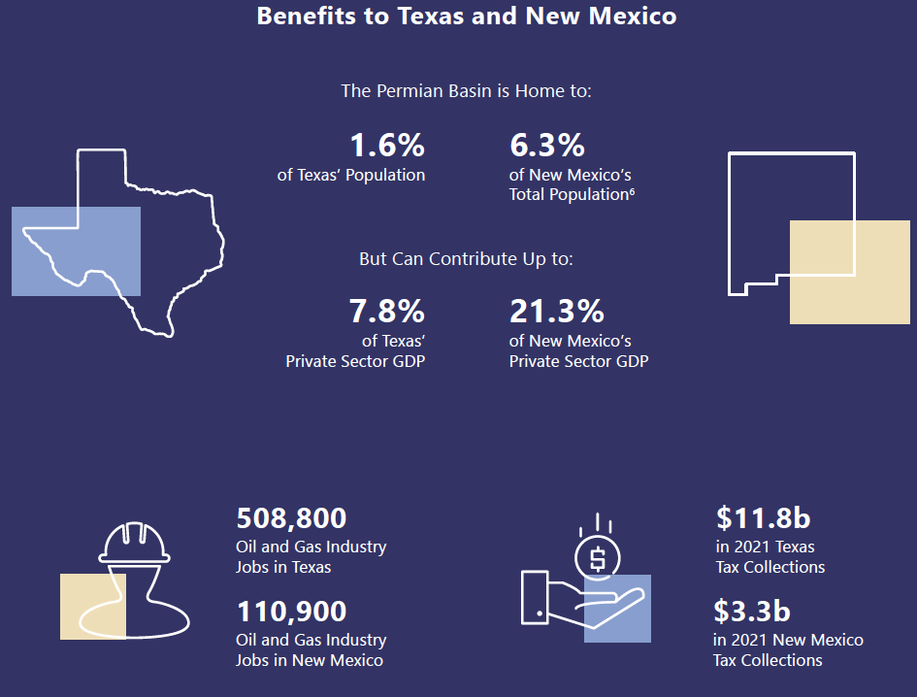
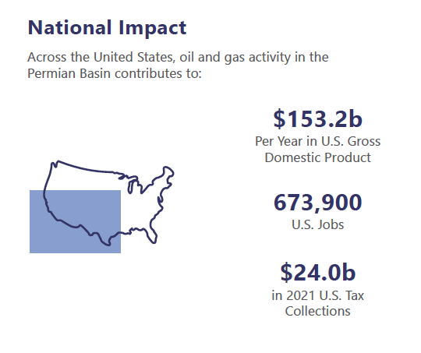
Power of the Permian – Essential Energy
Source: The Perryman Group.

Slide 6
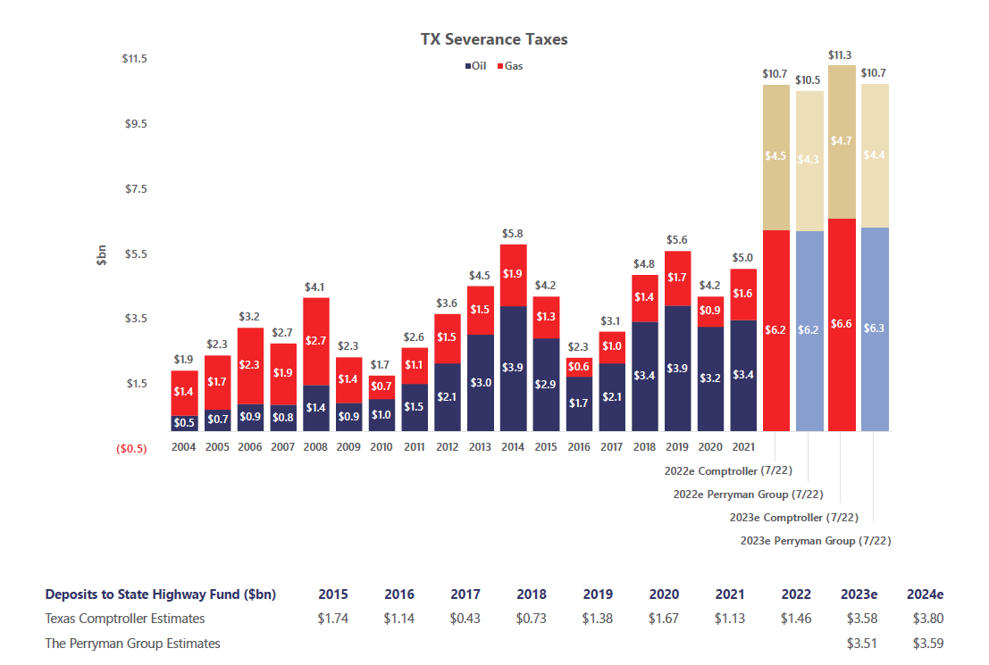
Power of the Permian – Tax Revenues and Royalties
Source: The Perryman Group.
Notes:
State Highway Fund – estimated to be $3.58B next year

Slide 7
Power of the Permian – Essential Energy
The US is the top oil producer today and will continue to be in 2030 and beyond.
The Permian Basin makes up nearly half of the US production in 2030
Source: Rystad Energy. Oil includes crude oil and condensate.
Notes:
If it was its own country, the Permian would be the fourth largest producer in the world.

Slide 8
Power of the Permian – Essential Energy
Below shows US production by basin. The Permian is shown in the dark blue and includes a high, base and low case. In the base case, the peak production hits in 2029 at 7 MMbopd
Oil Production by US Basin (MBopd)
Source: Rystad Energy. Oil includes crude oil and condensate.
Anadarko Region
Appalachia Region
Bakken Region
Eagle Ford Region
Haynesville Region
Niobrara Region
Permian Region
High/Low Cases

Slide 9
Power of the Permian – Clean Energy
The Permian Basin’s contribution to U.S. clean energy and renewable energy capacity is significant and growing.
Low-Carbon Crude
Carbon dioxide content is 22.8% lower than the average of the remainder of world production.
Permian Basin oil and gas have 42.5% and 46.2% lower carbon dioxide emissions than coal, respectively.
Solar
In 2020, approximately 93% of all Texas solar capacity was in the Permian Basin.
Texas ranks second to California with 12,332 MW. However, Texas outpaced California with capacity additions in 2020 (2,459 Texas capacity additions, vs. California’s 1,610 MW)
About 30% of the state’s currently planned solar capacity is scheduled to be built in the Permian Basin.
Wind
Wind capacity in the Permian Basin has more than doubled in the past decade, increasing from less than 1,663 MW in 2010 to nearly 4,003 MW in 2020
Of the US total wind capacity 27% came from Texas. Texas ranks first among all US states for installed wind capacity and is also adding new facilities at a more rapid rate than other areas.
Source: The Perryman Group.
https://a112.awea.org/resources/fact-sheets/state-facts-sheets
Notes:
The Permian Basin’s contribution to U.S. clean energy and renewable energy capacity is significant and growing.
Texas’ full energy mix is represented in the Permian, making investment in our infrastructure that much more critical for statewide energy resiliency.

Slide 10
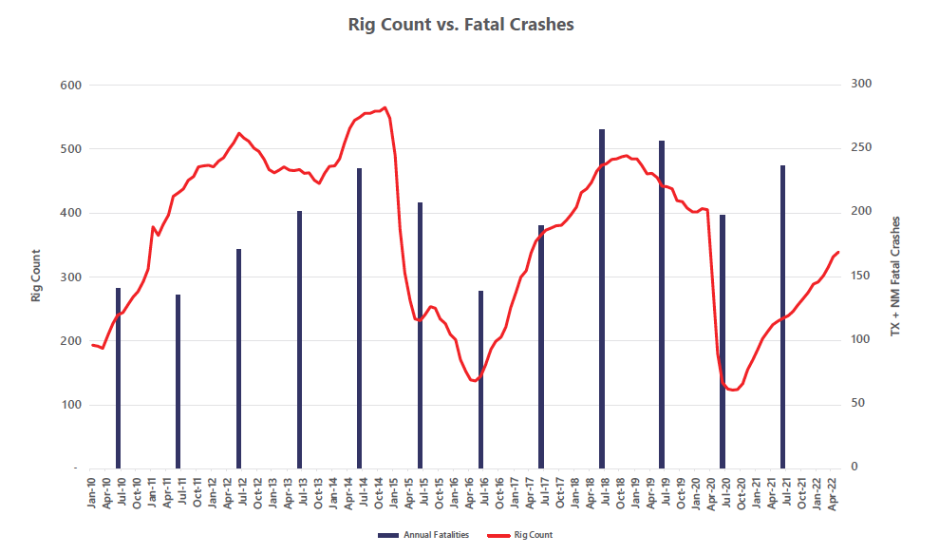
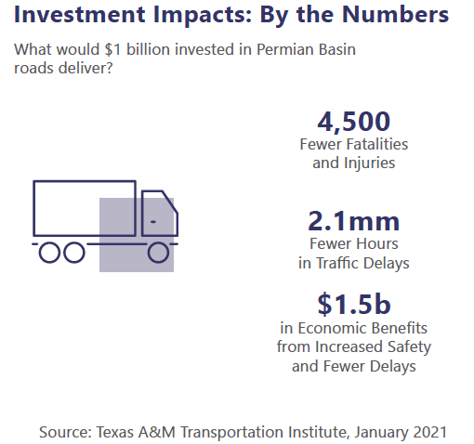
Power of the Permian – Infrastructure
Notes:
For each horizontal well, 4-7K truck trips are needed over 45 to 75 days.
The Permian peaked at 568 rigs in fall 2014 which meant more than 3.8M truck trips.
Rig counts are back on the rise and infrastructure improvements are necessary to support growth.

Slide 11
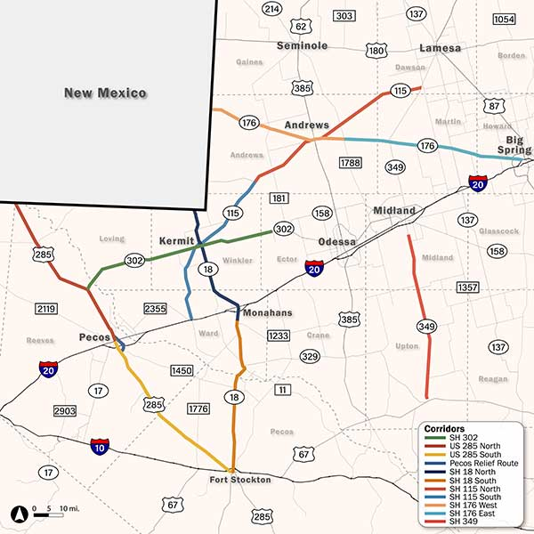
Power of the Permian – Infrastructure
TxDOT Permian Promise
The Permian Promise is a Texas Transportation Commission sponsored program that was developed in the 2020 Unified Transportation Program by committing $600 million of strategic priority funding to help address the transportation needs throughout the Permian Basin.
As this energy sector continues to grow, so too does the amount of traffic on the roadways causing congestion, crashes, and fatalities.
The goal of the Permian Promise is to identify roadway enhancements that reduce congestion and fatal crashes by improving existing corridors and identifying corridors in need of possible expansion.
Notes:
We are proud to partner with TxDOT leadership on the Permian Promise program.
Grateful that TxDOT is looking forward to the next round of Permian Basin priority projects and is working with Permian stakeholders to future proof our region

Slide 12


12

