Slide 1

Looking North NOW

Slide 2
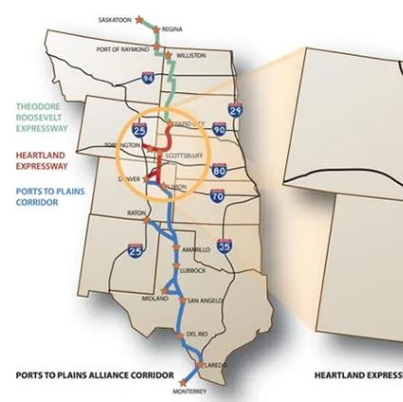
History of the High Priority Corridor
Heartland Expressway’s vision of a four-lane highway connecting Denver, Colorado to Rapid City, SD was born in 1988.
The lntermodal Surface Transportation Efficiency Act of 1991 (ISTEA) identified the Heartland Expressway from Denver through Scottsbluff to Rapid City as a high priority corridor.

Slide 3
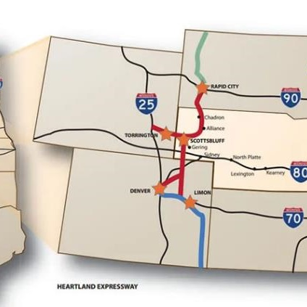
“3-Legged Stool”
Marathon
The Heartland Expressway is part of the “3-Legged Stool” known to us all as, the Ports-to-Plains Corridor!
Kudos to TRE & PTP for the work you have completed, we are in the race for the long-haul.

Slide 4


History of the High Priority Corridor
2005
Kimball to Scottsbluff-Gering 4-lane expressway completed in 2005.
2009
Heartland Expressway joined Port-to-Plains Alliance as a member on December 31, 2009.
2011
Kimball 4-lane bypass completed in 2011.
2014
South Dakota completes 4-lane highway from Rapid City to the Nebraska Stateline August 2014.
Oct. 2014
Corridor Management Study completed.
2016
NDOT Public Prioritization process resulted in the selection of U.S. 26 from Minatare to U.S. 385 scheduled to begin construction 2024.
2017
Dedication of the Heartland Expressway groundbreaking for Alliance South – 4 lane for 15 miles, Phase I.
2019
Opening of Alliance South Phase I, August.
2022
Opening of Alliance South Phase II, just this month but dedication planned for October.

Slide 5
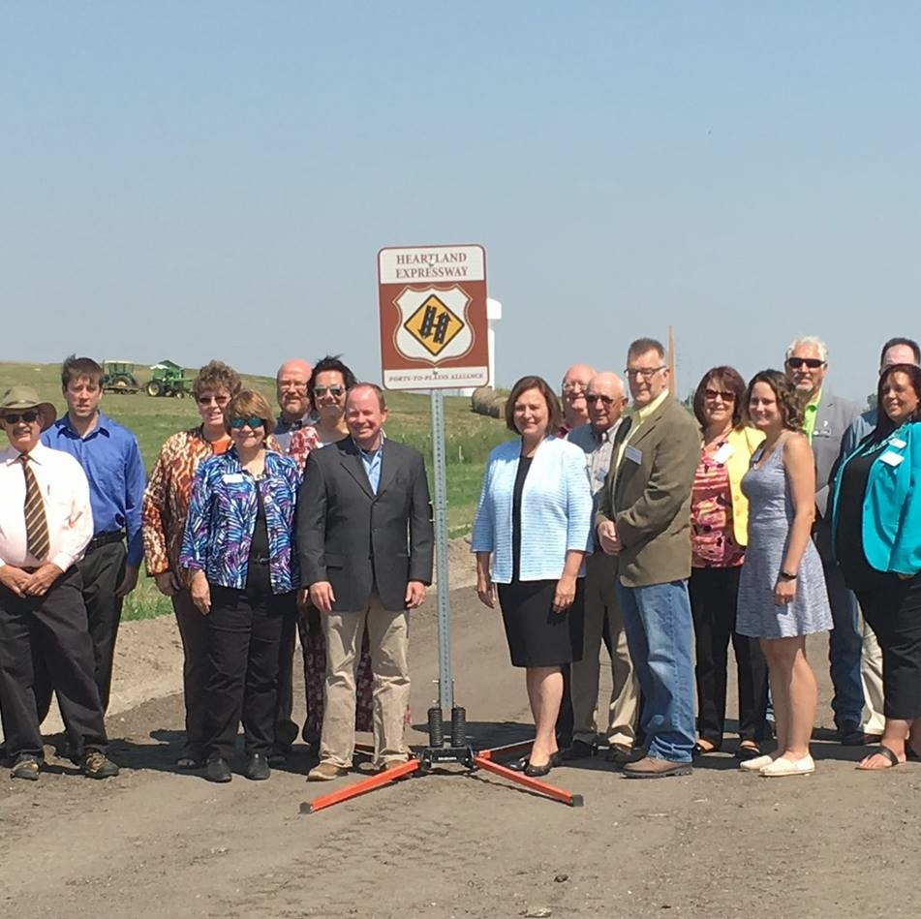
What’s improved…
It has improved access to…
  Communities
  Recreation
  Tourism/Hospitality
  Enhanced Economic Impact
  Improved Safety – all weather highway makes it safer for school buses, emergency vehicles, etc.

Slide 6
What’s improved…
The Heartland Expressway Corridor has provided many national, regional, and local benefits. Some of the most noteworthy national benefits include:
Connection of metropolitan cities and regional trade centers
Enhances the national freight network and freight movements
Provides a north/south high-speed corridor
Provides an alternative to avoid urban congestion and delay along I-25
Completes an integral segment of the PTP Alliance Corridor, a trans-national corridor

Slide 7
What’s improved…
It has helped the region's communities to be better able to compete for new industries and new types of economic development:
Providing safer travel
Improving our regions competitiveness on projects
Improved interstate commerce
Easier and more efficient transportation of goods

Slide 8




Critical users in our region…
Value Added Agriculture
Hospitality & Tourism Industry
Business & Manufacturing
Energy

Slide 9









Value Added Agriculture

Slide 10
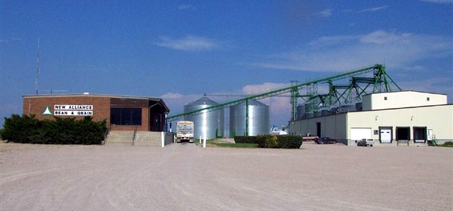


Offers customers several varieties including:
Light Red Kidney Beans
Pinto
Great Northern
Garbanzo
Black Eyed Peas
Lesser quality beans are shipped off for Dog Food.
New Alliance handles and processes… Great Northern Pinto dry edible beans Processing beans in Alliance, Bridgeport and Gering, Nebraska. Specializing in canning quality beans to food companies around the world. The finished product is milled to customer specifications and packed in a variety of ways including bulk totes and paper or poly bags from 20 lbs. - 50 kilo. Beans are shipped in bulk rail hoppers or bulk trucks.

Slide 11




Competitive Response:
It is not possible to predict the exact type of business relocation that might occur in response to the productivity improvement; likely expansions would include food processing manufacturing to take advantage of the corridor’s significant agricultural assets and distribution facilities that take advantage of the corridor’s low costs and proximity to the larger urban areas.
“On September 9, 2022, we brought in over 11 million pounds or 5,500 tons of potatoes and dirt in Nebraska. That is approximately 25,000,000 individual potatoes from the field. That’s a lot of tater chips!”
Troy Sorensen
Western Potato Inc.

Slide 12

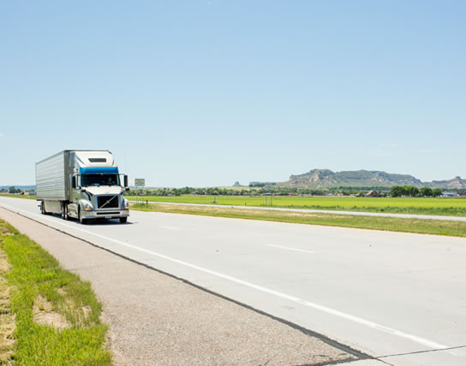
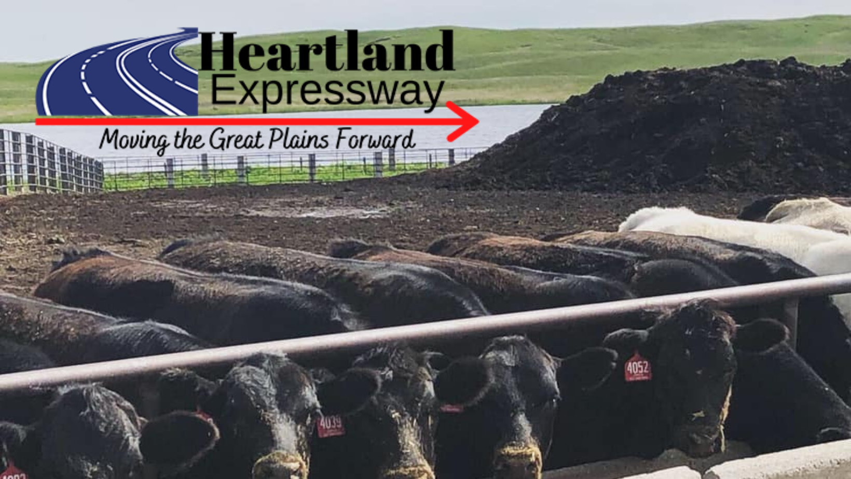

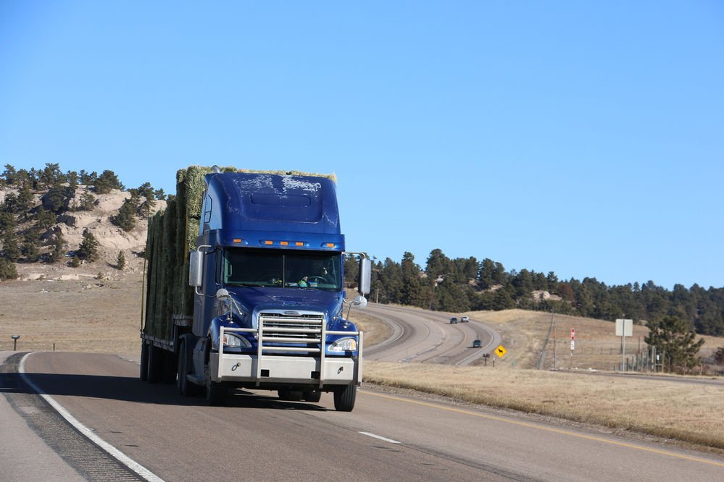

Slide 13
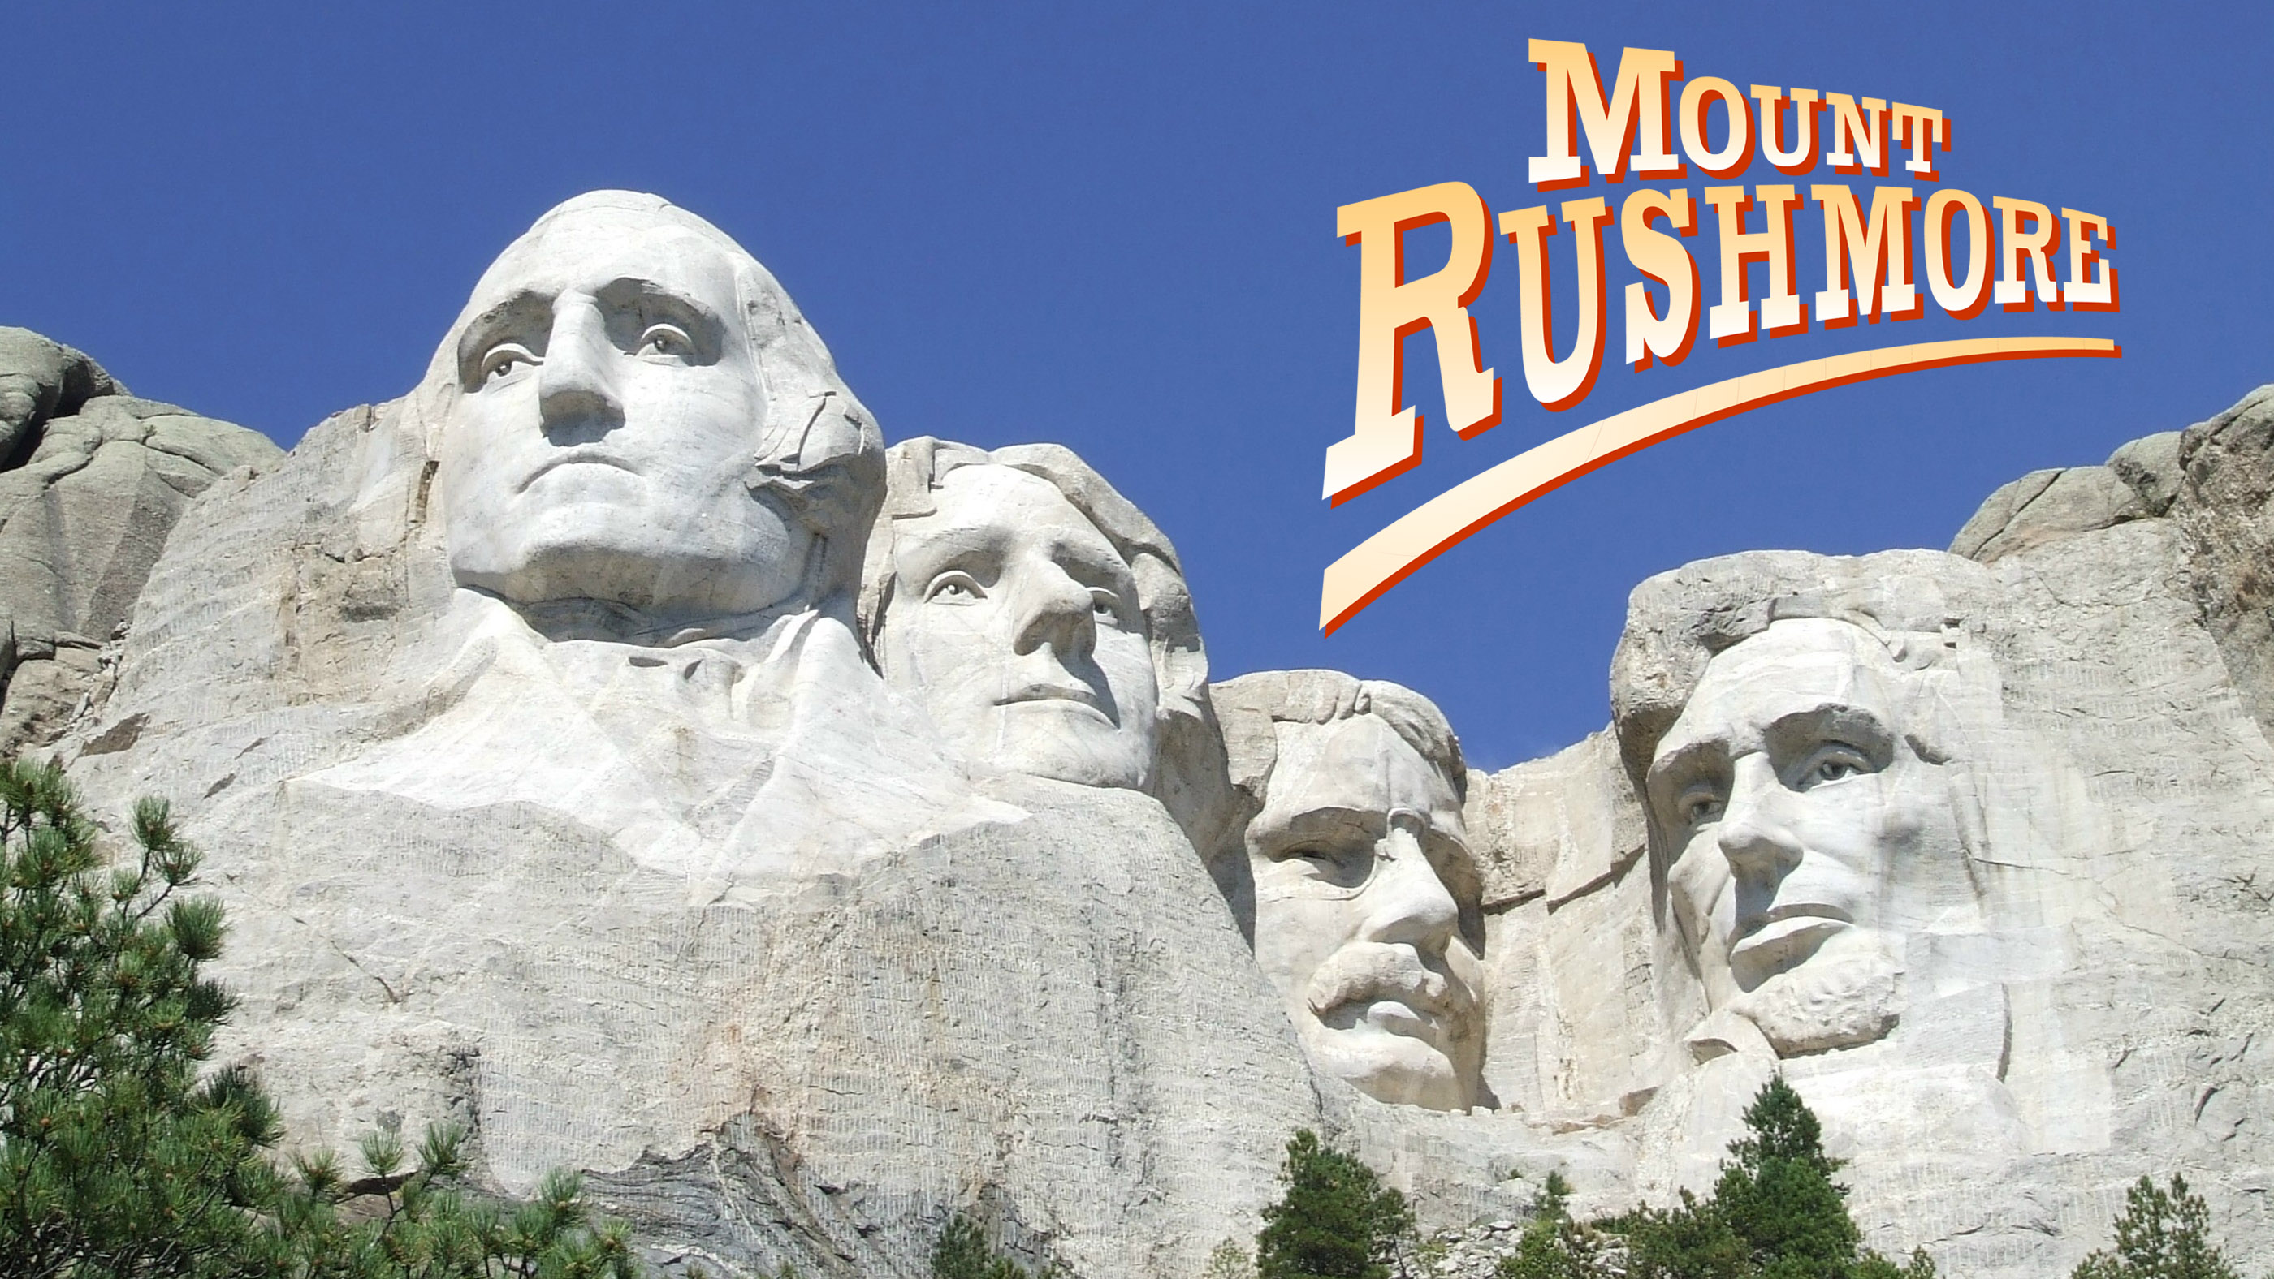

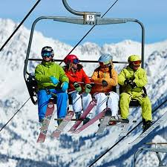
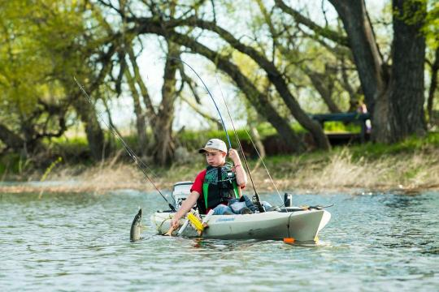
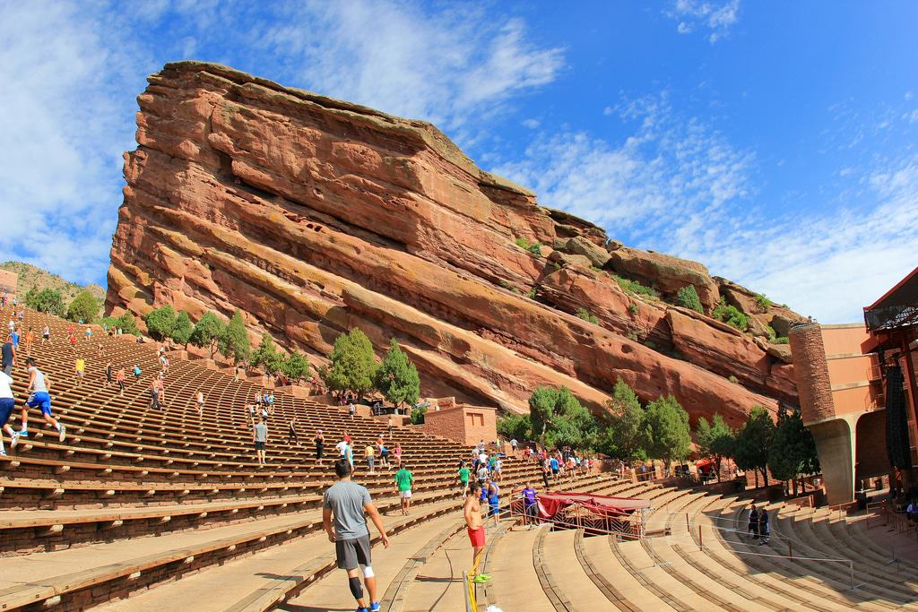
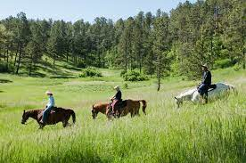
Tourism

Slide 14

As it relates to tourism:
“I think a correlation can be drawn between the visitor industry and the use of our highway system, including the Heartland Expressway. Dawes County (Chadron and Crawford) had a record setting year in 2022, according to lodging tax receipts. These visitors are rarely coming to Chadron any other way than driving. Our safe, modern highways are an important link for those visitors who provide a significant bump to our economy. Finishing the Heartland Expressway through the region continues to be an important infrastructure project.”
Deb Cottier, Executive Director
Northwest Nebraska Development Corporation

Slide 15

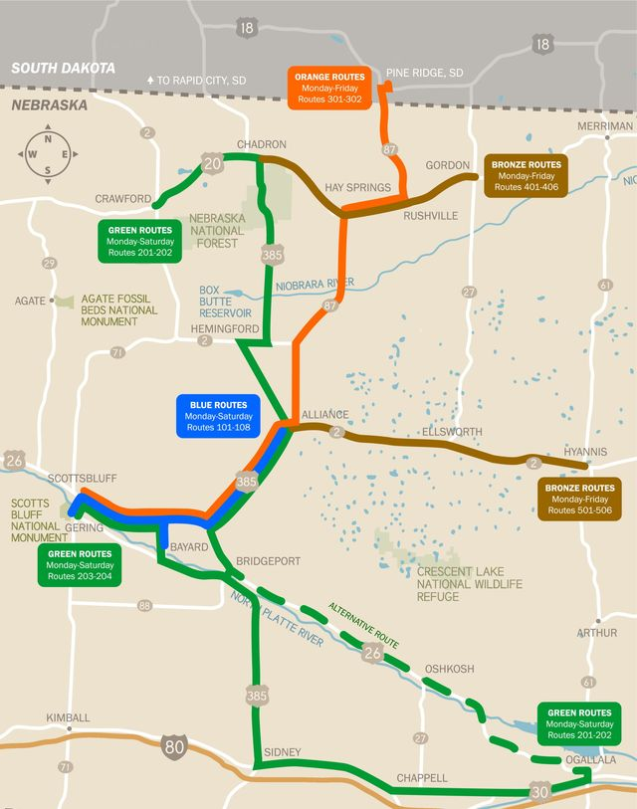
Averaged 3300 passenger boardings our past fiscal year
13 passengers/operational day along just the 385 corridor –
  assisting with access to healthcare,
  connections to regional airports, education, tourism, shopping, etc.
86,000 miles traveled this past fiscal year

Slide 16


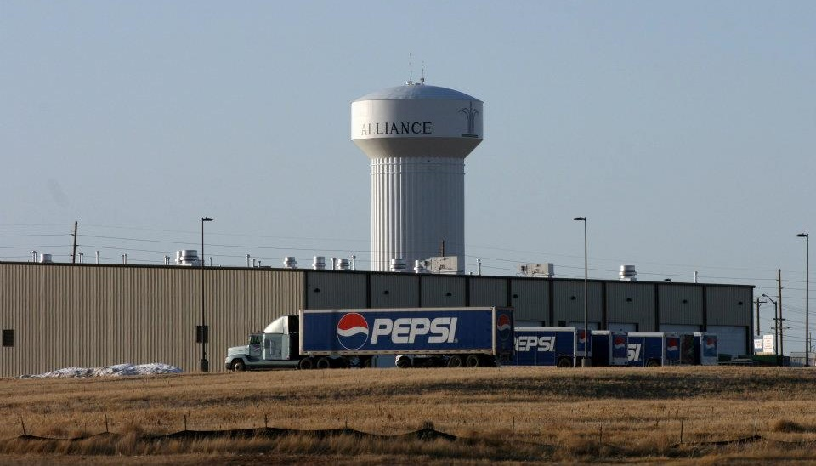
Business

Slide 17











NEW BUSINESSES :
2011 – Pepsi $4M
2014 – Maverik $900K
2017 – Bomgaars $3M
2018 – Holiday Inn Express $5.1M
2018 – Scooters $285K
2019 – Dollar General W. $746K
2021 – Pizza Hut $800K
2022 – Dollar Tree/Family Dollar $390K
2022 – Goodwill $258K
2022 – Runza $1.4M
Total Investment in Alliance:
$16,879,000.00

Slide 18

COMING SOON!
Groundbreaking this Fall for,
‘Alliance Heartland Flats Mall & Apartment Building’…
51 units
2 retail anchors
12 extended stay rooms
$10M+ project to be completed by late 2023
“We are excited for this new mixed-use development coming to Alliance. This is the first housing project, in over 30 years, and more importantly, we’re thrilled for one of this magnitude. The improved quality of housing is what is most needed and everything else it will bring to our community.”
Chelsie Herian, Executive Director
Box Butte Development Corporation

Slide 19


“Lodging tax receipts in Scotts Bluff County are also hitting record highs and this is important, as Deb said. We always include the Ports to Plains map highlighting the HEA portion in all of our RFP’s and RFI’s, the North/South corridor is very important to economic development in the region, and it seems like more and more manufacturing, warehousing and logistics businesses are looking closely at our area for expansion.”
Starr Lehl
Economic Development Director
City of Scottsbluff, Nebraska

Slide 20
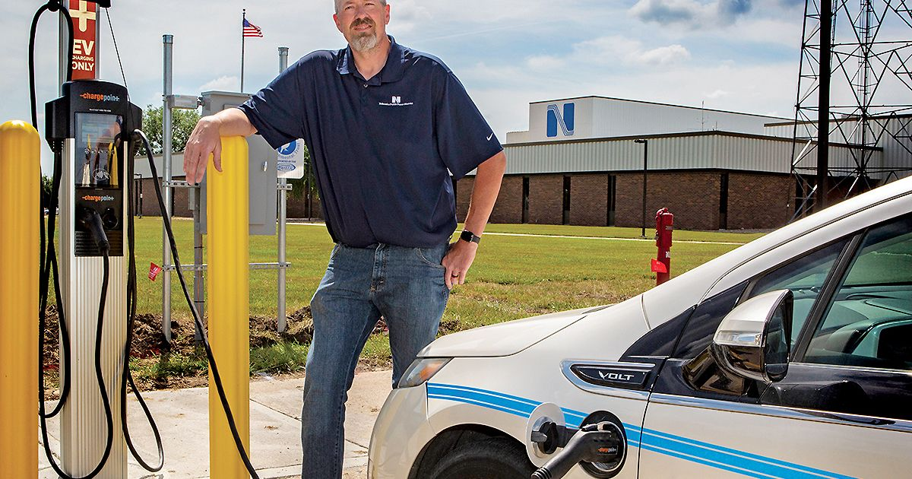
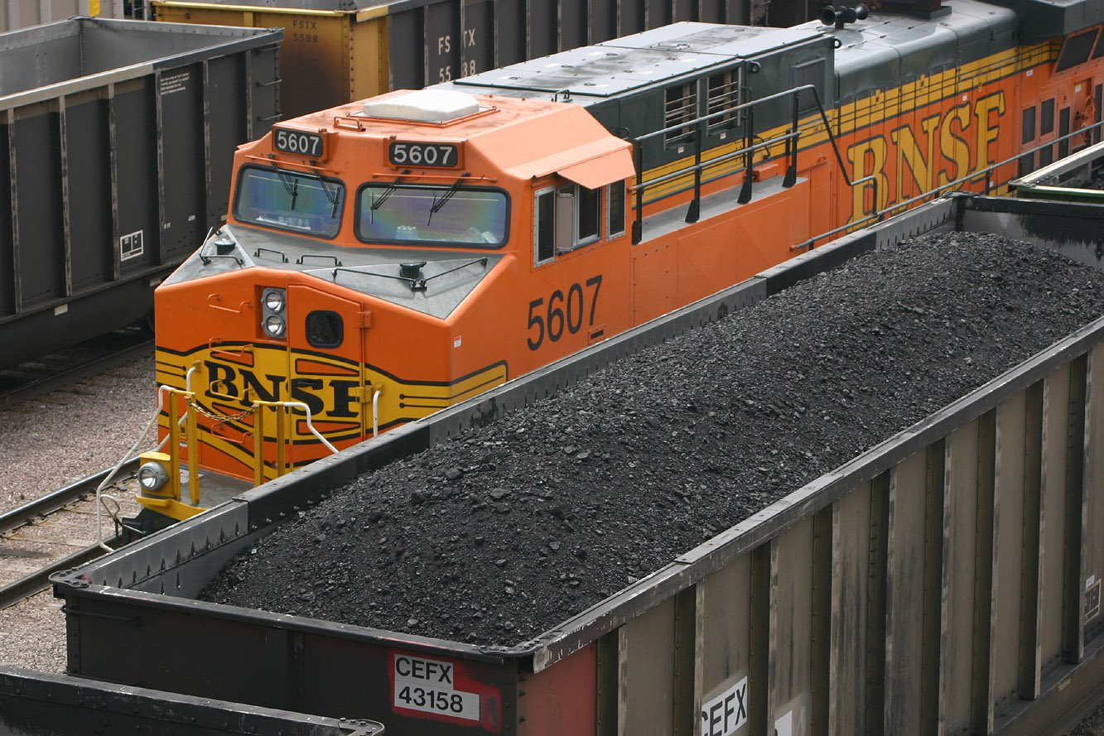


Energy

Slide 21
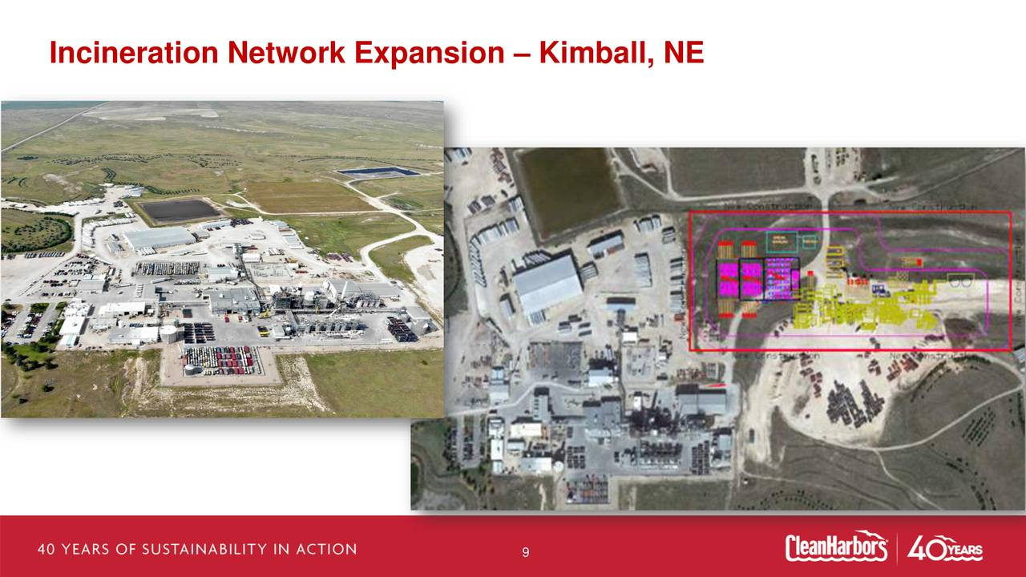

Slide 22

HEARTLAND EXPRESSWAY
L62A North:
  Construction complete Fall 2022
North of Alliance:
  Programmed first Super-2 Segment north of US-20 near Chadron
Minatare- US385:
  Consultant prepared two proposed plans for public input September 8, 2022

Slide 23
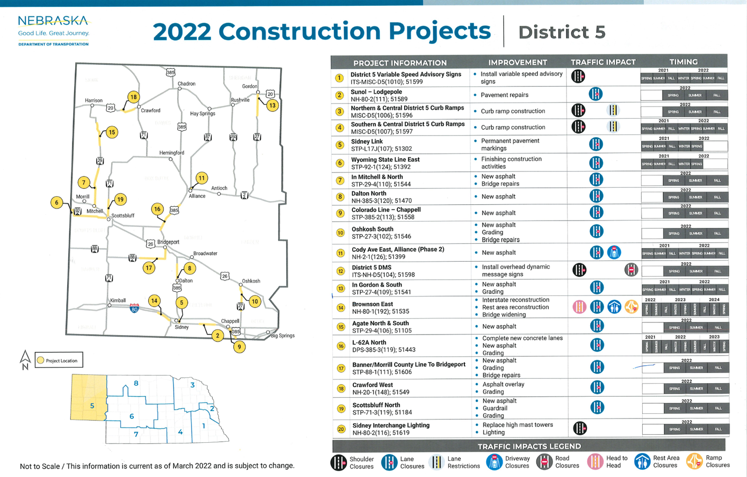

Slide 24
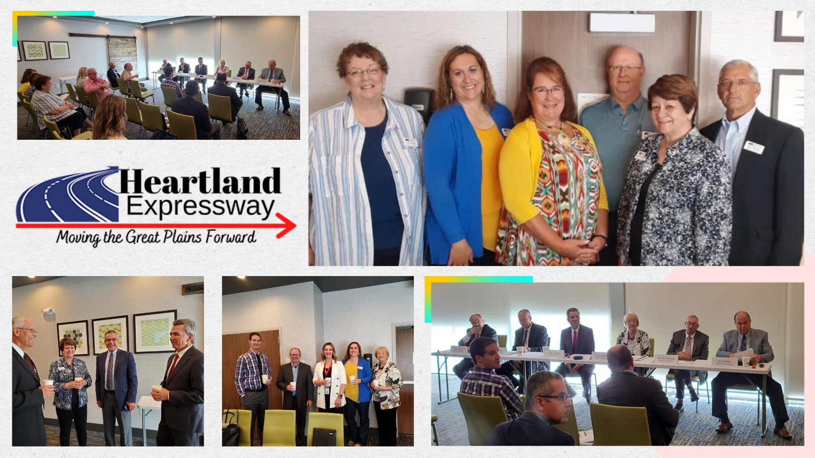

Slide 25
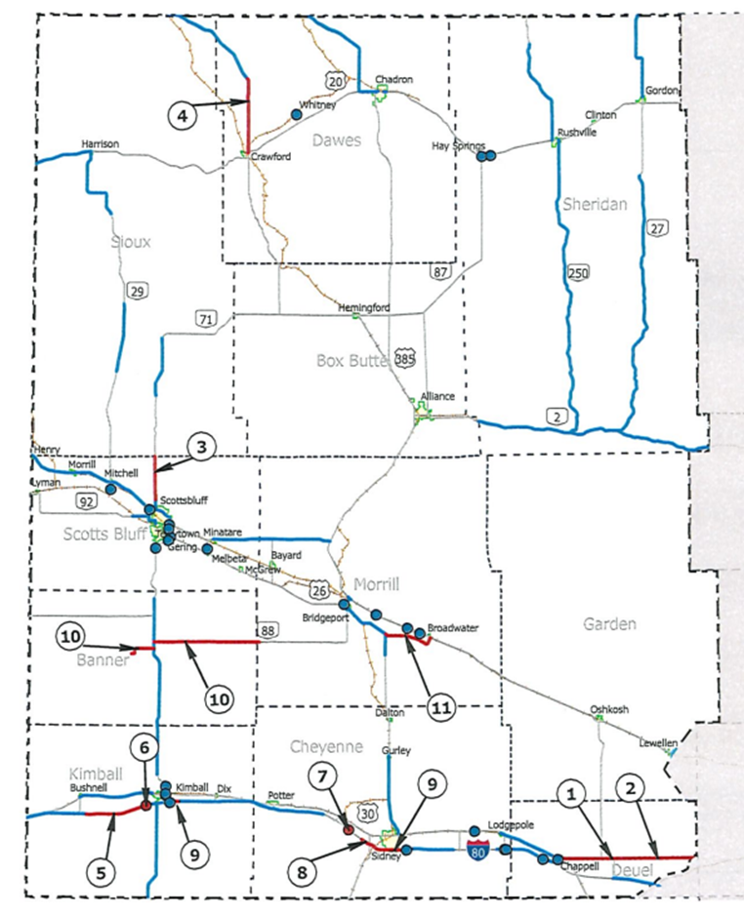
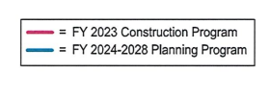

Slide 26
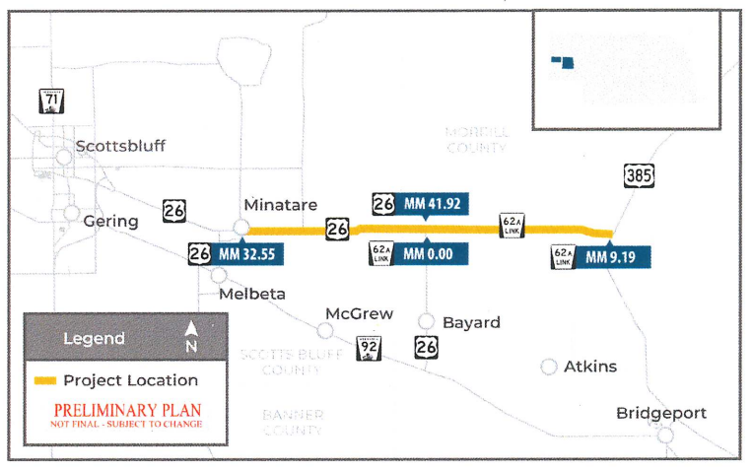
L62A-Minatare
Purpose –
Improve Highway on National
Highway System (NHS) high
priority corridor
Fulfill legislative intent of
constructing a four-lane highway
along the Heartland Expressway
Need –
High traffic volumes, including a high percentage of heavy truck traffic, local travelers, and agriculture
Complete last remaining gap in the four-lane Highway System between
I-80 and Alliance
Other Goals & Objectives –
Efficient use of available funds
Improve safety & comfort for driving public
Maximize utilization of existing pavement
Minimize impacts to the Natural & Human Environment

Slide 27
COMMUNICATION
&
MARKETING

Slide 28

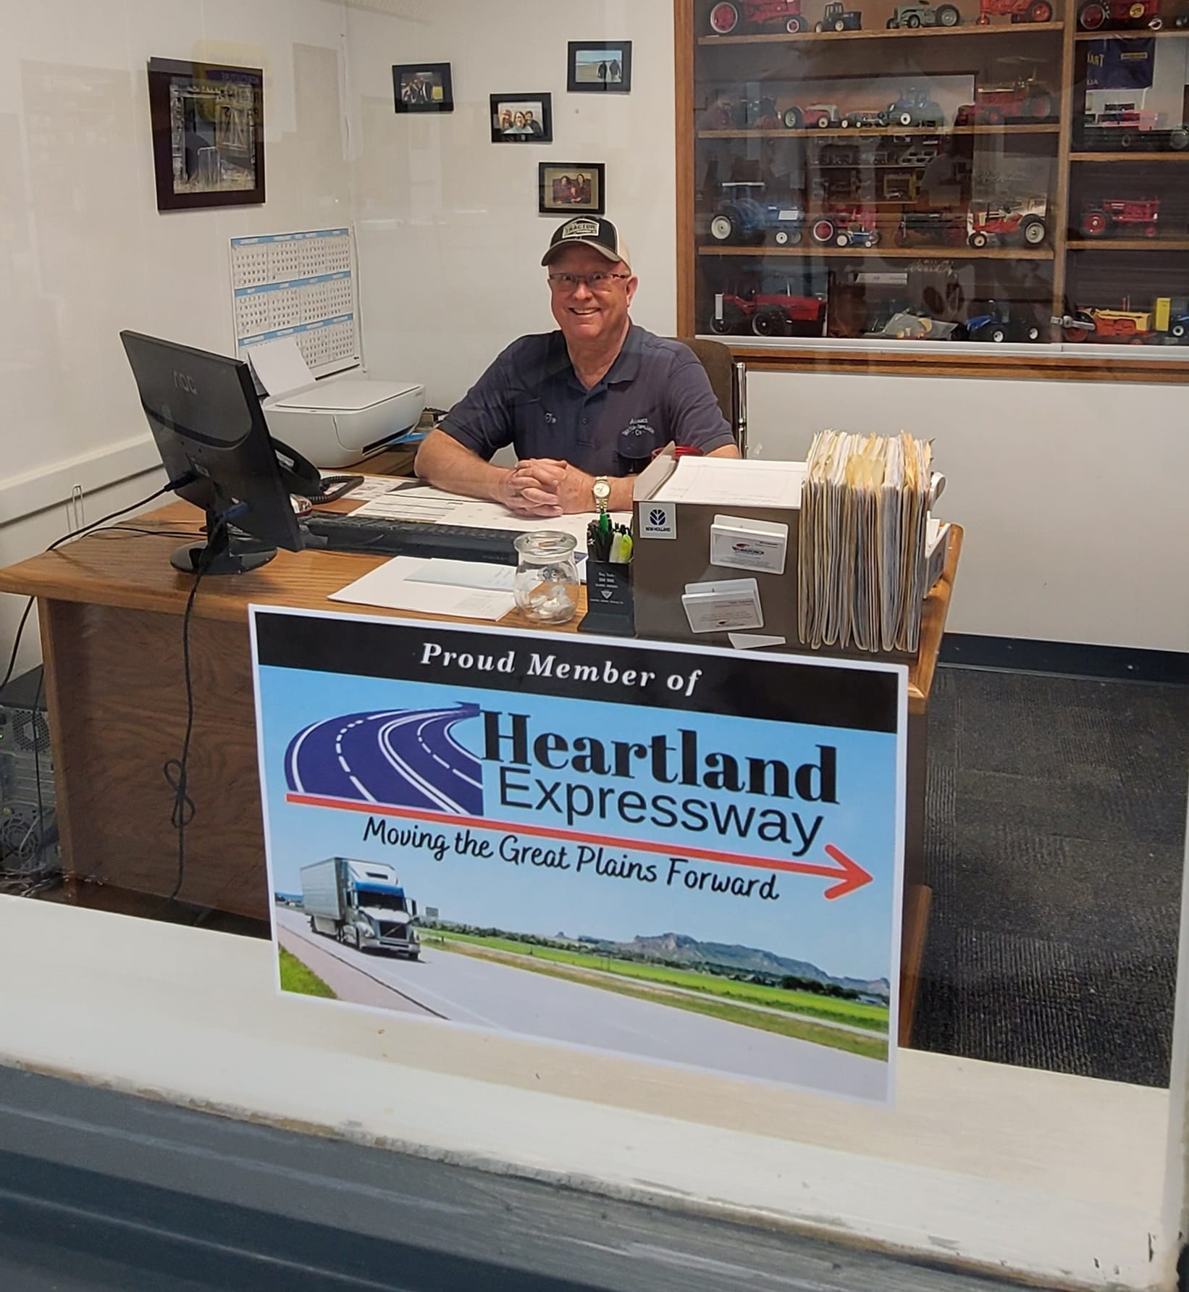

Slide 29

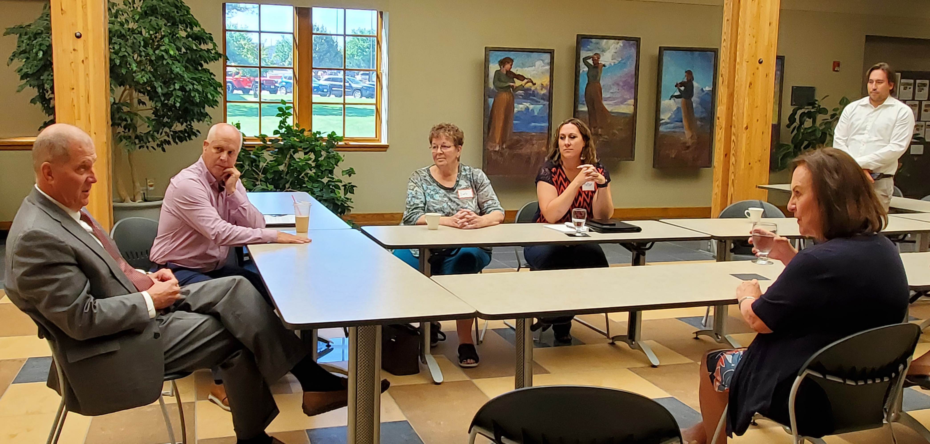
Chadron State College (CSC) President Randy Rhine, banker Steve Cleveland along with HEA board members Deb Cottier and Chelsie Herian met for a round table discussion with US Sen. Deb Fischer. Cottier (from Chadron) and Herian (from Alliance) updated the Senator on the recent progress of the 4-lane Heartland Expressway project south of Alliance. President Rhine added his concurrence that finishing the Heartland Expressway would be a game-changer of the local economy.

Slide 30
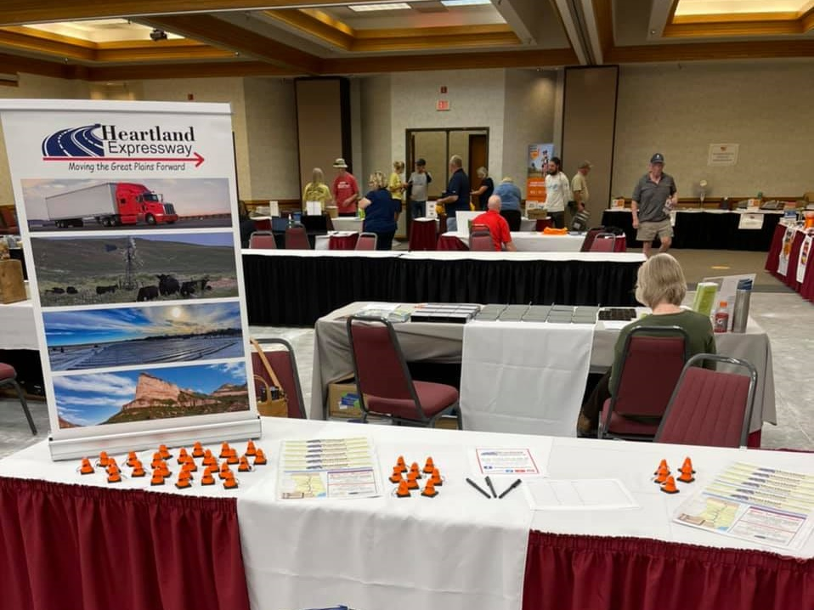
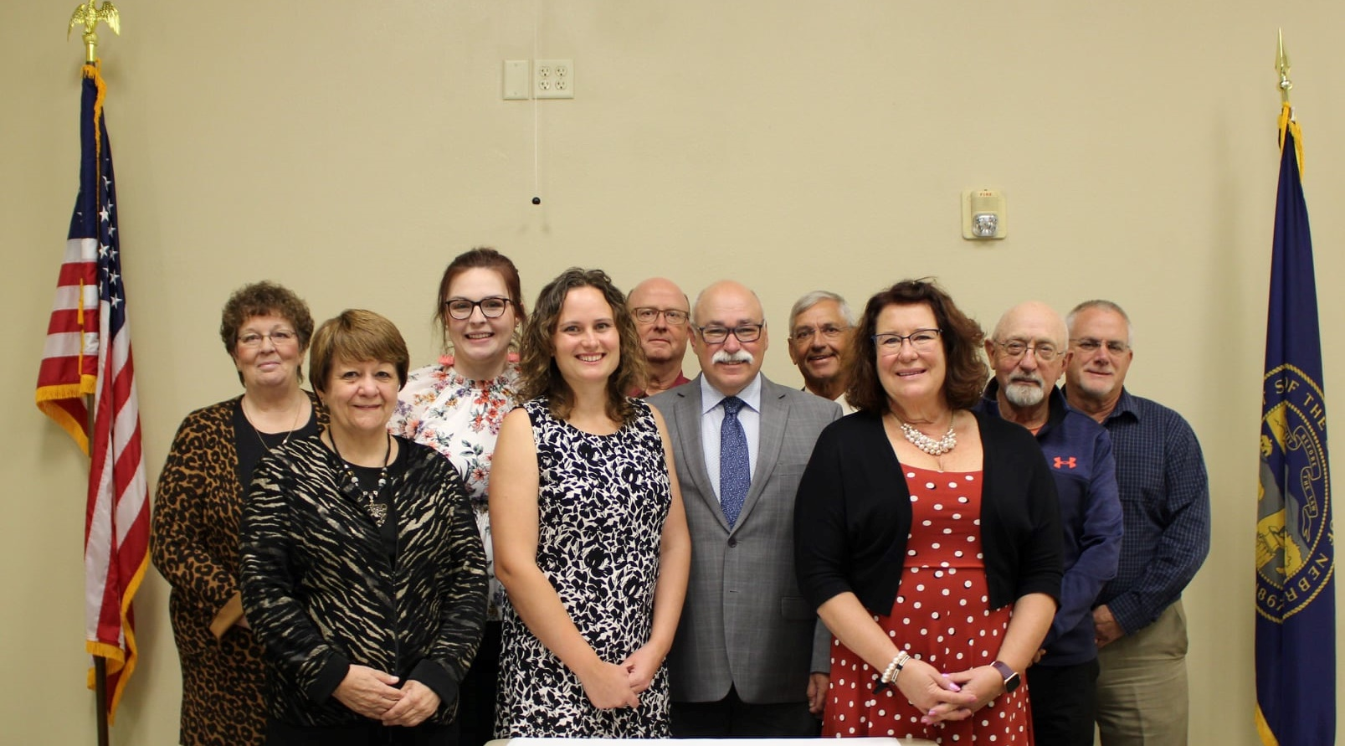
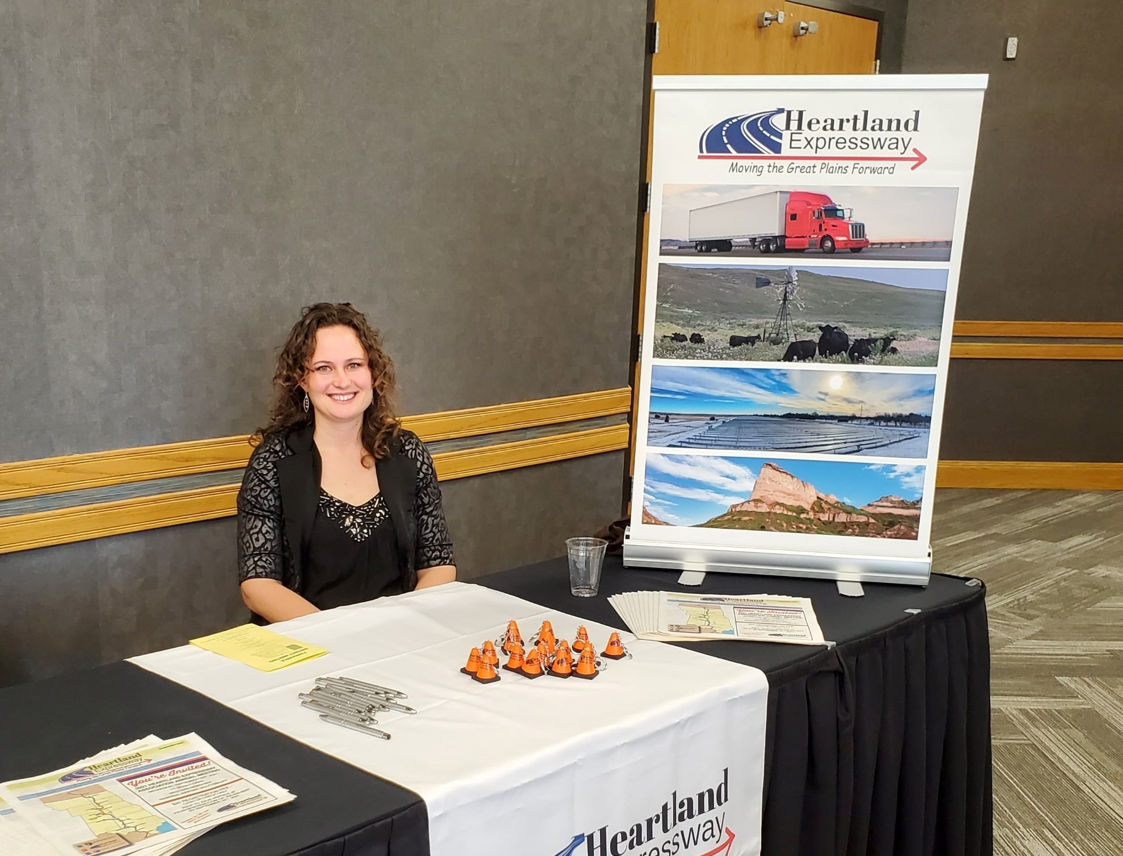

Slide 31
Benefits by the Numbers
(all at 7% Discount Rate)
Value of Pavement Savings
$0.4 MILLION
Value of Accident Reduction Savings
$94.8 MILLION
Value of Economic Inventory Savings
$215.4 MILLION
Value of Travel Time Savings for Diverted Users
$1.0 MILLION
Value of Travel Time Savings for Existing Users
$140.8 MILLION
TOTAL BENEFITS
Between 2016-2054
$452.4 MILLION
From 2014 Heartland Expressway Corridor Development and Management Plan

Slide 32
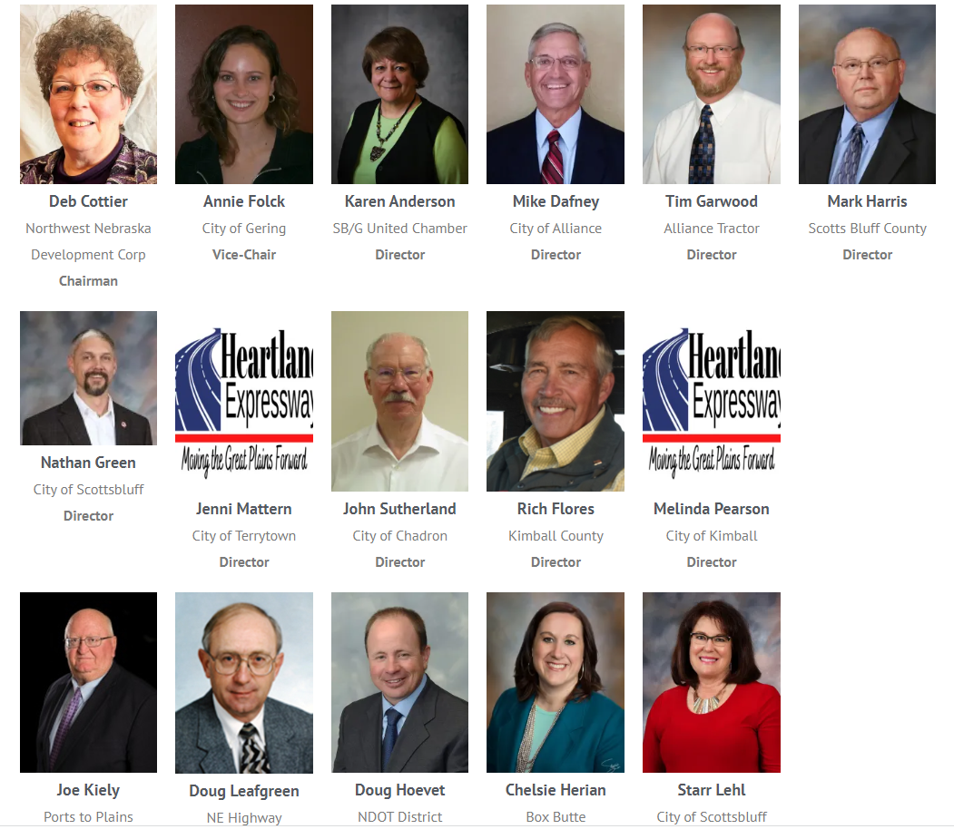
Current
Board of Directors
www.HeartlandExpressway.com
info@heartlandexpressway.com
www.facebook.com/heartlandexpressway

Slide 33
Looking North NOW
Thank You

