Slide 1


Ports to Plains Alliance
Thursday September 15, 2022
Big Spring, Texas

Slide 2

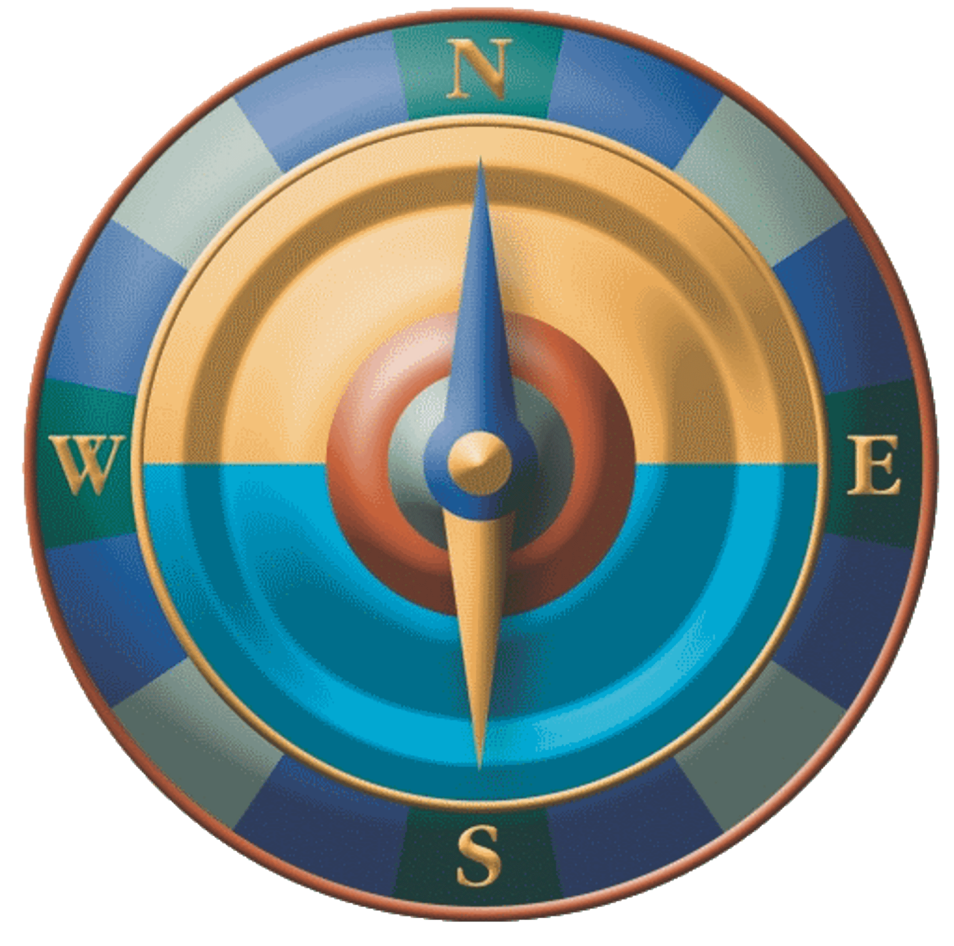

Mission Statement
Ports-to-Plains is a grassroots alliance of communities and businesses whose mission is to advocate a robust international transportation infrastructure to promote economic security and prosperity through North America’s energy and agricultural heartland including Mexico and Canada.

Slide 3
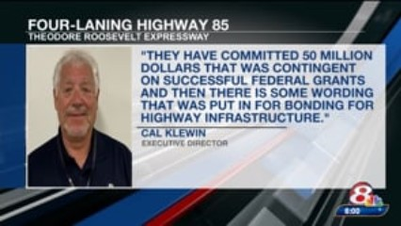
Four-laning of Highway 85
<image010.jpg>
<image010.jpg>

Slide 4
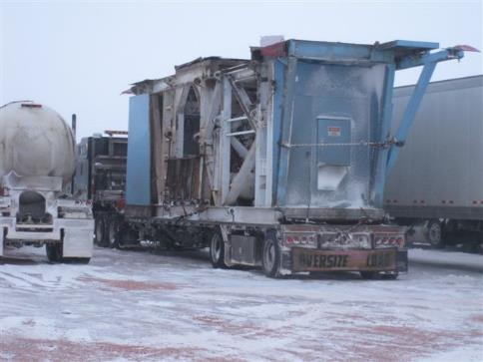
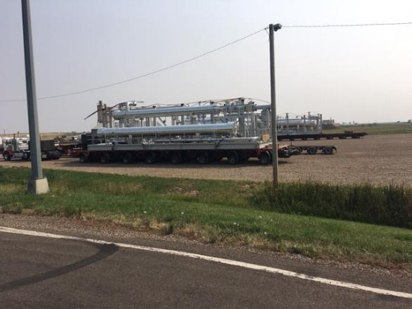
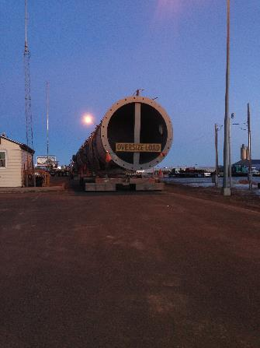
Overweight/Oversize Permitted Loads on US 85

Slide 5

Oversize/Overweight Permit Comparison
Year | U.S. 2 4-lane | U.S. 83 4-lane | I-29 4-lane | I-94 4-lane | U.S. 52 4-lane | U.S. 85 2-lane
2014 |  | 22,128 | 32,300 |  |  | 78,367
2015 |  | 15,438 | 25,460 |  |  | 57,637
2016 |  | 13,378 | 25,068 |  |  | 44,484
2017 |  | 11,452 | 25,332 |  | 15,664 | 45,540
2018 | 56,203 | 13,655 | 25,840 | 48,503 | 17,129 | 51,168
2019 | 59,816 | 15,124 | 25,268 | 46,963 | 16,570 | 51,669
2020 | 45,056 | 12,193 | 23,681 | 40,378 | 14,738 | 33,214
2021 | 42,659 | 10,237 | 25,606 | 38,400 | 13,477 | 35,131
2022 (2nd) | 21,357 | 4,322 | 11,490 | 18,354 | 6,843 | 16,272

Slide 6

Completed Items
Long X Bridge Project (Construction Phase)
Long X Bridge Southern Wildlife Fencing (Construction Phase)

Slide 7
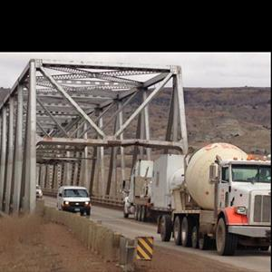

Slide 8
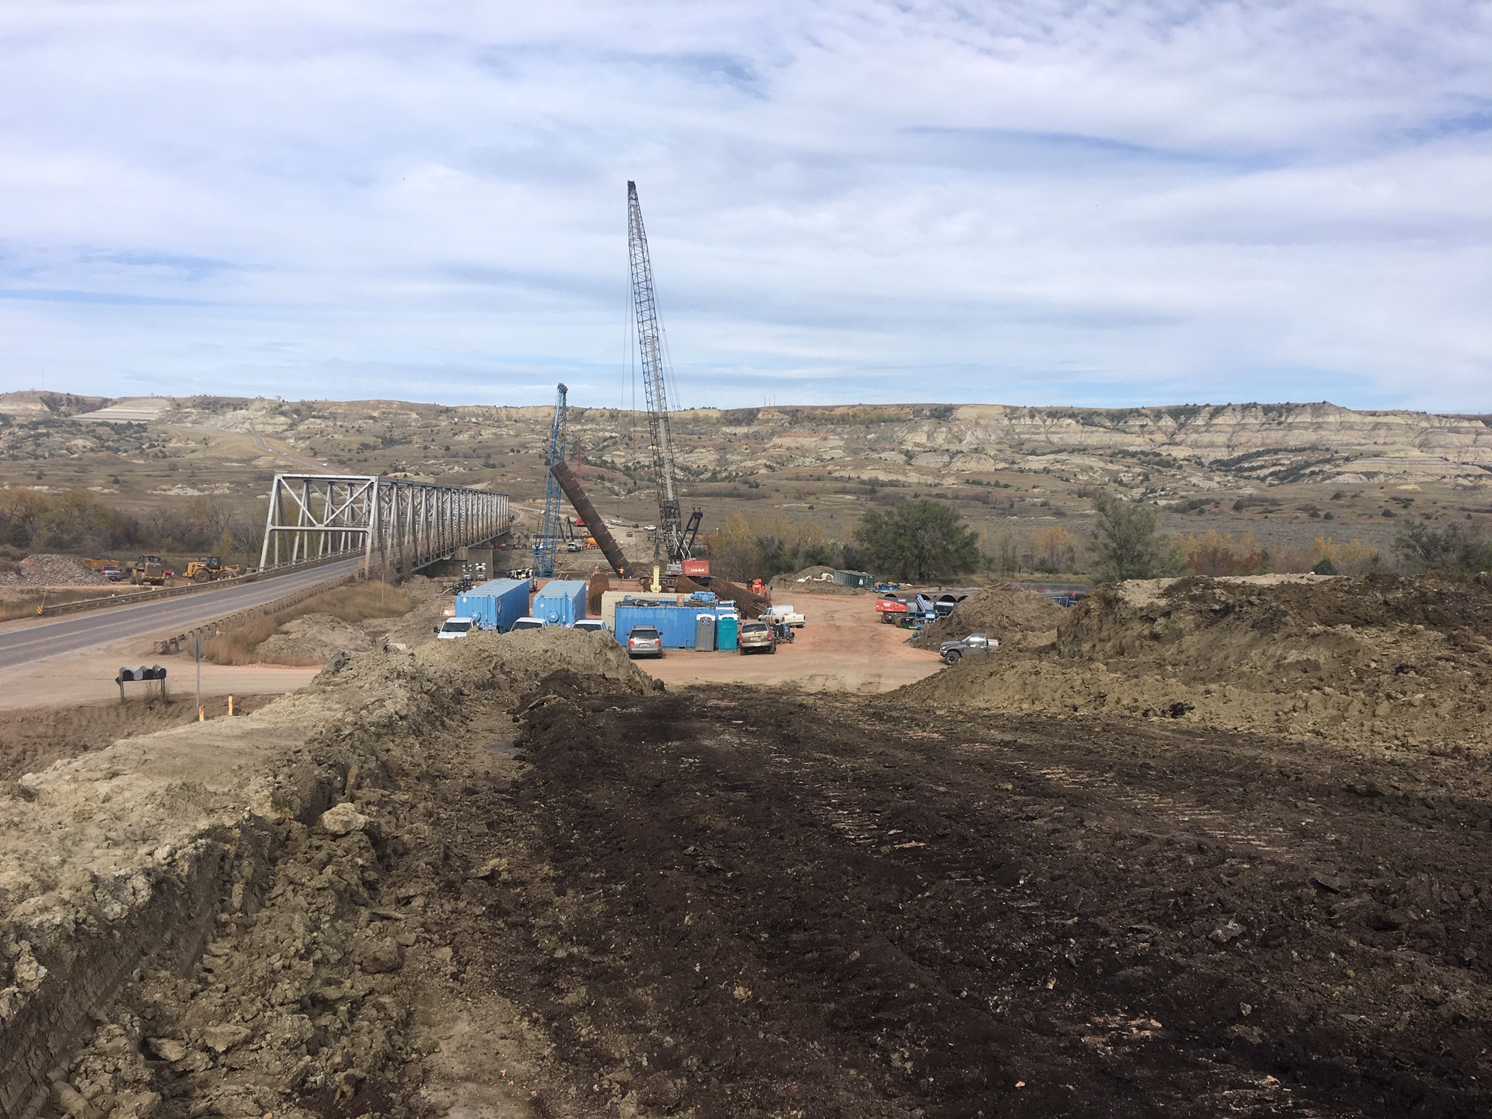
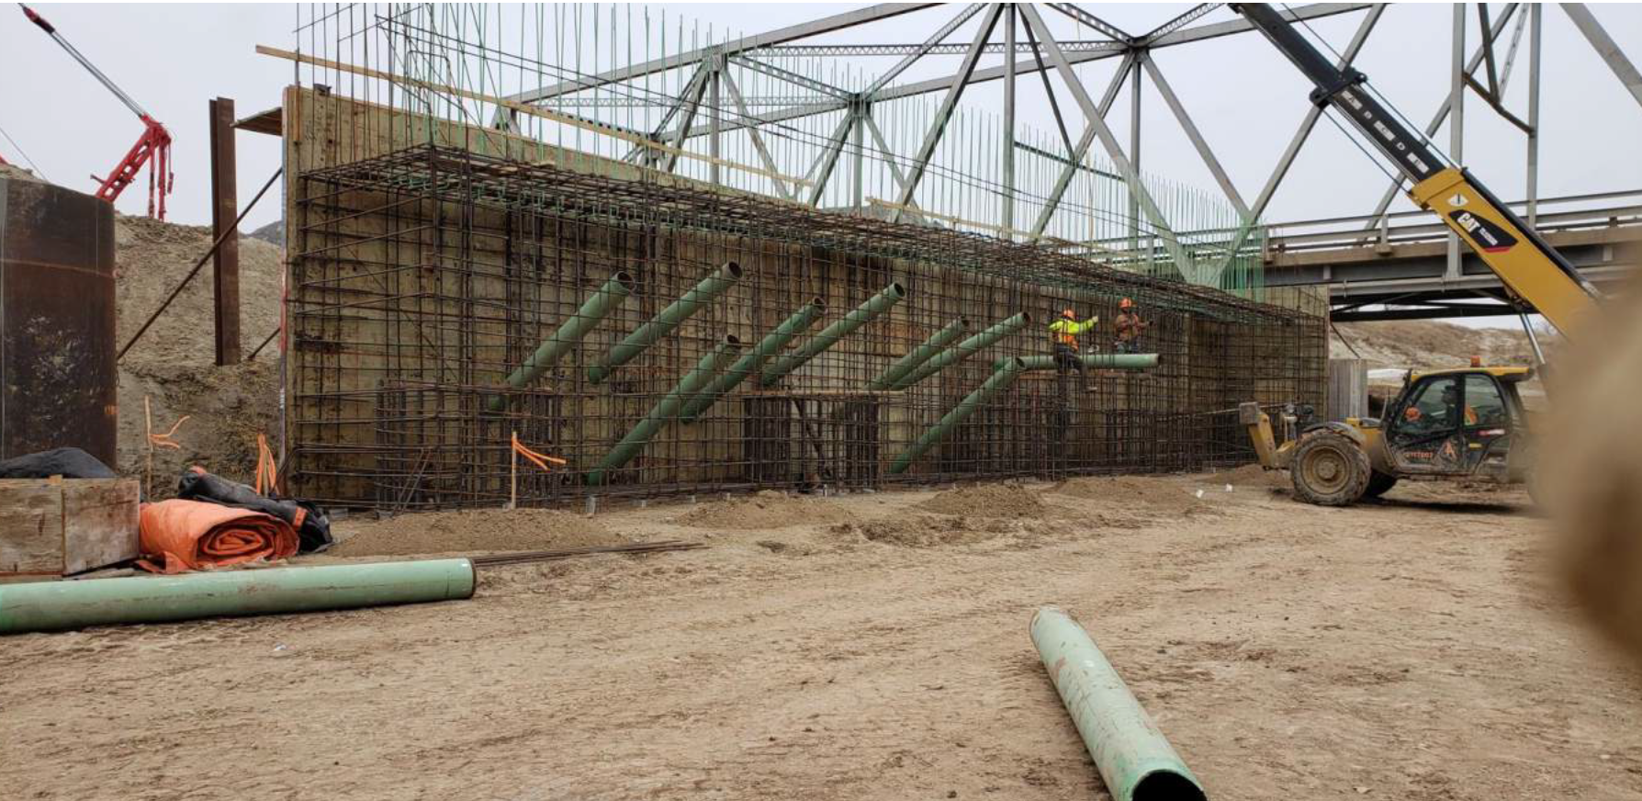

Slide 9
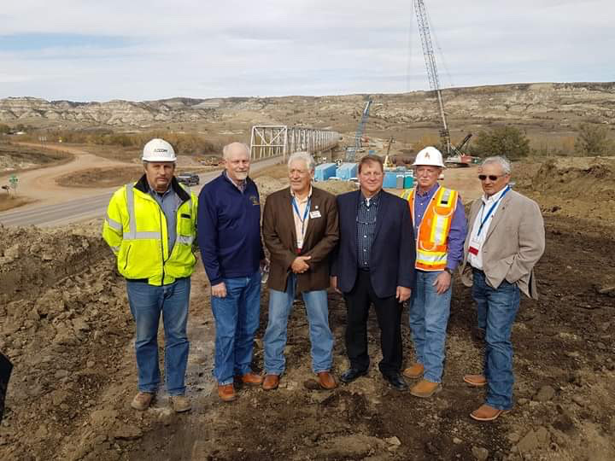
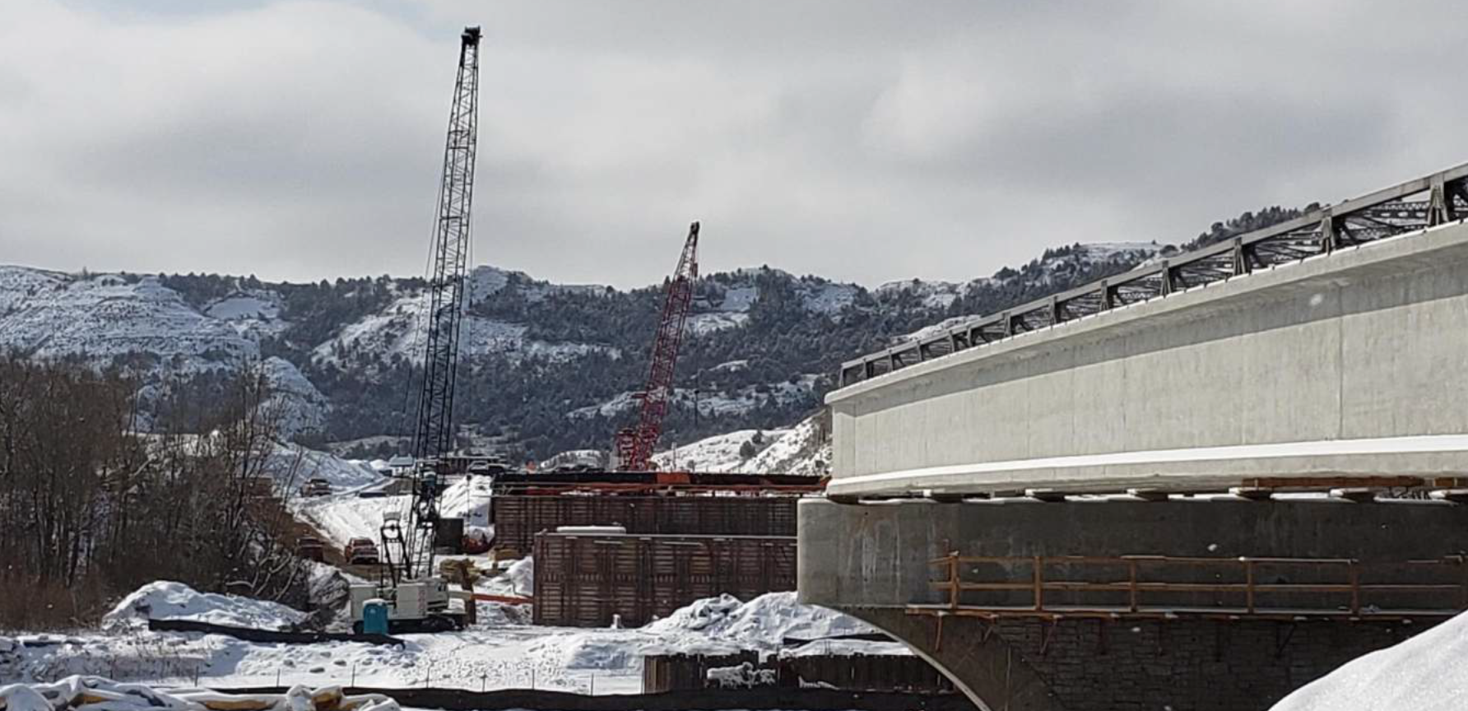
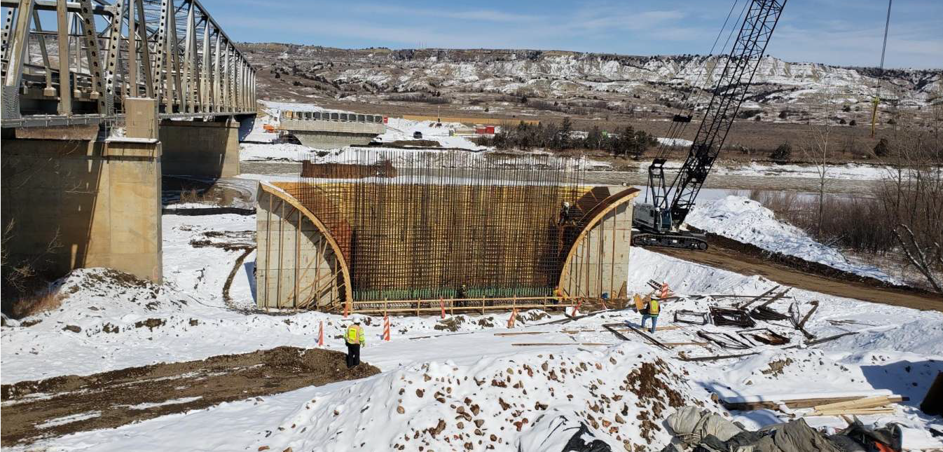

Slide 10
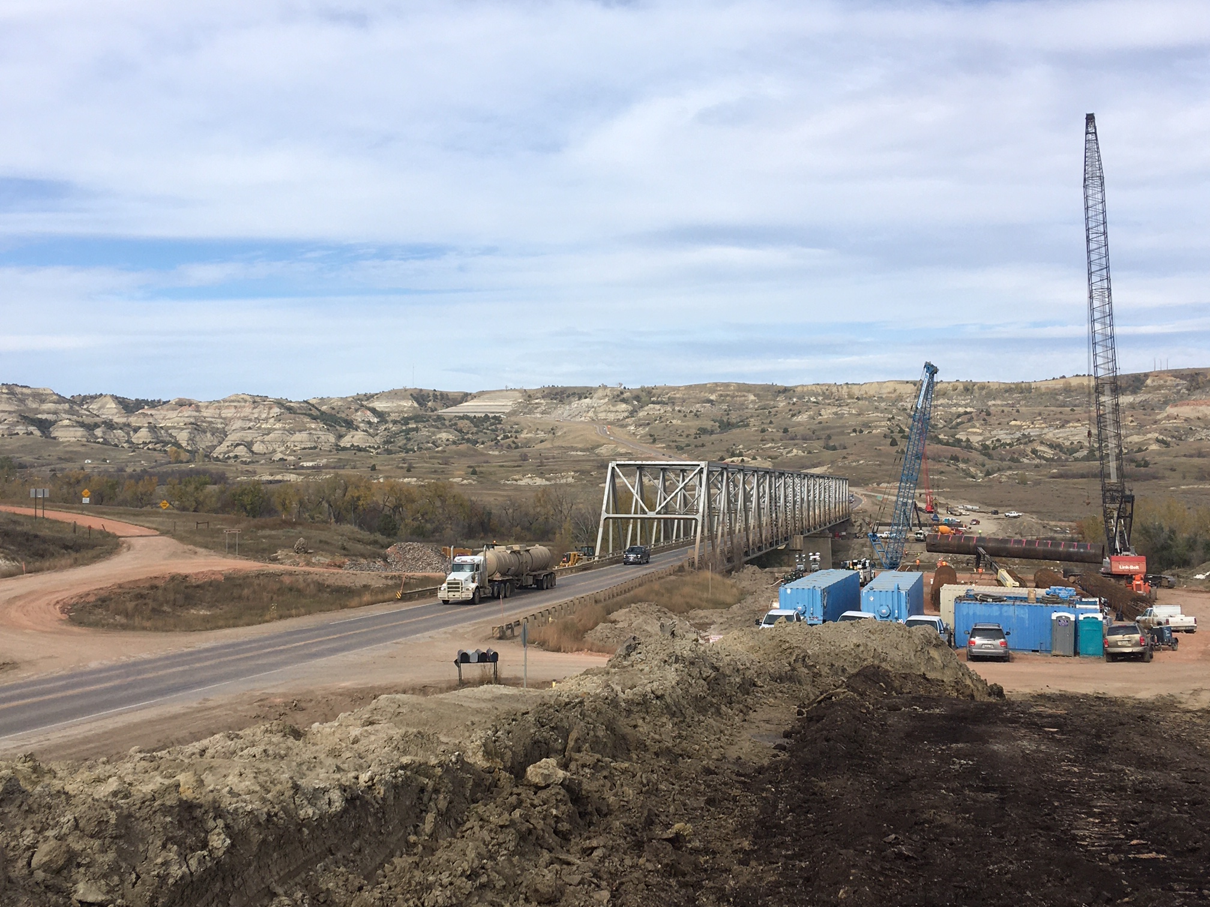
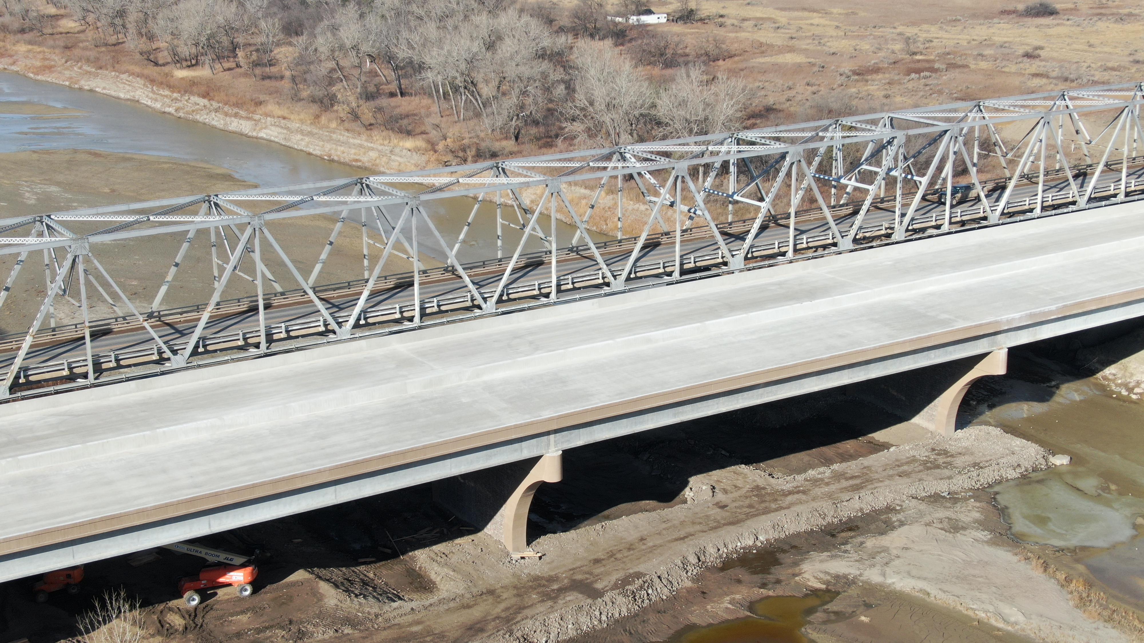

Slide 11
Final Environmental Impact Statement (FEIS) and Record of Decision (ROD)
The US Highway 85 Project encompasses approximately 62 miles of roadway in Stark, Billings, and McKenzie counties, North Dakota.

Slide 12
Completed EIS between Watford City and I-94

Slide 13
Long X Bridge to Watford City 4 Lane Project Update (Design Phase)
Continued efforts for:
Utility Coordination
Right-of-Way Negotiations
Cost Participation and Maintenance
Agreement with McKenzie County for the proposed trail is under final review
Aquatic resource re-delineation work submitted and is under review by U.S. Army Corps of Engineers
Wetland Restoration activities continuing
• Wildlife fence field review

Slide 14
US Highway 85 / Hwy 200 Intersection to Long X Bridge (Design Phase)
North Dakota Department of Transportation and consultants working on survey and starting design

Slide 15
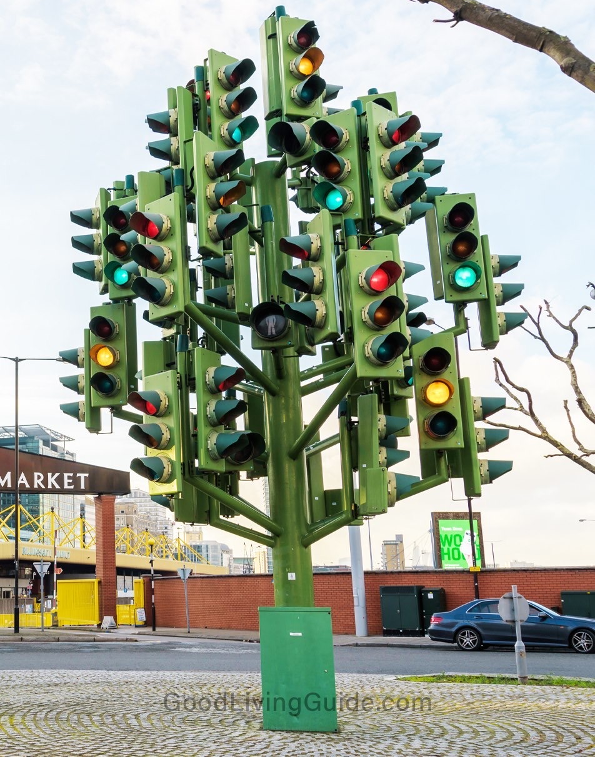

Slide 16
Horseshoe Bend Landslide Project Update (Construction Phase)
Paving is complete
Permanent striping complete
Along with final seeding and erosion control.

Slide 17
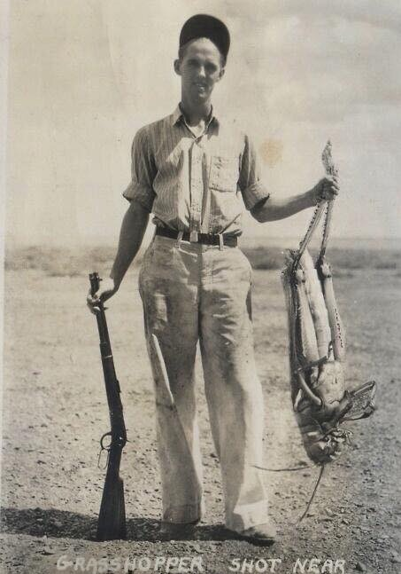

Slide 18
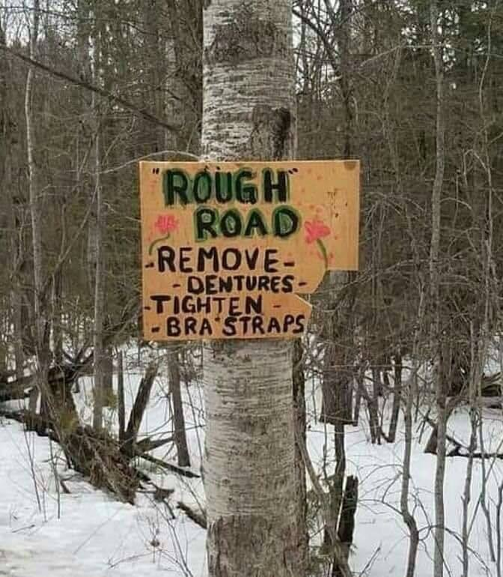

Slide 19
Thank You
Cal Klewin Executive Director
Theodore Roosevelt Expressway Association

