Slide 1

Eastern Plains Council of Governments
P2P Economic Impact Study
2022 Ports-to-Plains Annual Conference

Slide 2
Affected Areas
Colfax County (11,941 population)
          Raton (5,938)
          Springer (1,070)
          Angel Fire (906)
          Cimarron (881)
          Eagle Nest (251)
          Maxwell (212)
            Largest Industry: Ag (LQ Quarterly: 3.02)
Union Count (4,059 population)
          Clayton (2,681)
          Des Moines (122)
          Folsom (57)
          Grenville (29)
            Largest Industry: Ag (LQ Quarterly: 9.15)

Slide 3

Economic Impacts
One-Time Employment Impacts
15,672 (2025)
9,612 (2030)
2,958 (2035)
2,562 (2040)
Assumed 1% increase impact per year after 18 months.

Slide 4

Economic Impacts
(2)
Total Permanent Job Creation
(Cumulative)
454 (2025)
1,362 (2030)
2,359 (2035)
3,448 (2040)
Based on a traffic increase of 1% per year.

Slide 5
Value Added Ag - Cannabis Industry
Permanent jobs
118 (2025)
712 (2030)
1,422 (2035)
2,379 (2040)
Assumption of 1 FTE per 4,000 sq. ft.

Slide 6
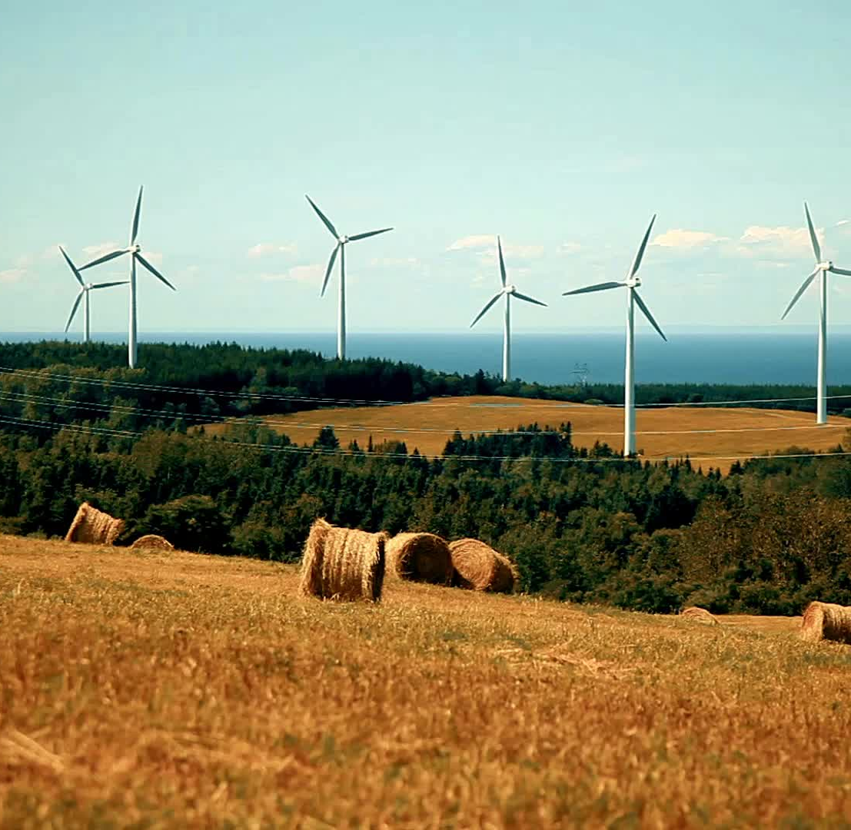
Wind Energy Manufacturing
Wind Energy Manufacturing
50 (2025)
100 (2030)
150 (2035)
200 (2040)

Slide 7

Wind Energy Generation
Wind Generation Employment
By 2035, 396 construction jobs
By 2035, 248 maintenance jobs
Assumed 2.25 jobs per megawatt for construction
Assumed 0.17 jobs per megawatt for maintenance

Slide 8
Solar Energy
Solar Energy Construction Employment
100 (direct jobs)
87 (supplier jobs)
110 (induced jobs)
Total indirect jobs: 197
Solar Energy Employment
Maintenance: 2 (2025-2040)

Slide 9
Meat Processing
Construction Jobs
Direct Jobs: 8.8
Supplier Jobs: 7.7
Induced Jobs: 9.8
Total Indirect Jobs: 17.4

Slide 10

Tourism
Northeast NM Tourism Visitors
Baseline: 5,700,000
5,990,757 (2025)
6,296,346 (2030)
6,617,523 (2035)
6,955,083 (2040)
Park Jobs
Up to 138 by 2040

Slide 11
Thank You
The full report can be accessed at www.epcog.org/document-library
Eastern Plains Council of Government
418 Main St.
Clovis, NM 88101
www.epcog.org

