Slide 1

Beginning NOW:
The Benefits of the Interstate Highway
Lorena Echeverria de Misi, P.E.
Corridor Planning Branch Manager
TxDOT Transportation Planning & Programming Division

Slide 2
Agenda
1
Overview of the Interstate Highway System
2
Existing and Future Interstates in Texas
3
Ports-to-Plains Corridor Interstate Feasibility Study
4
I-27 Advisory Committee
5
Ports-to-Plains Corridor Implementation
6
Interstate Requirements, Designation Process, and Timeline

Slide 3
Our Mission: Connecting You With Texas

Slide 4
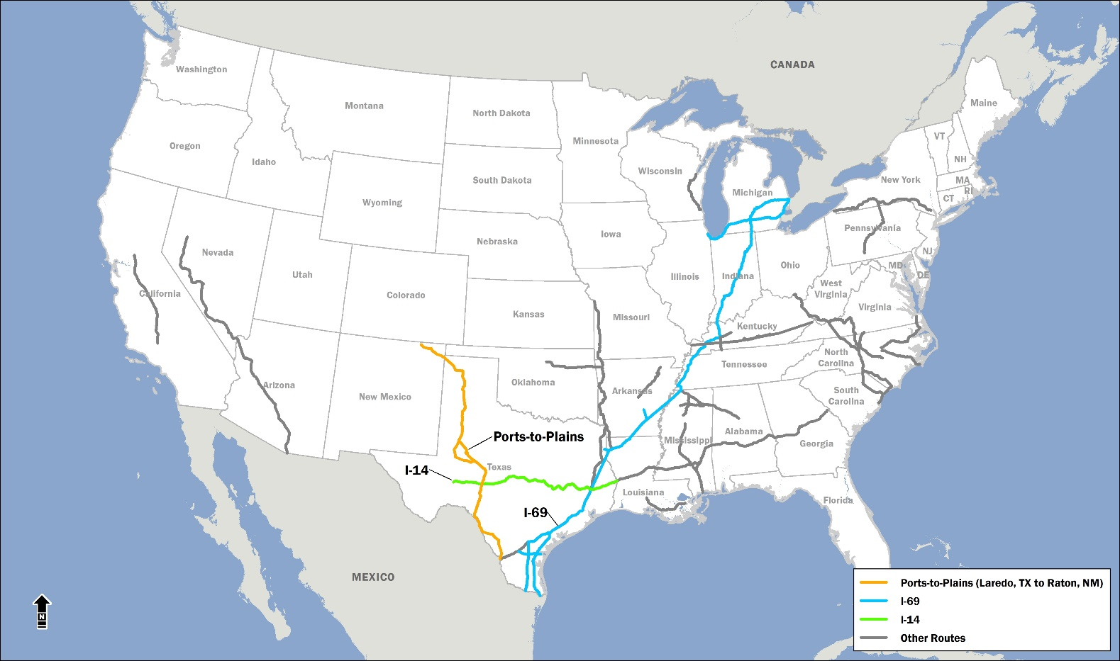
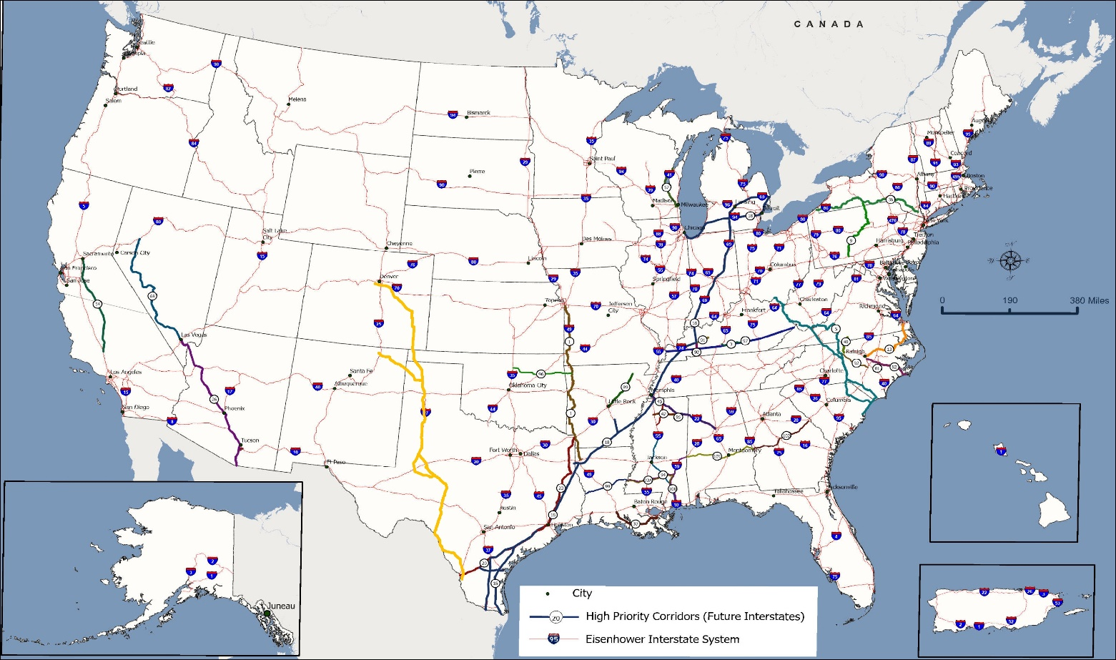

Congressionally Designated High Priority Corridors as Future Interstates
Notes:
** Ports-to-Plains Corridor from Laredo, TX to Raton, NM added to FHWA’s map.
** Colors are added for clarity only.
** Corridor number corresponds to statutory listing in Section 1105(c) of ISTEA 1991, as amended.
** Some portions of the future interstates have been constructed to Interstate standards, open to traffic and signed as Interstates.
** Corridor based on information available as of November 15, 2021.

Slide 5
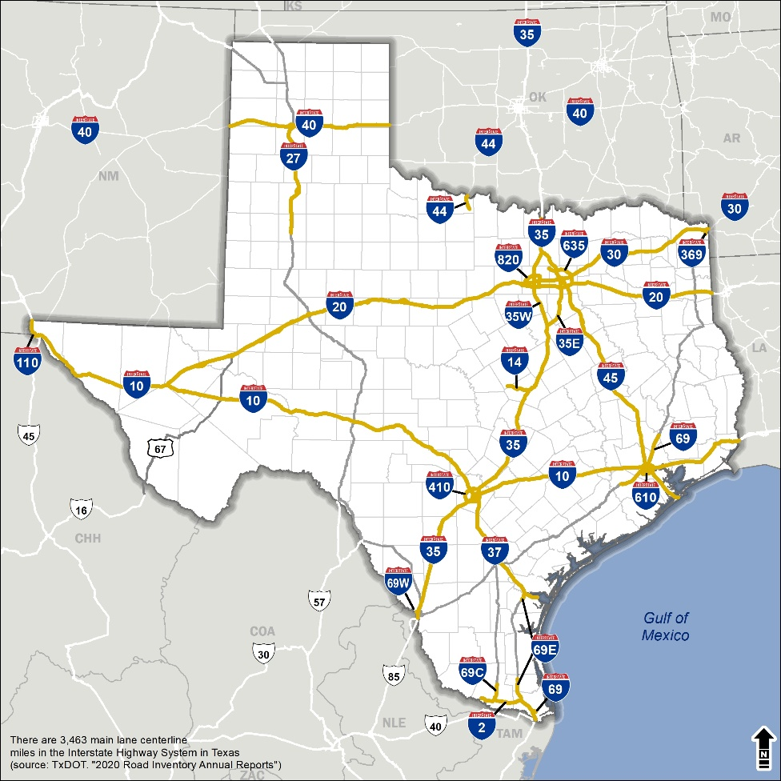
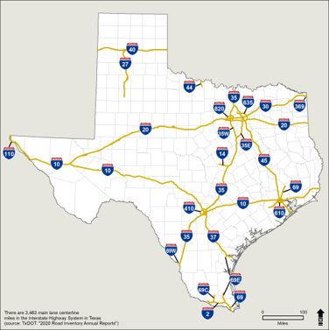

Interstate Highway System in Texas
First created in 1958, the Interstate Highway System remains critical roadway infrastructure:
Connecting principal metropolitan areas, cities, and industrial centers
Serving the national defense
Providing important corridors to Canada and Mexico
There are more than 3,400 main lane centerline miles in the Interstate Highway System
Source: Texas Roadway Inventory, 2020

Slide 6
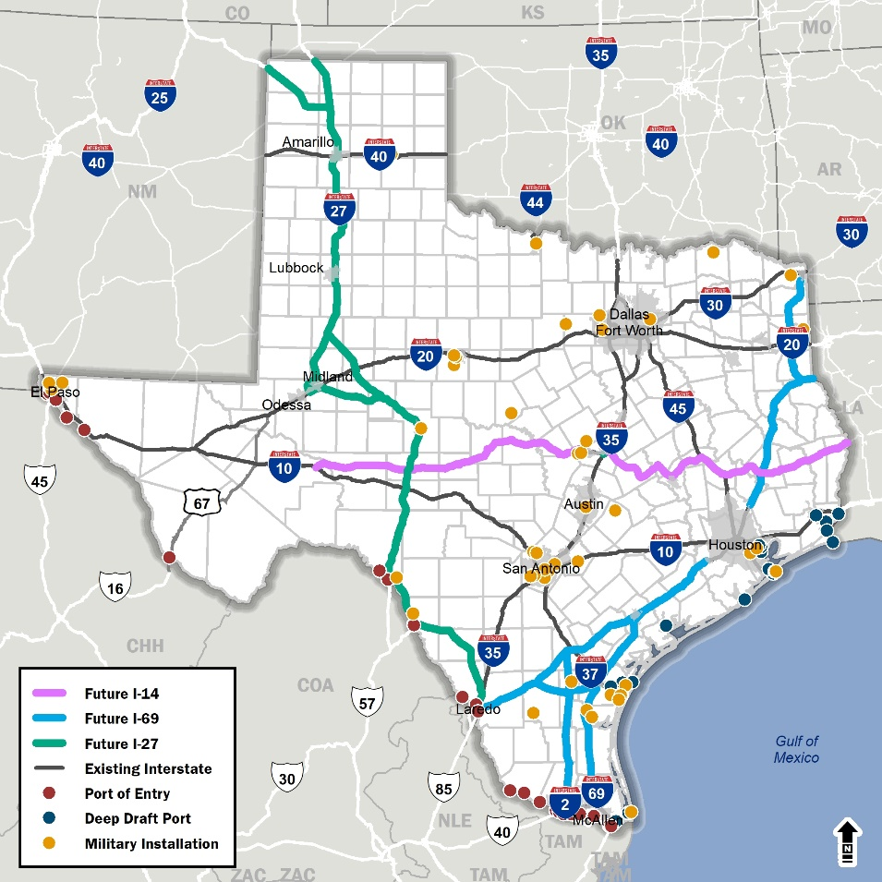
Future Interstates in Texas
Corridor | Corridor Length (mi.) | Current Interstate Highway Designation (mi.) | Dual Designation | % Designated
I-69 | 1,134 | 161 | 0 | 14%
I-14 | 1,031 | 26 | 53 | 8%
I-27* | 963 | 124 | 28 | 16%
Totals | 3,128 | 311 | 81 | 13%
When completed, the three future interstates will connect state, national and global markets through Texas seaports and border crossings.
*Ports-to-Plains Corridor designated as a Future Interstate and assumed will be designated as I-27
Notes:
.

Slide 7

The Role of Statewide Connectivity in the State’s Economic Prosperity

Slide 8
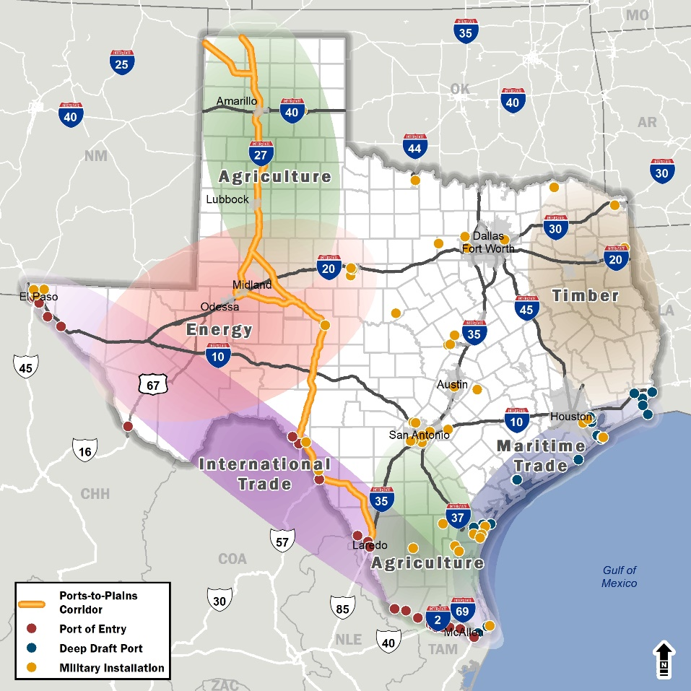
Statewide Connectivity Supports the State’s Key Economic Sectors
Agriculture Production
Generates approximately $34.9 billion a year in sales statewide and contributes $12.6 billion to the State’s GDP
Energy Production
In 2020 Permian Basin accounted for 39% of U.S. crude oil production and $9 billion in state taxes in royalties
In 2016, the Eagle Ford Shale contributed over $3 billion in state and local taxes and revenues
Timber and Lumber Production
In 2017, lumber industry contributed $33.6 billion to the Texas economy
International Trade
In 2020, 65% or $352 billion of $538 B US-Mexico trade passed through Texas.
International Maritime Trade
In 2019, Texas ports accounted for an average of $242.7 billion in trade value annually
National Defense and Security
In 2019, Texas military bases added $75 billion to the State’s GDP
Agriculture Production
Energy Production
Timber and Lumber Production
International Trade
Maritime Trade
National Defense and Security

Slide 9
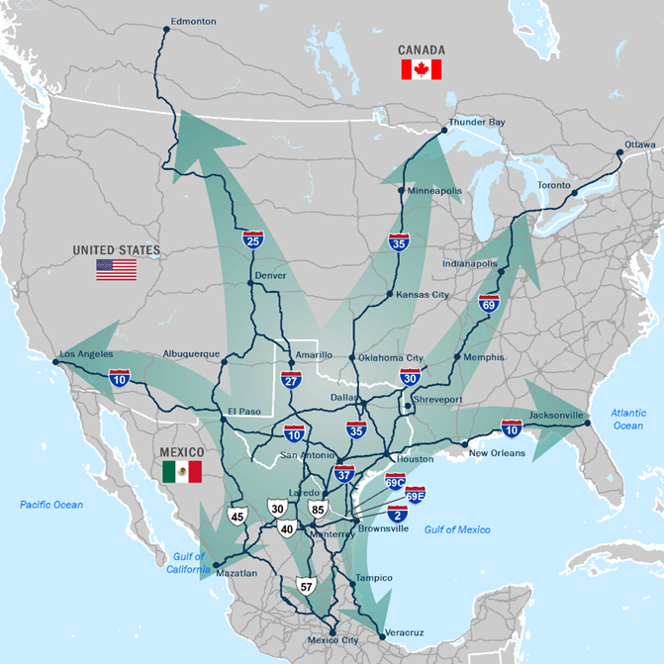


The Importance of the Texas-Mexico International Border
Texas-Mexico Border Transportation Master Plan (BTMP) adopted in 2021
Texas is the gateway for U.S.-Mexico trade
  28 border crossings (more than any other state)
  top exporting state for 18 consecutive years
  Mexico is number one trading partner and a major player in the Texas and global economy
^{IH 10 / FH 45}
^{IH 27 / FH 57}
^{IH 35 / FH 85}
^{IH 69 Brownsville}
^{IH 69 Laredo}
^{US 67 / FH 67 Presidio-Ojinaga}
^{IH 10}
^{IH 20}
^{IH 30}
^{IH 37 Port of Corpus Christi}
^{IH 45 Port of Houston}

Slide 10
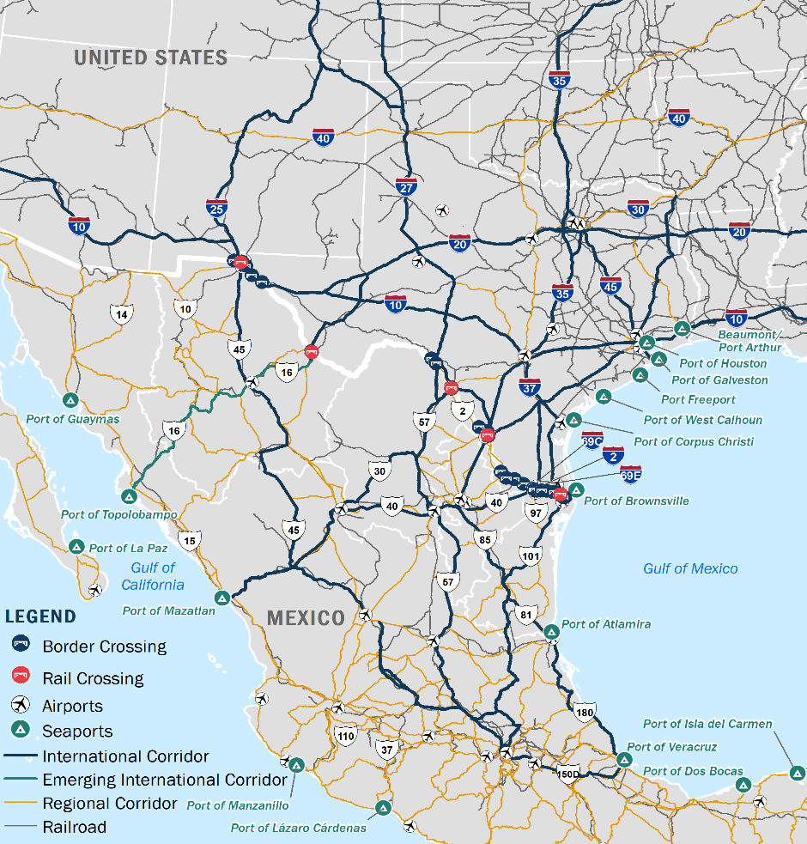




Overview of the Texas-Mexico Border Multimodal Transportation System

Slide 11
Ports-to-Plains Corridor Interstate Feasibility Study (HB 1079)

Slide 12
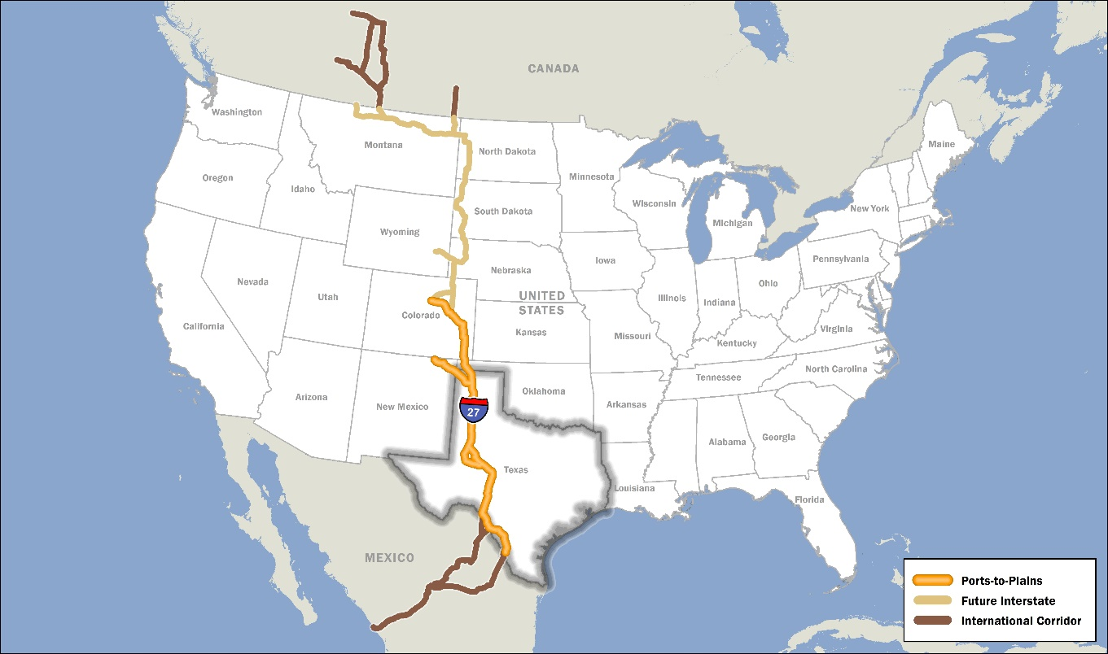
International and National Importance of Ports-to-Plains
Only north-south corridor that connects the nation’s and Texas’ most strategic economic engines of agriculture production, energy production and international trade:
  Supports the largest agricultural production in the country
  Facilitates movement of energy products to refineries in the Texas Gulf and to border crossings and seaports for exports to global markets
  Connects the west and south Texas with Mexico through the international trade gateways of Laredo, Eagle Pass, and Del Rio to destinations north, west and east and ultimately to Canada

Slide 13
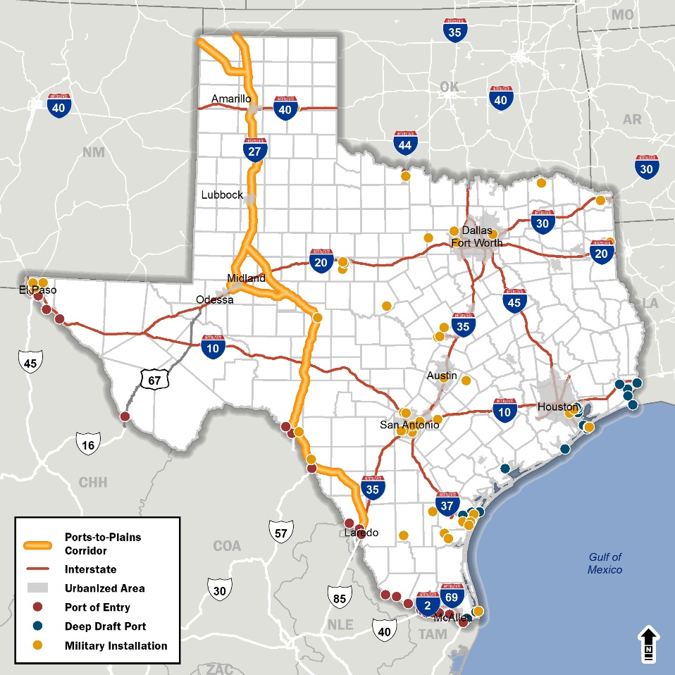
Ports-to-Plains in Texas
963 miles from Texas-Mexico border to Oklahoma/
New Mexico state lines
Sections include
  Interstates:
  I-20, I-35, Exist I-27 124 miles (completed in 1992)
  US Highways:
  US 83, US 87,
  US 277, US 287
  State Highways:
  SH 158, SH 349
26 counties
6 TxDOT Districts
4 MPOs
3 Major Ports of Entry
6 International Airports
6 Military Facilities

Slide 14
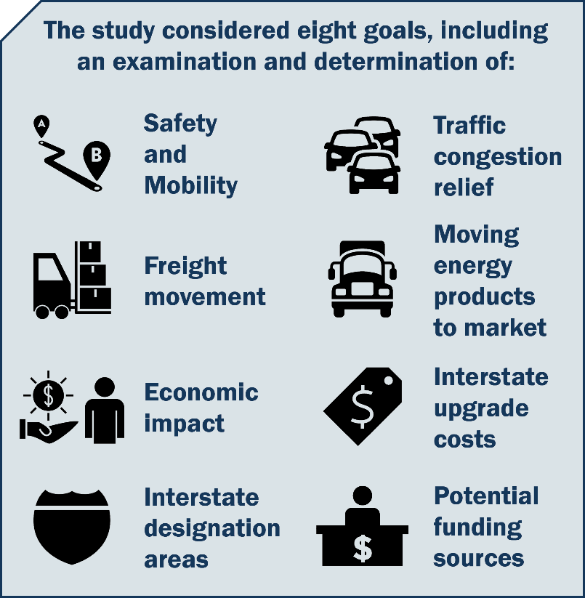
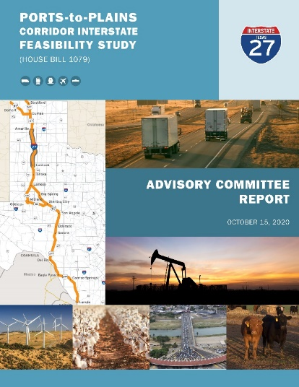
Ports-to-Plains Corridor Interstate Feasibility Study
In 2019, House Bill (HB) 1079 charged TxDOT with conducting an interstate feasibility study of the Ports-to-Plains Corridor.
Purpose of the Study
To evaluate the feasibility of, and costs and logistical matters associated with, improvements that create a continuous flow, four-lane divided highway that meets interstate standards to the extent possible, including improvements that extend I-27

Slide 15
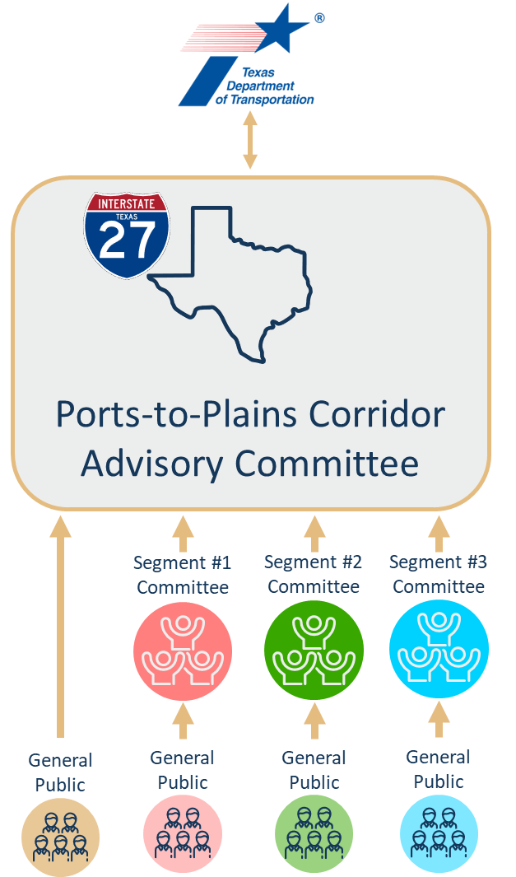
Stakeholder Engagement
Advisory Committee
Comprised of city mayors and county judges along the Ports-to-Plains Corridor
Segment Committees
Members of three Segment Committees selected by Advisory Committee
Public Meetings
Segment Committees held eight public meetings
Advisory Committee held two virtual public meetings

Slide 16
The Benefits of Extending Interstate Highway 27

Slide 17
Improvements to Connectivity, Safety, and Mobility
In 2050, reduce crash rates over the baseline* by an estimated
Annual economic benefit from reduced crashes of
^{Result in fewer crashes than a}
^{US highway by}
$450
^{Million}
15%
To
25%
21%
*The baseline condition does not include upgrading the Corridor to an interstate.

Slide 18




Create Jobs and Economic Opportunities
Create Permanent Jobs
Increase Annual GDP
The interstate upgrade would encourage economic development, resulting in an increase in local and state tax revenues
Food and
agriculture
+1,050 jobs
+2,550 jobs
+3,120 jobs
+10,990 jobs
+17,710 jobs total
+$80 million
+$450 million
+$400 million
+$1.27 billion
+$2.2 billion total
Warehousing and distribution
Energy
Other industries

Slide 19



Improvements to Travel Times and Travel Cost Savings
Travel Time Reduced over Baseline by 2050
(across the corridor)
Annual Savings to
Industries and Consumers
Average
$295 million travel cost reduction in food and agriculture
$365 million in more direct warehousing output
$505 million cost savings in energy
962 to 873 minutes
Reduced
89
minutes

Slide 20
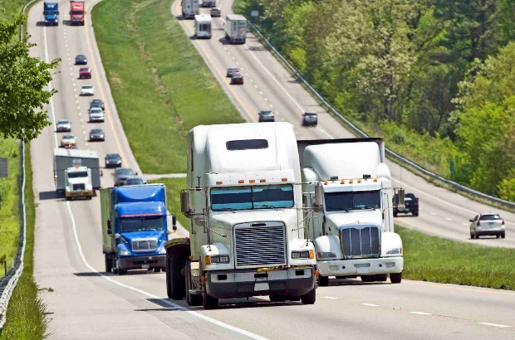
Improvements to Freight Movement
Attract truck traffic from routes such as I-10 and I-35
Reduce average travel time over the corridor by
Increase average daily truck traffic by
24%
89
^{minutes}
Improve freight access to international trade gateways in Del Rio, Eagle Pass, and Laredo

Slide 21
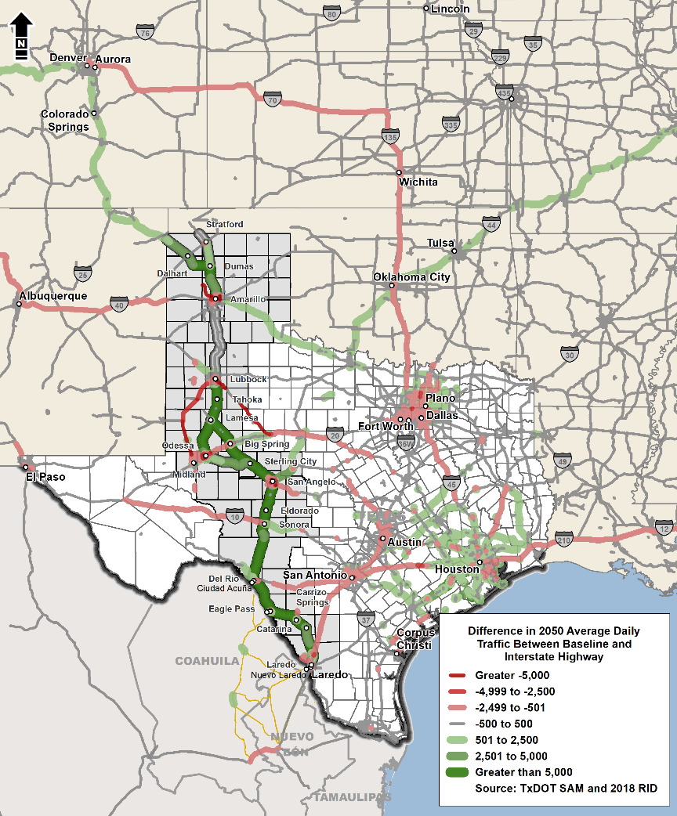
Alleviation of Congestion and Improvements to Reliability
Results in relatively higher speeds
Reduces congestion on other facilities in 2050
Anticipated to cause regional, statewide, national, and bi-national traffic diversions from other corridors

Slide 22
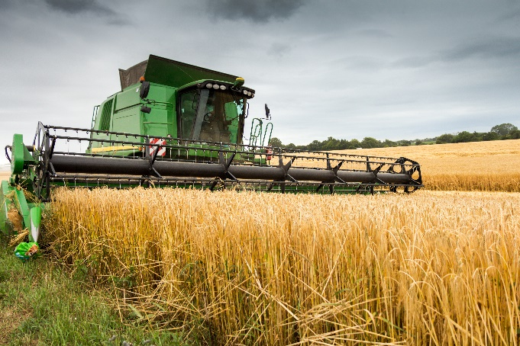




Increased Access to Markets for Energy and Agriculture Products
Transporting products improved by
reduction in travel time and increased
market access radius and route reliability
Fully access-controlled facility benefits
travel times and reliability
A safer and more reliable route for trucks traveling through cities and small towns

Slide 23
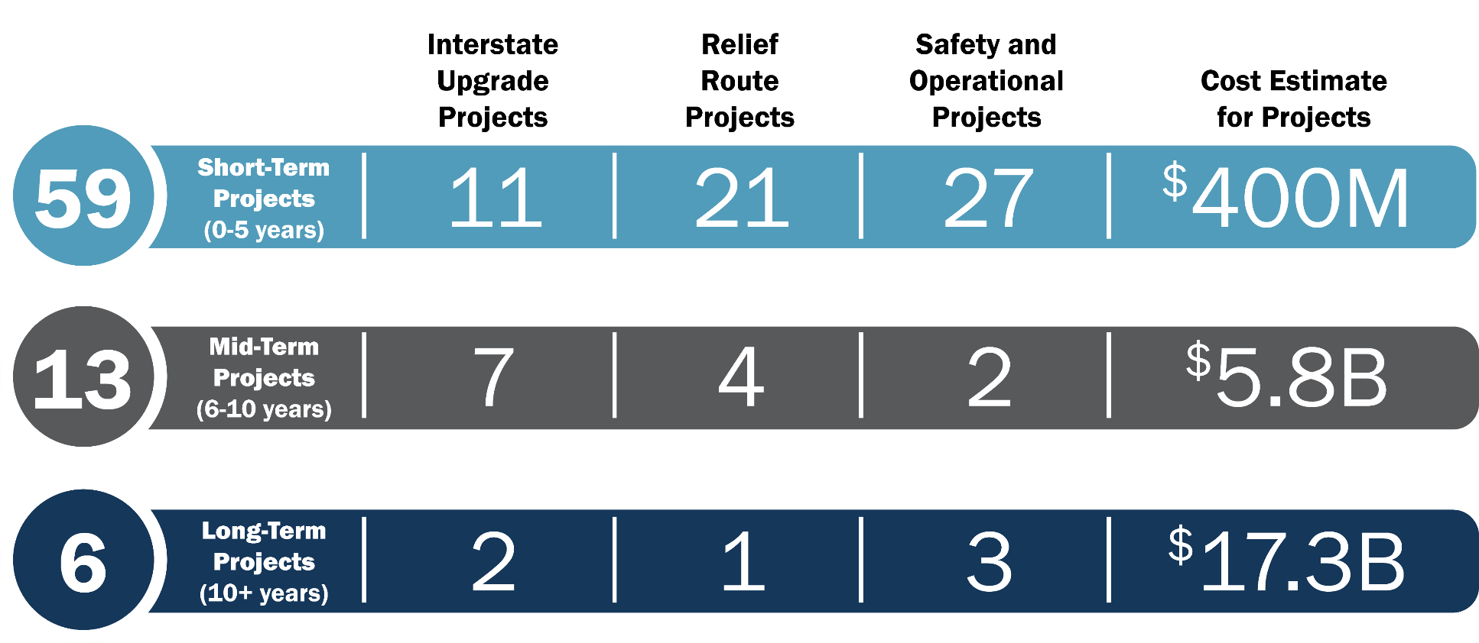
Ports-to-Plains Corridor Interstate Feasibility Study Recommendations

Slide 24
I-27 Advisory Committee (SB 1474)

Slide 25

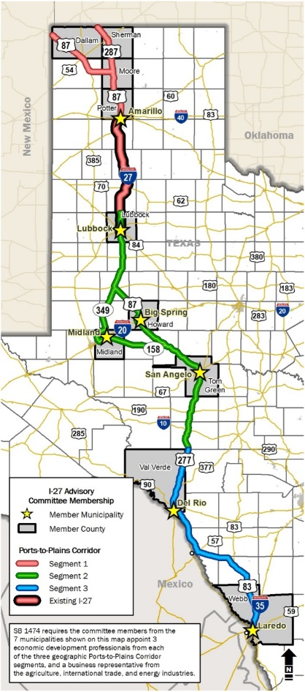



I-27 Advisory Committee
Texas Governor Greg Abbott signed Senate Bill 1474 to establish the I-27 Advisory Committee on June 15, 2021. The Committee is required to meet at least twice per state fiscal year (September through August).
Composed of
10
County Representatives
The county judge or a county official designated by the judge
Dallam, Howard, Lubbock, Midland, Moore, Potter, Sherman, Tom Green, Val Verde
7
Municipal Representatives
The mayor or a city manager / assistant city manager designated by the mayor
Amarillo, Big Spring, Del Rio, Laredo, Lubbock, Midland, San Angelo
Established to
Provide the department with information on concerns and interests along the Ports-to-Plains Corridor.
Advise the department
on transportation improvements impacting the Ports-to-Plains Corridor.
3
Economic Development Professionals
These member are based on geographic segments established for the Ports-to-Plains Corridor Interstate Feasibility Study
3
Business Professionals
These members are from the agriculture, international trade, and energy industries

Slide 26
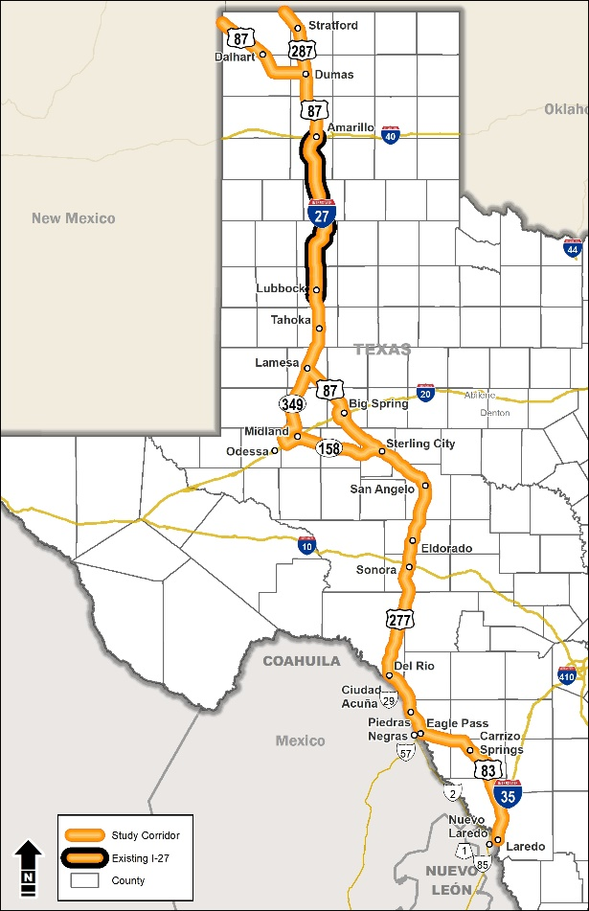
Ports-to-Plains Interstate Designation in Texas
The Ports-to-Plains Corridor was designated as a Future Interstate in the Fiscal Year 2022 Omnibus Appropriations Bill
This designation allows the Ports-to-Plains Corridor to be added to the Interstate Highway System when it has been developed, designed, and constructed to meet interstate standards
It is assumed the United States Department of Transportation will designate it as I-27

Slide 27
Ports-to-Plains Corridor Implementation

Slide 28
General Approach in Planning the Ports-to-Plains System in Texas
Obtain interstate designations approval as quickly as possible
Build from existing interstate highways (I-20, I-27, I-35), not just radiate from existing I-27
Identify 4-lane highway sections (undivided and divided) that are also adjacent to existing interstate highways for initial phase of planning and development
Stakeholder engagement
  Counties, cities, regional agencies, economic development orgs, transportation advocacy groups, ports, TxFAC, BTAC, I-27 AC, Mexico, trade community, private sector, travelers and other members of the public
  Conduct Public Information Meetings to inform and answer questions
Develop a strategy to:
    Identify logical termini for project development
    Identify areas that warrant route studies
    Prioritize locations for upgrading to interstate standards (hierarchy)
    Document the planning process in a Ports-to-Plains System in Texas Implementation Strategy Report

Slide 29
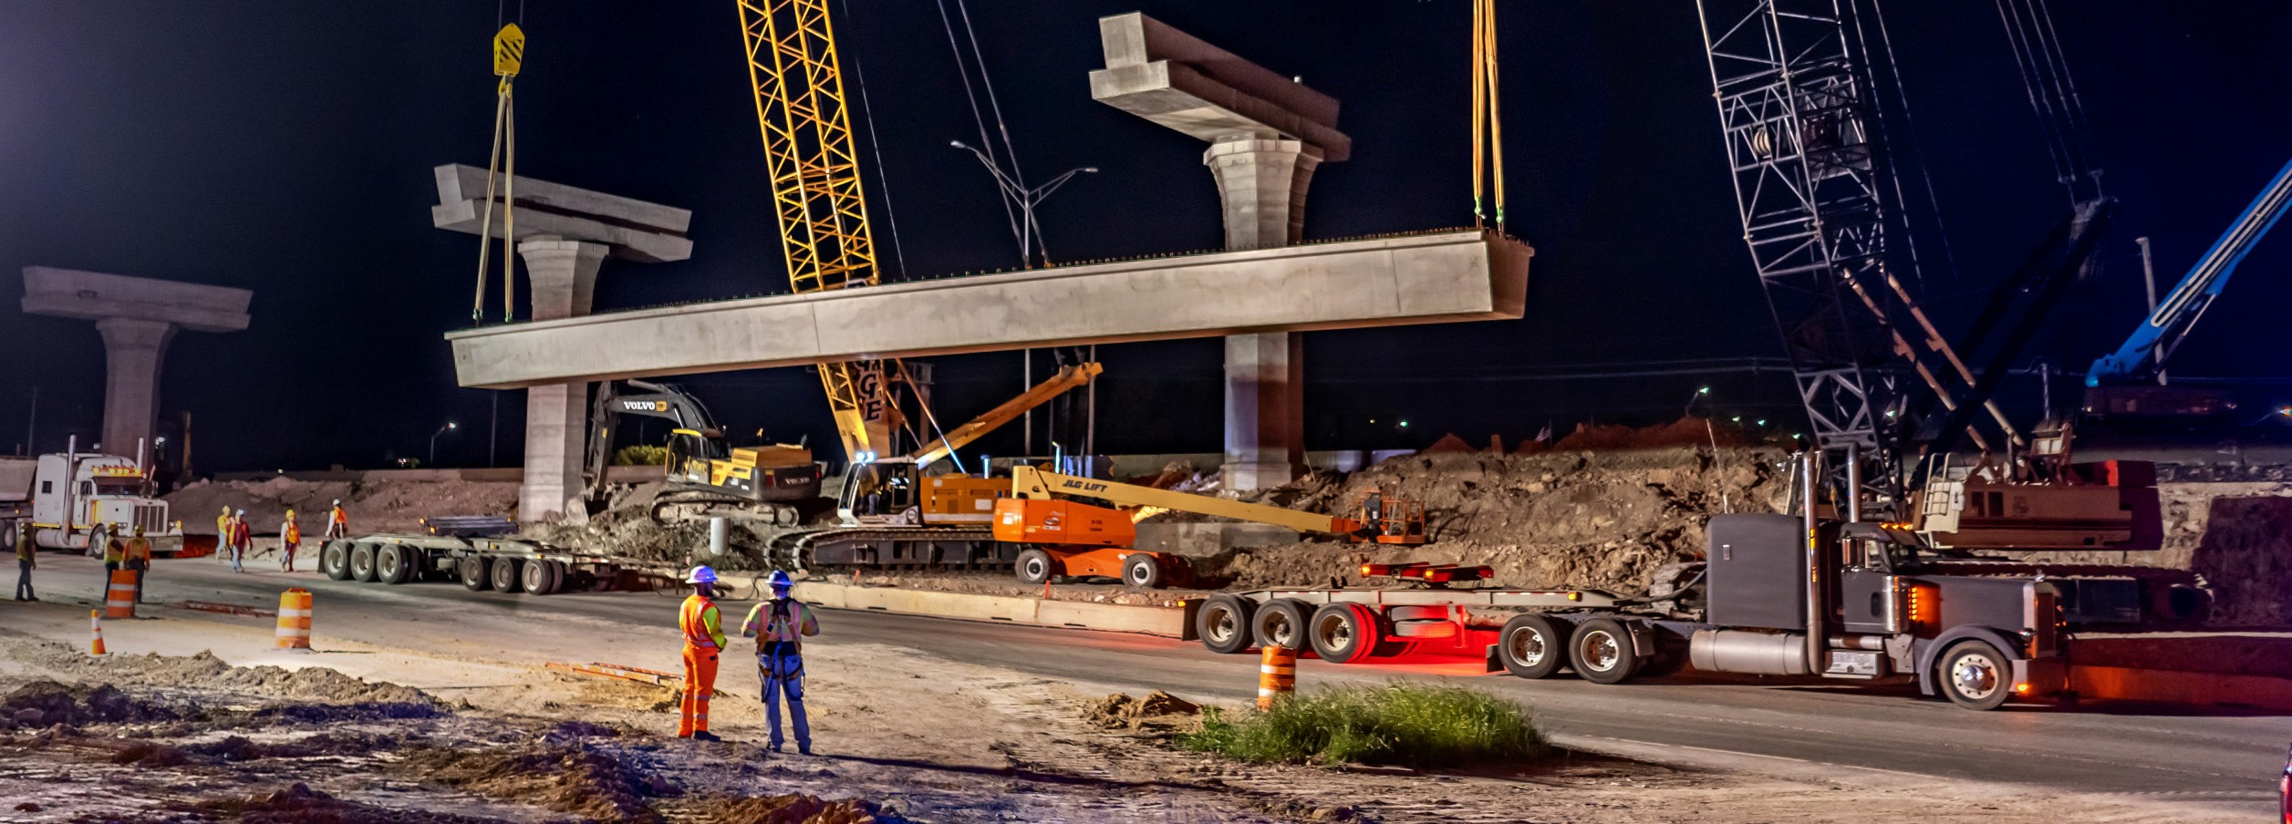
Interstate Requirements: Prior to Construction
TxDOT is required to complete:
Feasibility study
Traffic and safety analysis
Environmental clearance
Public involvement
Engineering and design
Interstate access justification report (IAJR)
Railroad agreements
Right of way acquisition and utility adjustments
Inclusion of the project in financially constrained plans
  Unified Transportation Program (UTP)
  Statewide Transportation Improvement Program (STIP)
  Transportation Improvement Program (TIP)
  29

Slide 30







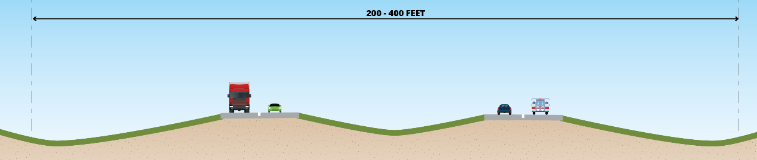
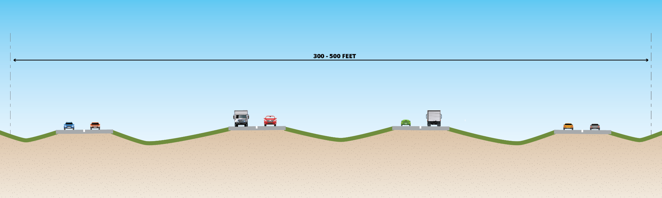
Interstate Requirements: Design Standards
Full control of access; no driveways connecting to main lanes; no stop signs or traffic signals on main lanes
Higher design speeds
Limited access points; grade separations needed
Larger right-of-way widths; main lanes and shoulders
Entrance and exit ramps decel/accel lanes
Interstate without frontage roads cross section
RIGHT OF WAY
RIGHT OF WAY
INTERSTATE MAIN LANES
INTERSTATE MAIN LANES
Interstate with frontage roads cross section
RIGHT OF WAY
RIGHT OF WAY
FRONTAGE
ROAD
INTERSTATE MAIN LANES
INTERSTATE MAIN LANES
FRONTAGE
ROAD
  30
Notes:
Interstate highways are subject to a uniform set of design standards throughout the country.
These high design standards set the Interstate Highway System above all other components of the National Highway System and ensure consistent design, development, construction, and preservation of this important national highway.
Here we have two typical sections for an interstate facility. The top one is the cross section without frontage roads and the bottom one is with frontage roads.
Interstate geometric and safety design standards include:
Full control of access; requiring the need for frontage roads, typically in urbanized areas
Minimum design speeds (70 mph for rural or 50 mph for urban)
Limitations on access points and grade separations needed for uninterrupted traffic flow on the main lanes
The ROW footprint need can range from 200 ft to 500 ft
Minimum of two 12-ft travel lanes and minimum shoulder widths
Accommodation of ramps with ramp spacing sufficient for deceleration and acceleration lanes
State DOTs, working through the American Association of State Highway and Transportation Officials (AASHTO), develop and maintain the Interstate Highway System design standards and the Federal Highway Administration (FHWA) finalizes and circulates them for application nationwide.
For the designation of an existing highway section that does not currently meet interstate standards, the state DOT will need to re-design and re-construct the highway section to meet those standards before beginning the designation process. Constructing a highway section to meet interstate design standards typically take years to complete.

Slide 31


US DOT Interstate Designation Process and Timeline
six months to one year
1
CONFRIM SECTION IS READY TO DESIGNATE
Meets Interstate Standards
- Connects to Interstate
- Part of 15-year plan to connect (Map 21)
2
PREPARE REQUEST
- Identify and coordinate design exceptions with FHWA
- Obtain MPO and local support resolutions
3
SUBMIT REQUEST
TO FHWA
- FHWA reviews and approves request
4
SUBMIT ROUTE NUMBER REQUEST TO AASHTO
- AASHTO assigns Interstate route number
5
INTERSTATE DESIGNATED
Three entities are responsible for polices and procedures that support the process.
Notes:
Constructing a completely new interstate highway or upgrading existing roadways to interstate highway standards can take multiple years or even decades. It requires coordination with partners, identifying funding, and completing environmental clearance, public involvement, and design before ultimately beginning construction.
Upon construction completion, the interstate designation process can begin, which may take months or years to complete.
Three entities are responsible for the policies and procedures that support the interstate designation process. FHWA, AASHTO, and TxDOT
The process can vary based on a number of factors, but the general range is 6 months to 1 year.
Once confirmed that segments are ready to designate, then the request is prepared and submitted to FHWA. Once FHWA approval is obtained, a route number request is submitted to AASHTO for assignment of an interstate route number. AASHTO’s Special Committee on route numbering meets bi-annually.
Once FHWA designates the highway as an interstate, TxDOT will prepare a minute order for consideration by the Texas Transportation Commission to add to the State Highway System.

Slide 32

Funding and Project Selection
Funding
Currently, no specific federal or state funding program set aside to build future interstate highway projects.
Projects compete with all other Texas highway improvement projects for funding
Continually balance competing interests throughout the state
  New construction
  Maintenance and preservation
Project Selection
Annual project scoring system evaluates all projects prior to developing the Unified Transportation Program (UTP) each year
Each project competes for funding during the annual project selection process in the UTP
Congressional designation for a future interstate does not promote future interstates above other projects
  32
Notes:
Currently, there is no specific federal or state funding program set aside to build future interstate highway projects. As a result, these projects must compete with all other Texas highway improvement projects for funding in the state’s annual project selection process.
TxDOT and the Texas Transportation Commission must continually balance competing interests throughout the state—that includes new construction, maintenance and preservation of current assets—while making the best use of the funding TxDOT receives from federal, state, and local sources.
TxDOT uses its annual project scoring system to evaluate projects to construct interstate highways against other construction and maintenance projects prior to developing the Unified Transportation Program (UTP) each year.
Congressional designation for a future interstate does not promote the future interstate above other state projects. Each project must compete for funding during the annual project selection process in the UTP cycle.

Slide 33

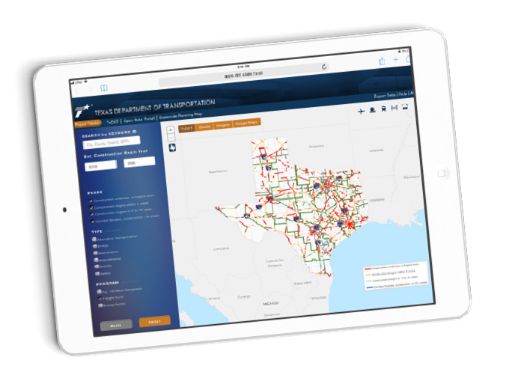


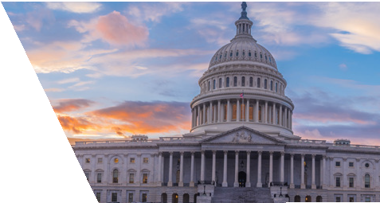
Connecting You with Texas
TxDOT is committed to your safety and to the reliability of the information contained on this site. While road conditions can change rapidly, DriveTexas.org is an industry leader in providing some of the most accurate and up-to-date travel-related information currently available to drivers in Texas. Information presented here is as close to real time as possible. For those who use our roads, please do not use this site while operating a motor vehicle.
Be Safe. Drive Smart. Thank you!
TEXAS DEPARTMENT OF TRANSPORTATION
Project Tracker
TxDOT RESOURCE LINKS
Scan the QR codes with your mobile device to direct you to additional resources and more details on the information provided in this presentation.
Project Tracker is the gateway to up-to- date information about TxDOT highway improvement projects, providing
24/7-access to the public, employees, and elected officials.
TEXAS DEPARTMENT OF TRANSPORTATION
Government Affairs
TxDOT’s Government Affairs Division works closely with government on both the state and federal levels though the State Legislative Affairs and Federal Affairs sections.
TEXAS DEPARTMENT
OF TRANSPORTATION
2021-2022 Educational Series
TxDOT’s complete 2021-2022 Educational Series that focuses on a range of transportation issues affecting TxDOT and the state of Texas.

Slide 34
Questions
Lorena Echeverria de Misi, P.E.
TxDOT Manager, Corridor Planning Branch
Transportation Planning & Programming Division
Lorena.echeverriademisi1@txdot.gov
Notes:
I wanted to take some time to answer any questions anyone had about the study.
My contact information is shown here on this slide, if you want to reach out to me for additional questions or information.

