Slide 1

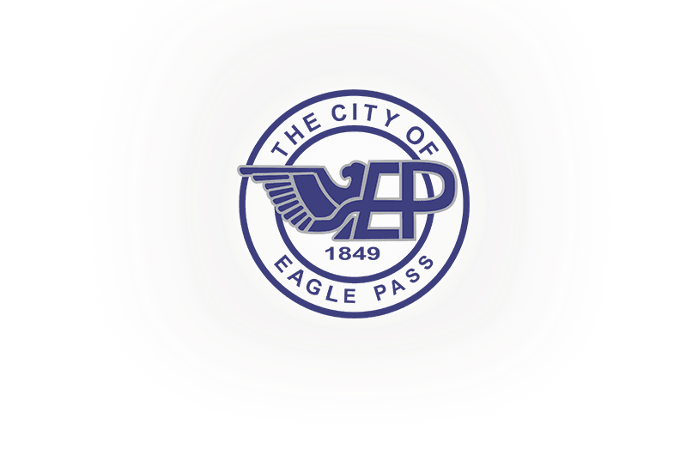

City of Eagle Pass
TEXAS

Slide 2
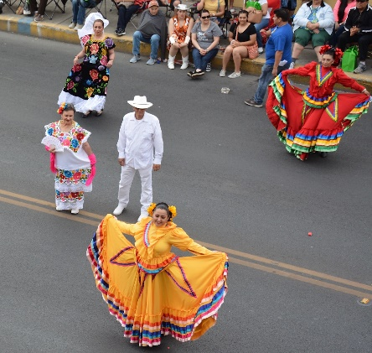

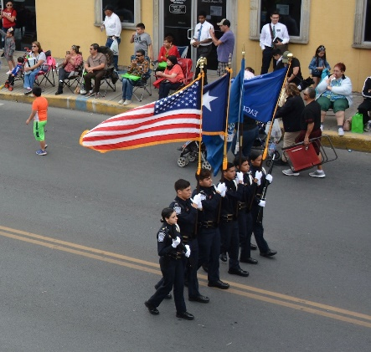
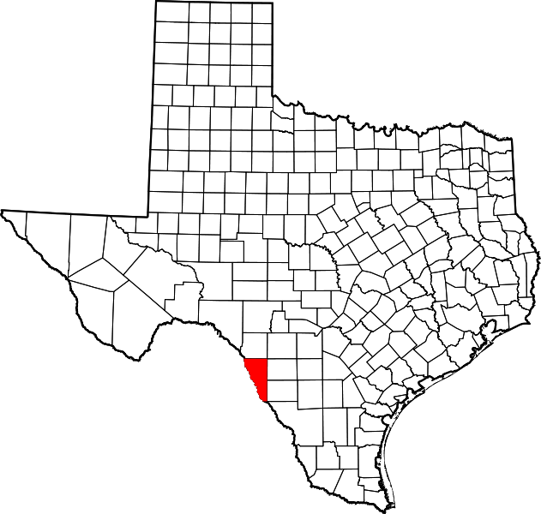

POPULATION
Located in Maverick County, Eagle Pass is considered the first American settlement in the Rio Grande. It is a multi-cultural community with rich Mexican-American and Native-American culture.
Eagle Pass was among the few communities along the border that saw a growth in population during the 2020 census.
Eagle Pass is also known as The Best Way to Mexico as it is a growing hub for international trade between the U.S. and Mexico.
 | 2010 population | 2020 population | % Change
Eagle Pass | 26,248 | 28,130 | 7.17%

Slide 3
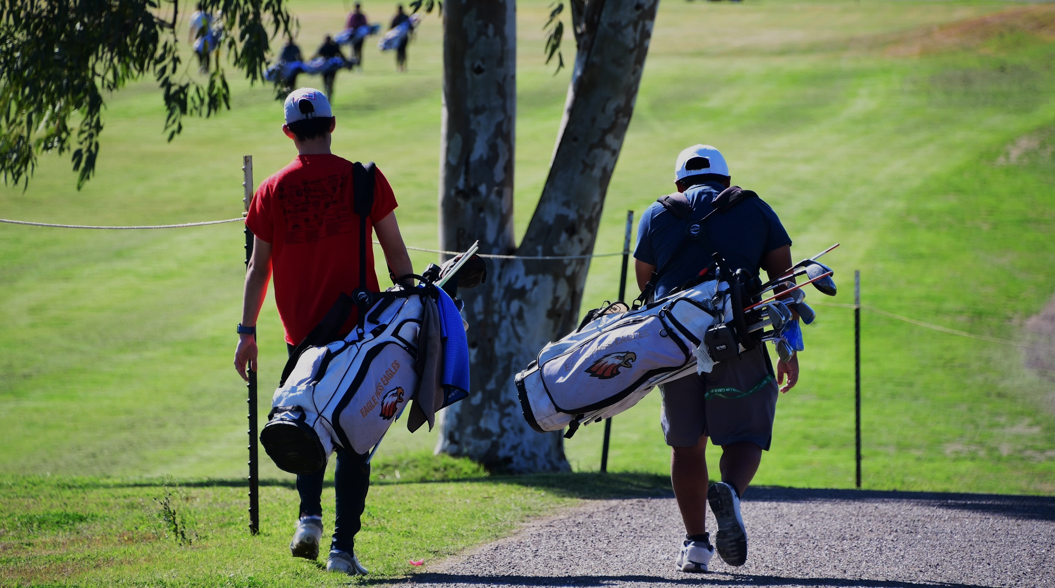
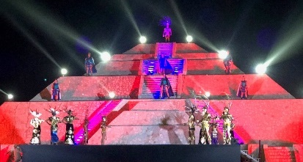

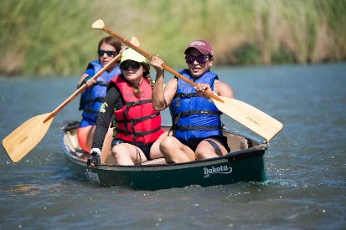

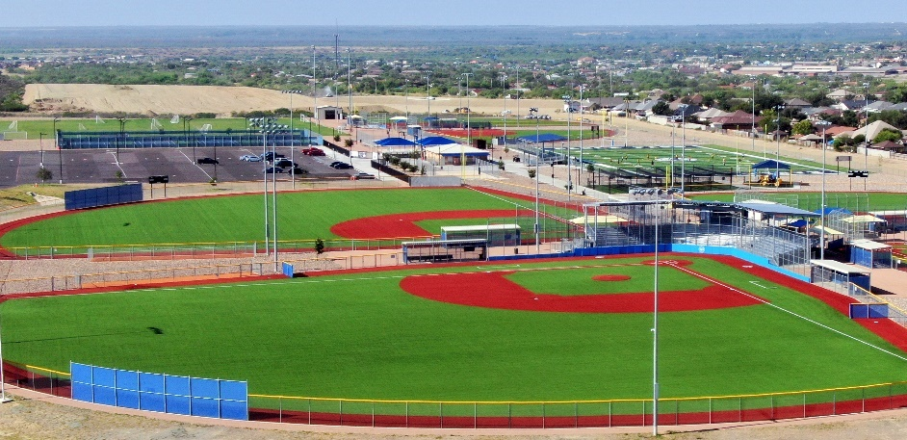
TOURISM
Hundreds of tourists visit Eagle Pass each year from around the region to enjoy some of the attractions EP offers:
Kickapoo Lucky Eagle Casino
City of Eagle Pass Golf Course
City of Eagle Pass Sports Complex
Maverick County Lake
Rio Grande (Kayaking)
Downtown
Piedras Negras

Slide 4
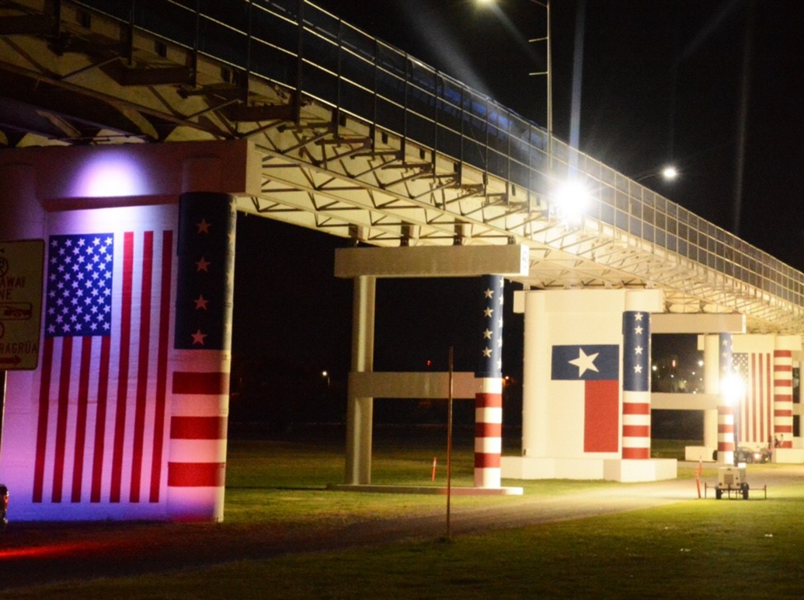
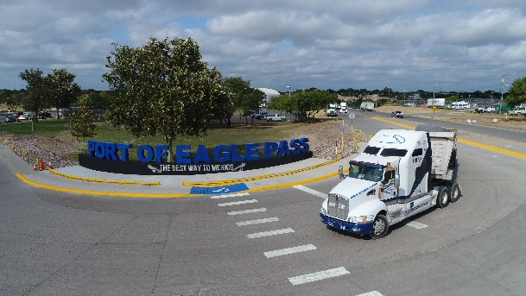
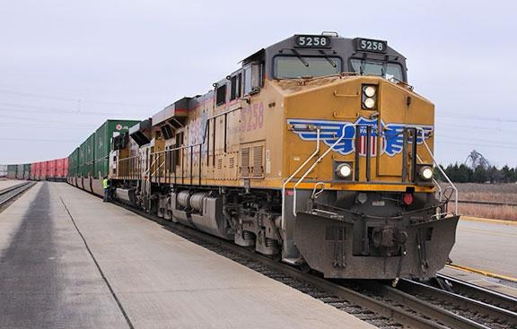
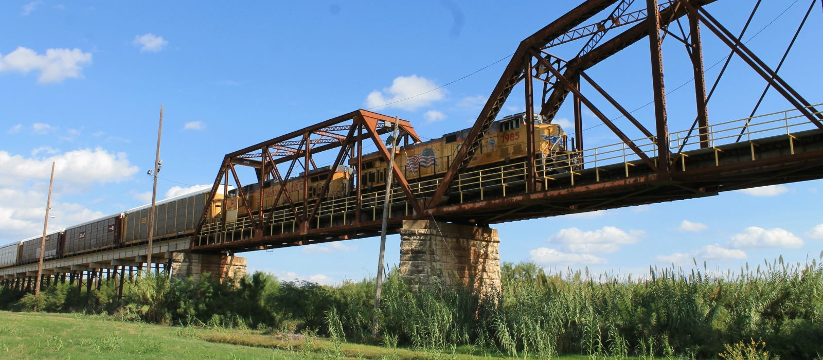
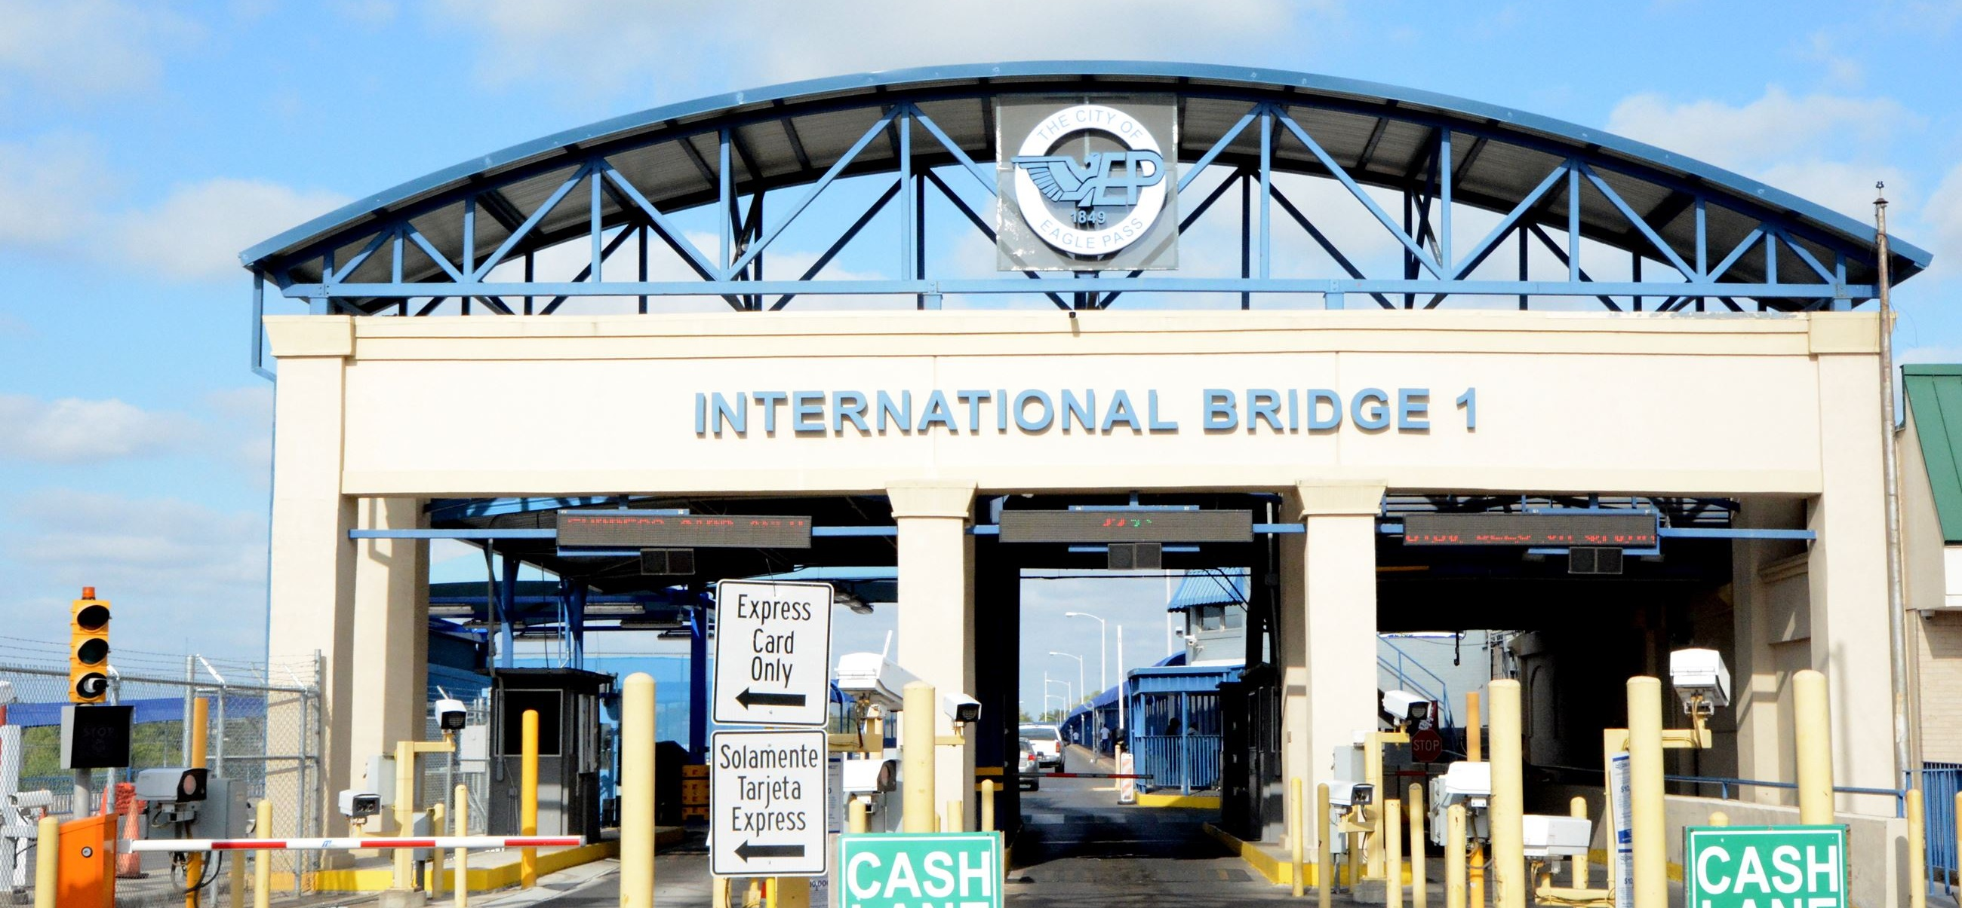
INTERNATIONAL TRADE
The Port of Eagle Pass processed $33 Billion in trade and placed 35th among all US ports (air, land and sea)
$23 Billion in imports
$20 Billion in exports
Roughly 800 commercial trucks and 1,000 rail cars pass through the Port of Eagle Pass each day, along with 8,000 personal vehicles and 1,000 pedestrians.

Slide 5
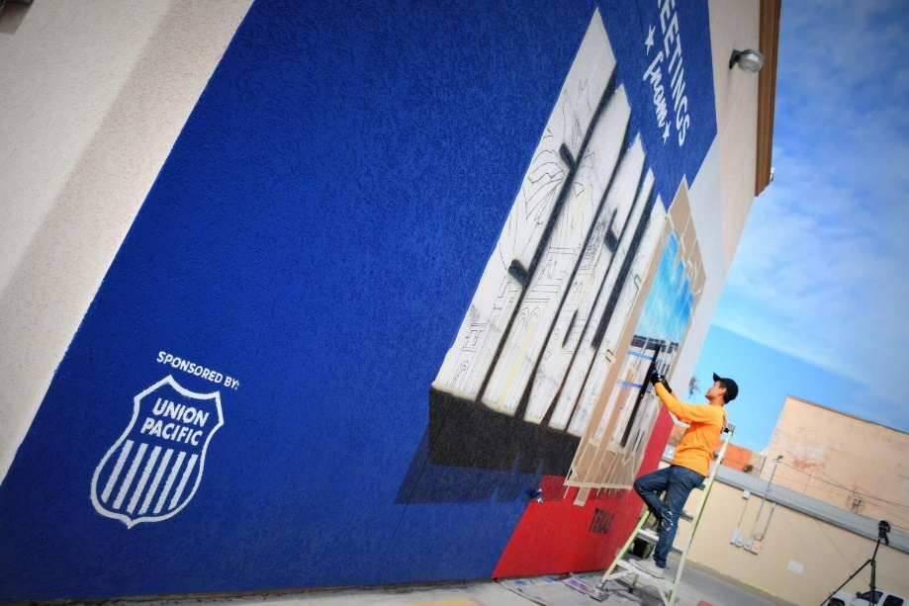
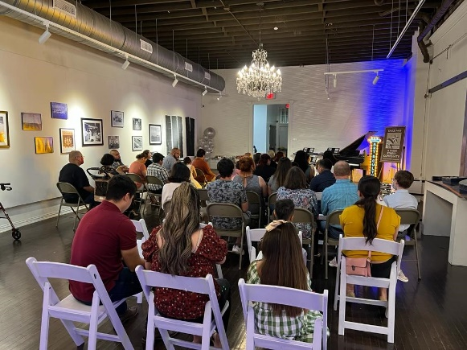

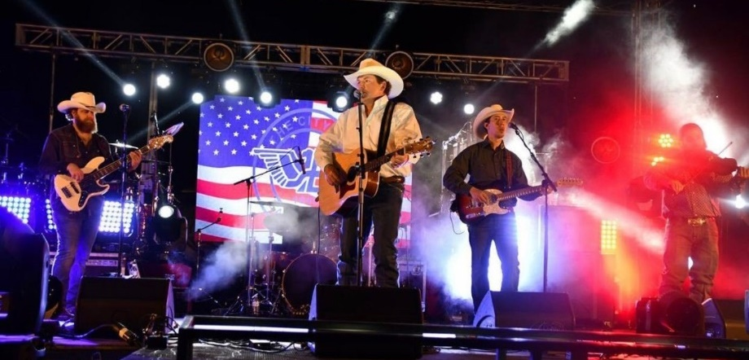
DOWNTOWN REDEVELOPMENT
The City is finalizing the downtown master plan but has made great strides with catalytic projects. These include opening the new Arts & Culture Center, design of the city’s first business incubator, creation of new murals, multiple annual events (4th of July Celebration, Dog Days of Summer, Fall Cook Off, Christmas lights decoration, Dia de Los Muertos Celebration and many more)
The City’s Economic Development Department also offers incentives through it’s Main Street Program for new and small businesses that relocate to the area.

Slide 6

SAFETY
The Port of Eagle Pass remains one of the safest borders between the U.S. and Mexico with federal, state and local law enforcement agencies stationed in Eagle Pass.
Piedras Negras is among the safest border cities in Mexico

Slide 7




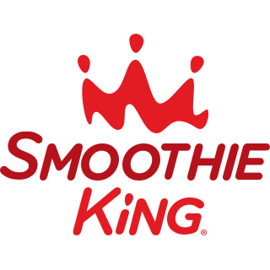
NEW BUSINESSES
Eagle Pass has seen a recent surge in interest for new businesses. Over the last 12 months, new businesses are calling Eagle Pass home, these include Starbucks, Harbor Freight, Home 2 Suites, La Michoacana, Smoothie King, and two more hotels to be announced before the end of 2022.
The City and the County have partnered up to offer matching incentives with the use of Chapter 380 and 381. The City’s newly created economic development department can assist new investors in the process.

